Slide 1
Project Selection Process Update
Transportation Policy Council
January 24, 2025

Slide 2
Project Selection Process
Approval of Project Selection Process - Spring 2023
  Major Projects
  High Growth Area Needs
  Regional Goods Movement
  Operational Improvements and Congestion Management
  Resiliency and State of Good Repair
  Transit
  Active Transportation
  Safety

Slide 3
Project Selection Since December 2023
Regional Goods Movement – December 2023
TxDOT Houston District PSP projects – June 2024
  Category 2 - Metropolitan and Urban Corridor Projects
  Category 5 – Congestion Mitigation and Air Quality
Preview of 5 categories - January 2025
Seek TAC and TPC approval - February 2025
Active Transportation and Safety Categories pending
COSD Project – December 2023, August – December 2024*
* Followed carry-over spend down policy approved by TPC in December 2023.

Slide 4
Available Funding by Category June 2024
Available funding for 5 categories after Regional Goods Movement, and TxDOT Houston priority programming,
Investment Category | Funding Instructions | Available Funding Federal ($M) | Available Total Funding Including Local Match ($M)
Major Projects | 34% | $272 | $340
High-Growth Area Needs | 29% | $232 | $290
Operational Improvements & Congestion Management | 17% | $136 | $170
Resiliency & State of Good Repair | 5% | $40 | $50
Transit | 7.5% | $60 | $75
Active Transportation | 7.5% | $60 | $75
Total | 100% | $800 | $1,000

Slide 5
Draft Recommendations
TxDOT Beaumont District and Local governments projects are recommended for funding award until the funding instructions are met for each category
TxDOT Houston District sponsored projects are not recommended due to priority programming approved by TPC in June 2024
Remaining projects on the draft ranked list of project are recommended for consideration of listing in the RTP
  Projects listed in the RTP may continue project development and seek federal approvals such as environmental clearance

Slide 6
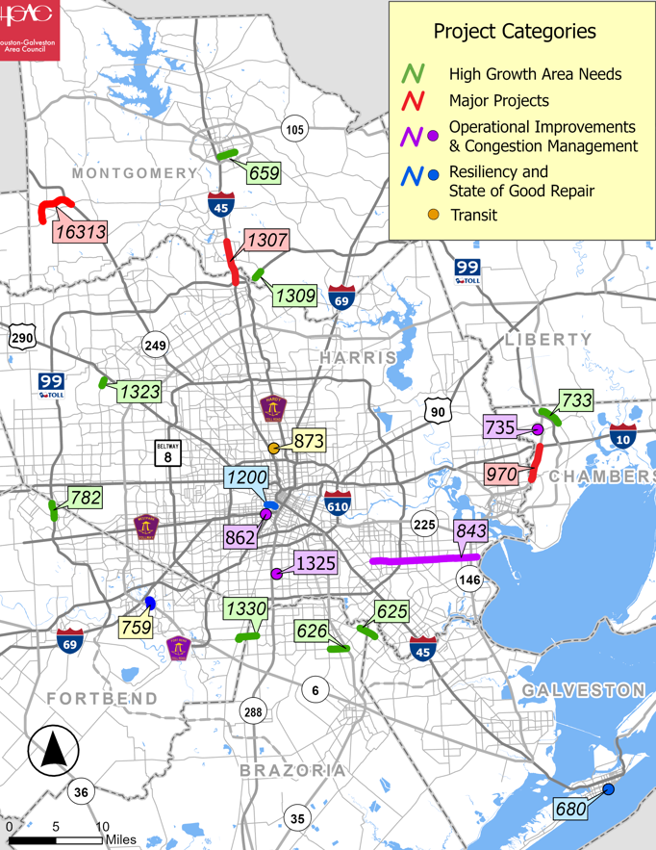
Recommended Projects
Category | # Projects | Federal Amount ($M) | Total Including Local ($M)
Major Projects | 3 | $355 | $385
High Growth Area Needs | 7 | $232 | $290
Operational Improvements and Congestion Management | 5 | $164 | $205
Resiliency and State Of Good Repair | 3 | $44 | $56
Transit | 1 | $45 | $45
Active Transportation | 0 | $0 | $0
Total | 19 | $840 | $981

Slide 7
Major Projects Recommendation
Sponsor | Project Title | Total Score | Rank | Fiscal Year* | Federal ($M) | Total Cost ($M)
Montgomery County | IH 45 Ramp Improvements at Hardy toll Rd, SH 99 and Woodlands Pkwy | 183 | 1 | 2032 | $176 | $220
Montgomery County | Magnolia Relief Route from FM 1488 to SH 249 | 158 | 4 | 2033 | $72 | $90
TxDOT Beaumont District | SH 146 Widening from IH 10 to Cedar Bayou | 119 | 10 | 2034 | $60 | $75
 |  |  |  |  | $308 | $385
*Construction phase fiscal year is based on project readiness assessment and fiscal capacity. Projects may be advanced if fiscal capacity is available and major project readiness milestones are met.

Slide 8
High Growth Area Needs Recommendation
Sponsor | Project Title | Total Score | Rank | Fiscal Year* | Federal ($M) | Total Cost ($M)
Brazoria County | Pearland Pkwy Exten from Dixie Farm to FM 2351 | 161 | 1 | 2034 | $46 | $56
Fort Bend County | Construct SH 99 Seg-D Front.Rd | 146 | 3 | 2030 | $25 | $31
Montg. County | SH 99 Seg-G EB Front.Rd | 136 | 5 | 2030 | $3 | $4
Brazoria County | CR 100 Exten from CR113 to SH 35 | 130 | 8 | 2034 | $20 | $26
Harris County | Barker Cypress Widening from Queenston Blvd to North of US 290 | 127 | 9 | 2032 | $70 | $88
*Construction phase fiscal year is based on project readiness assessment and fiscal capacity. Projects may be advanced if fiscal capacity is available and major project readiness milestones are met.

Slide 9
High Growth Area Needs Projects Recommendation
Sponsor | Project Title | Total Score | Rank | Fiscal Year* | Federal ($M) | Total Cost ($M)
City of Conroe | Foster Drive widening from S Frazier St. to N Porter Rd. | 123 | 11 | 2031 | $30 | $37
City of Mont Belvieu | Eagle Drive widening from FM 565 to SH 146 | 122 | 12 | 2030 | $38 | $47
 |  |  |  | Total | $232 | $290
*Construction phase fiscal year is based on project readiness assessment and fiscal capacity. Projects may be advanced if fiscal capacity is available and major project readiness milestones are met.

Slide 10
Operational Improvements and Congestion Management Projects Recommendation
Sponsor | Project Title | Total Score | Rank | Fiscal Year* | Federal ($M) | Total Cost ($M)
Harris County | Precinct 1 Signals Replacement. | 175 | 1 | 2028 | $13 | $16
Metro | 82-Westheimer BOOST | 175 | 2 | 2029 | $37 | $47
City of Mont Belvieu | Traffic Management Center | 174 | 3 | 2027 | $3 | $4
Harris County | Fairmont Parkway Widening, Access Management, and Safety Improvem. | 124 | 6 | 2031 | $68 | $85
Fort Bend County & Brazoria County | E Dallas St./County Road 59 Widening from FM 521 to CR 48 | 127 | 7 | 2033 | $43 | $53
 |  |  |  | Total | 163 | $205
*Construction phase fiscal year is based on project readiness assessment and fiscal capacity. Projects may be advanced if fiscal capacity is available and major project readiness milestones are met.

Slide 11
Resiliency and State of Good Repair Projects Recommendation
Sponsor | Project Title | Total Score | Rank | Fiscal Year* | Federal ($M) | Total Cost ($M)
City of Houston | Westheimer Road Reconstruct. from Montrose Blvd to Main St. | 160 | 1 | 2033 | $28 | $35
City of Galveston | 33rd St. Intersect. Signalization at Seawall Blvd | 150 | 2 | 2027 | $0.5 | $0.6
City of Sugar Land | Williams Trace Blvd Reconstruction from Lexington Blvd to SH 6 | 118 | 6 | 2030 | $16 | $20
 |  |  |  | Total | $44 | $56
*Construction phase fiscal year is based on project readiness assessment and fiscal capacity. Projects may be advanced if fiscal capacity is available and major project readiness milestones are met.

Slide 12
Transit Projects Recommendation
Sponsor | Project Title | Total Score | Rank | Fiscal Year* | Federal ($M) | Total Cost ($M)
Metro | Northline Transit Center | 152 | 1 | 2029 | $45 | $45
 |  |  |  | Total | $45 | $45
*Construction phase fiscal year is based on project readiness assessment and fiscal capacity. Projects may be advanced if fiscal capacity is available and major project readiness milestones are met.

Slide 13
Summary of Total Programming Since December 2023
Category | Project Selection Process | TxDOT Out of Cycle | Carry-Over Spend Down | Total | Percentage | Funding Instructions
Major Projects | $385 | $200 | $79 | $664 | 21% | 30%
High Growth Area Needs | $290 | $490 | $96 | $876 | 28% | 25%
Regional Goods Movement | $180 | $239 | $0.8 | $420 | 13% | 12%
Operational Improvements and Congestion Management | $205 | $0 | $156 | $361 | 12% | 13%
Resiliency and State Of Good Repair | $55 | $0 | $220 | $276 | 9% | 5%
Transit | $45 | $0 | $297 | $342 | 11% | 7.5%
Active Transportation | $0 | $0 | $185 | $185 | 6% | 7.5%
Total | $1,161 | $929 | $1,035 | $3,124 | 100% | 100%

Slide 14
Next Steps
Selection Process Steps | Month 2024
Criteria questionnaires ​ | February 2024​
Evaluation scoring & ranking ​ | March-May​
Evaluation score validation ​final criteria scores | June-July​
Benefit-cost analysis (BCA) | August
Benefit-cost analysis (BCA) assessment | September/October
BCA validation, draft final scores ranking | October
Project readiness | November – December
BCA validation & final draft ranking | December
Draft recommendation | January 2025
Seek approval | February 2025

Slide 15
Information & Discussion
For Information and discussion only

Slide 16
Contacts
Vishu Lingala
Vishu.Lingala@H-GAC.com
713-993-4561

Slide 17
Spring 2023 Funding by Category
Investment Category | Funding Instructions | Available Funding ($M)
Regional Goods Movement | 12% | $156
Major Projects | 30% | $389
High-Growth Area Needs | 25% | $324
Operational Improvements & Congestion Management | 13% | $168
Resiliency & State of Good Repair | 5% | $65
Transit | 7.5% | $97
Active Transportation | 7.5% | $97
Total | 100% | $1,296
Safety | $30M Per Year | $300
*48% of the total estimated available was reserved for cost overruns and next PSP

Slide 18
TxDOT Houston Funding Request
Received as part of the TIP development process
Concurrent request of new projects in the current project selection effort
  Category 2 - Metropolitan and Urban Corridor Projects
  Category 5 – Congestion Mitigation and Air Quality
Staff recommended approval of all of TxDOT Houston funding request and committed to allocating about $1B for TxDOT Beaumont District and Local projects competing in PSP.
TPC approved TxDOT Houston District’s request in June 2024

Slide 19
Summary of Total Programming Since December 2023
Category | Project Selection Process | TxDOT Out of Cycle | Total | Percentage | Funding Instructions
Major Projects | $385 | $200 | $585 | 28% | 30%
High Growth Area Needs | $290 | $490 | $780 | 37% | 25%
Regional Goods Movement | $180 | $239 | $419 | 20% | 12%
Operational Improvements and Congestion Management | $205 | $0 | $205 | 10% | 13%
Resiliency and State Of Good Repair | $55 | $0 | $55 | 3% | 5%
Transit | $45 | $0 | $45 | 2% | 7.5%
Active Transportation | $0 | $0 | $0 | 6% | 7.5%
Total | $1,161 | $929 | $2,089 | 100% | 100%

Slide 20
Next Steps
Selection Process Steps | Month 2024
Criteria questionnaires ​ | Feb 2024​
Evaluation scoring & ranking ​ | March-May​
Evaluation score validation ​final criteria scores | June-July​
Benefit-cost analysis (BCA) | August
Benefit-cost analysis (BCA) assessment | September/October
BCA validation, draft final scores ranking | October
Project readiness | November – December
BCA validation & final draft ranking | December
Draft recommendation | January 2025
Anticipated approval | February 2025

Slide 21
Project Selection Process
Approval of Project Selection Process
  Total $1.6B of $3.1B (FY 2024 – 2023) - Spring 2023
Regional Goods Movement
  $180M – December 2023
COSD 1st round – December 2023, August – December 2024
  $885M
TxDOT Houston District PSP projects – June 2024
  $1B for remaining 6 categories
Preview of 5 categories - January 2025
Seek TAC and TPC approval - February 2025
Active Transportation and Safety Categories pending

Slide 22
Category Analysis – Includes COSD, RGM, Out of Cycle, and PSP Recommendations
 | Category | Programming Amount
 | Major Projects | 20%
 | High Growth Area Needs | 26%
 | Regional Goods Movement | 12%
 | Operational Improvements and Congestion Management | 10%
 | Resiliency and State Of Good Repair | 9%
 | Transit | 12%
 | Active Transportation* | 9%
 | Total $2.71B Without Safety | 100%
$30M/Year Safety not included in percentage calculation
*Pending project selection process.

Slide 23
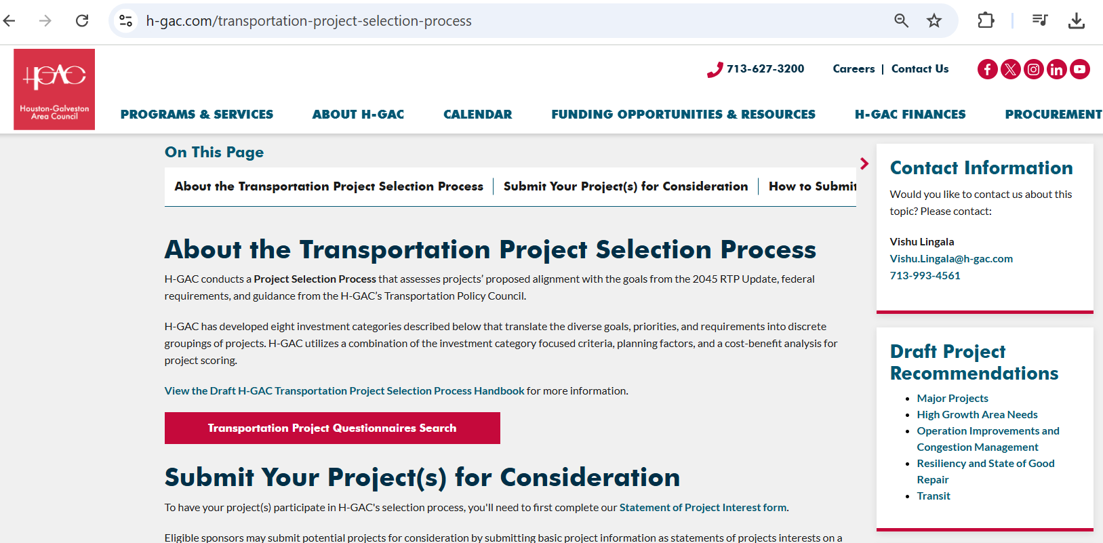
Draft Recommendations online

Slide 24
Programming & Available balances - Cumulative 2035
Cumulative 2035
Category | Authorized | Programming | Balance
Cat 5 | $1,399,866,113 | $1,084,371,214 | $315,494,899
Cat 7 | $2,477,957,066 | $2,135,419,190 | $342,537,876
Cat 9 | $290,319,344 | $111,843,145 | $178,476,199
Cat 10 CRP | $330,921,873 | $188,719,366 | $142,202,507
Total | $4,499,064,396 | $3,520,352,915 | $978,711,481

Slide 25
Recommended Projects
Category | Federal ($M) | State/Local Match ($M)
Major Projects | $342 | $85
High Growth Area Needs | $232 | $58
Operational Improvements and Congestion Management | $164 | $40
Resiliency and State Of Good Repair | $44 | $11
Transit | $45 | $0
Active Transportation | $0 | $0
Total ($1.02B) | $828 | $196

Slide 26
Category Analysis – Includes COSD, RGM, Out of Cycle, and PSP Recommendations
 | Category | Programming Amount
 | Major Projects | 21%
 | High Growth Area Needs | 26%
 | Regional Goods Movement | 12%
 | Operational Improvements and Congestion Management | 10%
 | Resiliency and State Of Good Repair | 9%
 | Transit | 12%
 | Active Transportation* | 9%
 | Total $2.71B Without Safety | 100%
$30M/Year Safety not included in percentage calculation
*Pending project selection process.

Slide 27
Selection Process Steps
Sponsors submitting updated Statements of Project Interests
Staff published evaluation criteria
Submitting evaluation criteria questionnaires
Draft criteria scores
Validated criteria scores
Published criteria scores
Submitted Benefit-Cost Analysis

Slide 28
Selection Process
All projects that scored >50 points in evaluation criteria were scored for BCA
Total Benefits/Total Cost
  B/C ratios ranged from 0.1 to > 100.0
  Covert benefit/cost ratios > 1.0 in to points 0 -100
Validated all Benefits-Cost ratios and assigned BCA scores

Slide 29
Total Score
Combined BCA with evaluation criteria scores
Sorted from highest to lowest
Projects ranked
Posted ranked lists of projects for each Investment Category

Slide 30
Funding Recommendations by Category
Category | Remaining Funding Instruction Amounts | Selection Process Recommendations | Percentages
Regional Goods Movement |  | $150,531,795*
Major Projects | $340,000,000 | $369,523,950 | 38%
High Growth Area Needs | $290,000,000 | $290,118,176 | 30%
Operational Improvements and Congestion Management | $170,000,000 | $204,506,815 | 21%
Resiliency and State Of Good Repair | $50,000,000 | $55,548,455 | 6%
Transit | $75,000,000 | $45,016,157 | 5%
Active Transportation | $75,000,000 | $0 | 0%
Total | $1,000,000,000 | $964,713,553 | 100%
Safety | $300,000,000
*Current programming is $179,729,586

Slide 31
Recommended Projects Summary by Category
 | Category | Programming Amount
 | Major Projects | 38%
 | High Growth Area Needs | 30%
 | Operational Improvements and Congestion Management | 21%
 | Resiliency and State Of Good Repair | 6%
 | Transit | 5%
 | Total ($965M) | 100%

Slide 32
Selection Process Update
Screened out RTP only projects
Completed project readiness with project sponsors
Posted revised ranking list at https://www.h-gac.com/transportation-project-selection-process
Reviewed funding eligibility for project types
Applied funding instructions from TPC
Prepare recommendation for TAC and TPC consideration
  TIP , 10-Year Plan, RTP

Slide 33
Benefit-Cost Scoring Method
BCA Scoring Method 3:
  Projects with BCR > 1.0 were sorted from high to low
  Projects with a BCR > 10 were assigned 100 points (max)
  Projects with a BCR from 6.0-10.0 were assigned 75 points
  Projects with a BCR from 3.0-6.0 were assigned 50 points
  Projects with a BCR from 1.0-3.0 were assigned 25 points
  BCR <1.0 was assigned 0 points (lowest)

