Slide 1
Project Development & Delivery at TxDOT
Catherine McCreight, MBA
Sr. transportation planner
October 2019

Slide 2





Key learning objectives
Understand the many steps and their interdependencies to
successfully develop and construct transportation projects
1
…
  Define how projects are created and move through a funnel as
  part of a portfolio that is actively managed by each district
2
…
  Describe how Performance Based Planning facilitates alignment
  of project selections with the department’s strategic objectives
3
…
  Describe how the Quarterly Review Process facilitates accurate
  tracking of each project’s progress
4
…
  Describe how the Project Delivery & Governance process
  ensures on-time and on-budget completion of projects
5
…
PRELIMINARY DRAFT

Slide 3

Contents
  Chapter 1: Overview of Project Development and Delivery
    Performance Based Planning
    Quarterly Review Process
    Project Delivery and Governance
  Chapter 2: Project Initiation/Planning
  Chapter 3: Preliminary Engineering
  Chapter 4: Plans, Specifications, and Estimate (PS&E)
  Chapter 5: Letting
  Chapter 6: Construction

Slide 4
What is project development and delivery?
1
    Project Initiation/ Planning
    Preliminary Engineering
    Plans, Specifications & Estimate
    Letting
    Construction
    Close-out & Maintenance
District Utilities
Attend utility coordination meeting
Map utilities
Utility verification reimbursable or not reimbursable
Update SUE findings
District ROW
Begin title research
Obtain agreement with LPA to contribute ROW funds, if not covered in AFA with LPA
Develop ROW map and identify parcels
District Environmental
Begin initial public involvement
Obtain right of entry for environmental study
Conduct environmental study
Create core environmental team, including division personnel
Conduct initial public outreach
Begin technical studies and draft documents
District Railroad Coordinator
Provide right of entry from RR to TP&D/DES
http://ftp.dot.state.tx.us/pub/txdot/tpp/workflow.pdf

Slide 5
What is project development and delivery?
1
Focus of this course
The process is cyclical: operations and maintenance identify needs which feed into project selection
Operations
and
maintenance
Operations
and
maintenance
Project
selection
Project initiation
Project
selection
Construction
Preliminary engineering
Letting
Plans, Specifications & Estimate (PS&E)

Slide 6
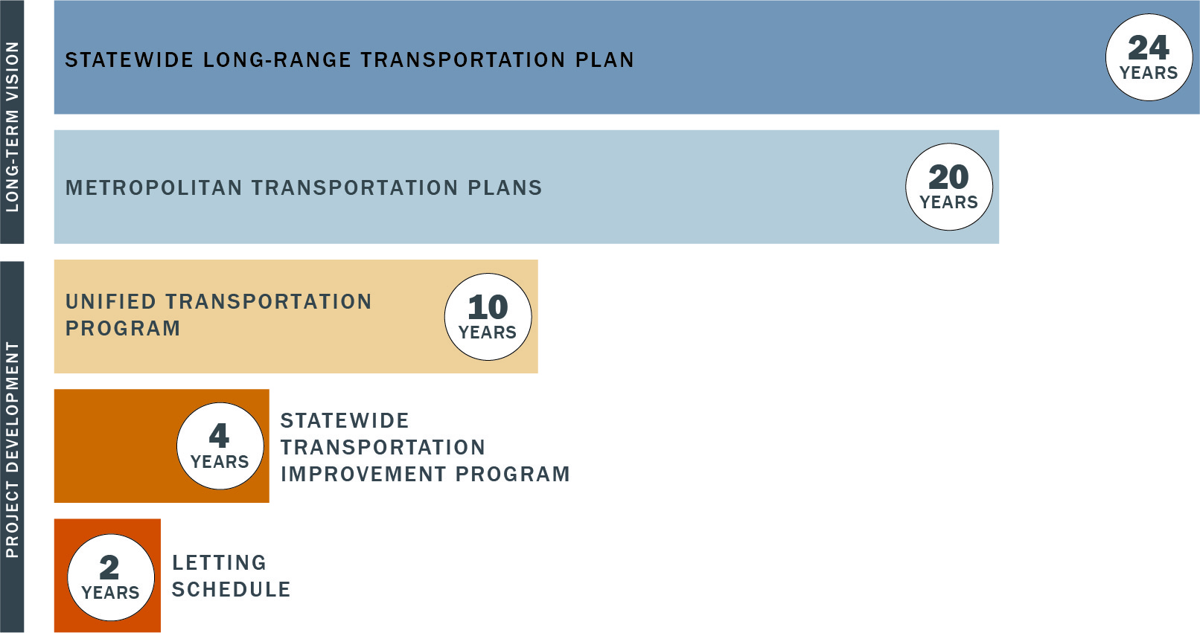
1
What is project development and delivery?
TxDOT Comprehensive Planning and Programming Process
Federal Req’t - TxDOT
Federal Req’t - MPO/TxDOT
State Req’t - TxDOT
Federal Req’t – MPO/TxDOT
State Req’t - TxDOT

Slide 7
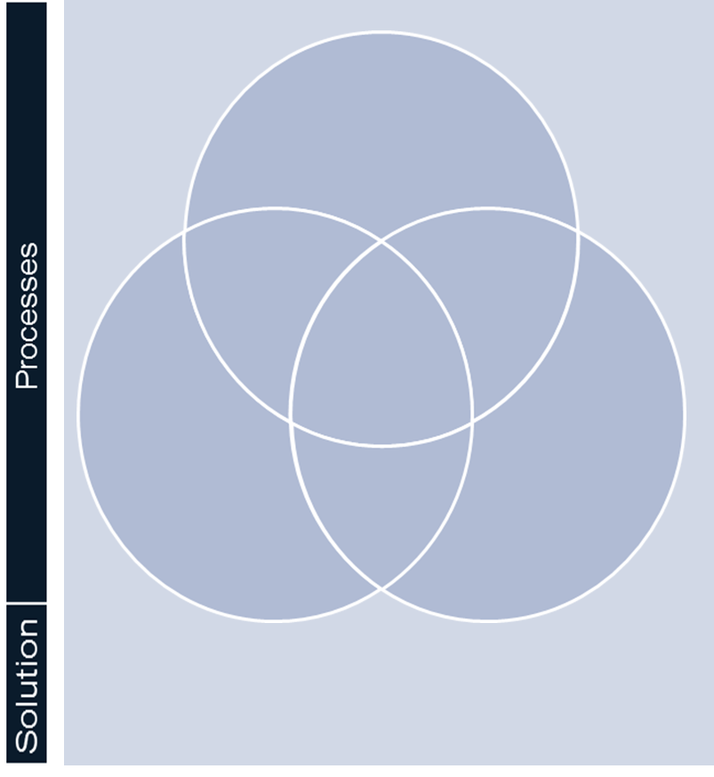
Where do new processes fit?
2
a
b
  Document our current project development and delivery process and refine it to improve efficiency and facilitate improved staff training
  Define our planning process and develop scoring criteria and ranking methodology to improve and demonstrate reasons for projects in our 10-year plan and comply with requirements of House Bill 20 (HB20) from 84th Legislative Session
  Performance Based Planning
d
  New technology solution to ensure we have accurate data to support performance of these 3 processes and to deliver our transportation program
  Project Delivery & Governance
  Quarterly Review Process
c
  Build a structure into monitoring the progress of individual projects and the health of each district’s and the department’s portfolio of projects
  Modernize Portfolio and Project Management
  (TxDOTCONNECT)

Slide 8
Where do new processes fit?
2
  These processes integrate within project development and delivery in 3 areas that facilitate successful transportation program management and enable TxDOT to meet our
  transportation goals
Plan
(Performance Based Planning, PBP)
Manage
(Quarterly Review Process, QRP)
Deliver
(Project Delivery and Governance, PD&G)

Slide 9
Where do new processes fit?
2
YEAR
10+
10 - 5
4 - 0
Construct
Preliminary design & environmental
Final design & ROW acquisition
Safety
Preservation
Construction and maintenance
Congestion
Connectivity
Projects that reach the end of the funnel are ready to let and construct
Projects advance in the funnel as they meet development milestones
Projects are developed with the goal of improving one or more of the four transportation strategic objectives
10-year transportation program
Quarterly Review Process Activities
Performance Based Planning Activities

Slide 10
Contents
  Chapter 1: Overview of Project Development and Delivery
    Performance Based Planning
A
    Quarterly Review Process
B
    Project Delivery and Governance
C
  Chapter 2: Project Initiation/ Planning
  Chapter 3: Preliminary Engineering
  Chapter 4: Plans, Specifications, and Estimate (PS&E)
  Chapter 5: Letting
  Chapter 6: Construction
  Chapter 7: Summary & Review

Slide 11
Role of Performance Based Planning (PBP)
A
Plan
(Performance based planning, PBP)
Manage
(Quarterly review process, QRP)
Deliver
(Project Delivery and Governance, PD&G)
  Define clear key performance measure (KPM) goals
  Develop planning targets for each District & MPO
  Align with strategic objectives and support compliance with State Legislative requirements
  Districts program a mix of projects to help meet their KPM goals
  Manage portfolio to maintain the right volume and mix of projects
  Defined meeting cadence standardized throughout state
  Standardized workflow
  Track projects from start to finish
  Defined roles and responsibilities
  Pro-active collaboration
  Individual projects are delivered on time and at budgeted cost to minimize delays and cost overruns

Slide 12
Role of Performance Based Planning
A
Facilitate adherence to State and Federal rules and regulations
  Enable TxDOT to comply with the performance metric portion of State laws (HB20 , SB312) and Federal requirements (MAP-21 and FAST Act)
  Implement standardized project scoring and selection criteria
A
Performance Based Planning
(PBP)
Align planning with strategic objectives
  Allow TxDOT to optimize allocations among funding categories to maximize alignment of projects in the portfolio to TxDOT’s strategic objectives
B
Enables improved project performance tracking
  Enable TxDOT to monitor impact of previous investment allocation decisions to system performance improvements over a period of time
C

Slide 13
Performance assessment in project selection
2
B
Plan Authority
(10+ years)
Candidate projects are scored and ranked for its ability to improve system performance aligned with the department’s strategic objectives
Funds are allocated across 4 strategic objectives related to departmental goals
Performance assessment process
1
2
Safety
3
1
4
Corridor
Studies
Preservation
5
2
6
3
Congestion
7
8
Connectivity
9
5
Economy
6
Environment
4
10
11
12
Effects on the Economy and Effects on the Environment are also considered
PBP Initial Scoring

Slide 14
Examples of Potential Key Performance Measures
A
Safety
Fatalities
Preservation
Structurally Deficient Bridges Repl.
Incapacitating Injuries
Bridge Sufficiency Rating
Safety Project Classification
Roadway Ride Score
Hurricane Evacuation Route
Roadway Distress Score
Connectivity
Rural Mobility
Congestion
Current Congestion Addressed
Connecting Activity Centers
Future Congestion Addressed
Access to Ports of Entry
Intermodal Connector
Connectivity to Adjacent States
New Connectivity

Slide 15


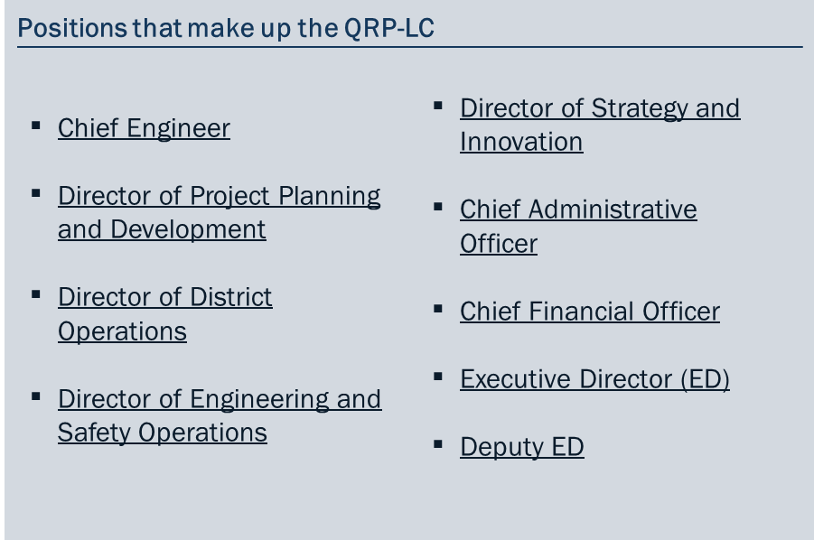






Stakeholders in Performance Based Planning
A
Key Stakeholders in PBP
Process:
MPOs
Commission
QRP Leadership
Committee
Other Interested Parties^{1,}
UTP
TPP
Districts
TRF / MNT /
BRG
Finance
1 State/local elected officials, FHWA/FTA, System users, and any interested party.

Slide 16
Contents
  Chapter 1: Overview of Project Development and Delivery
    Performance Based Planning
A
    Quarterly Review Process
B
    Project Delivery and Governance
C
  Chapter 2: Project Initiation/ Planning
  Chapter 3: Preliminary Engineering
  Chapter 4: Plans, Specifications, and Estimate (PS&E)
  Chapter 5: Letting
  Chapter 6: Construction
  Chapter 7: Summary & Review

Slide 17

Importance of QRP for successful portfolio management
B
Plan
(Performance based planning, PBP)
Manage
(Quarterly review process, QRP)
Deliver
(Project Delivery and Governance, PD&G)
  Define clear key performance measure (KPM) goals
  Develop planning targets for each District
  Align with strategic objectives and support compliance with State Legislative requirements
  Districts program a mix of projects to help meet their KPM goals
  Manage portfolio to maintain the right volume and mix of projects
  Defined meeting frequency standardized throughout state
  Standardized workflow
  Track projects from start to finish
  Defined roles and responsibilities
  Pro-active collaboration
  Individual projects are delivered on time and at budgeted cost to minimize delays and cost overruns

Slide 18
What is the Quarterly Review Process (QRP)?
B
Q1
Q2
Q3
Q4
Each quarter is structured around 3 key actions:
District portfolio review
Pre-alignment mtg. - Districts & Central Planning team (TPP, FIN, ENV,ROW, PEPS)
QRM between TxDOT QRP-LC and Central Planning team
  Review and update District portfolios
  Meet with Metropolitan Planning Organizations (MPOs)
  Meet with Divisions
  Districts and Central Planning team meet to:
    Review portfolios
    Assess progress against letting schedule
    Assess resource needs and availability
    Prioritize projects
  Central Planning team and QRP Leadership Committee meet to:
    Review consolidated portfolio and District inputs
    Identify and take appropriate actions

Slide 19




Importance of QRP for successful portfolio management
B
There are four desired success outcomes from managing the portfolio:
Programming
Milestones
Resources
Coordination
  There is the right mix and volume of projects programmed at each stage and fiscal year of the funnel to meet planning targets and performance targets for each transportation objective
  Monitor progress of letting projects on time, with all milestones cleared (e.g. ROW clearance, environmental clearance, etc.), making the full use of available funds
  There are enough resources available to Districts and Divisions (internal and external) and they are used effectively to develop the portfolio
  All stakeholders have complete visibility into the portfolio and take ownership for their part of the process
  The QRP enables the achievement of the four outcomes through regular coordination between all stakeholders

Slide 20


Stakeholders in Quarterly Review Process (QRP)
B
Central Planning Team
Key Stakeholders in QRP Process:
    MPO involvement flows through Districts
MPOs
Commission
QRP Leadership Committee
Additional Support ¹
UTP
TPP
Districts
ROW/ENV/ PEPS
Finance
1 Design (DES), Construction (CST), Traffic Safety (TRF), Bridge (BRG), Maintenance (MNT), Strategic Planning (STR)

Slide 21
Example risks in managing the Department’s portfolio through QRP
B
Potential Complications
Implications
  Projects ready to let - Not having a right-sized funnel with projects “in the hopper” waiting to let
  Timely and accurate data - Gathering key data for the QRP at the last minute
  Delivering with integrity- Prioritizing short term “issue of the day” over QRM focus in the meeting
  Ineffective allocation of resources, especially when additional funding is received
  Lack of time for district pre-meeting reviews, making the Quarterly Review Meeting (QRM) less effective
  QRP relies on specific actions being completed for each QRM, falling behind on one has negative effects on future steps in process

Slide 22
Contents
  Chapter 1: Overview of Project Development and Delivery
    Performance Based Planning
A
    Quarterly Review Process
B
    Project Delivery and Governance
C
  Chapter 2: Project Initiation/Planning
  Chapter 3: Preliminary Engineering
  Chapter 4: Plans, Specifications, and Estimate (PS&E)
  Chapter 5: Letting
  Chapter 6: Construction
  Chapter 7: Summary & Review

Slide 23
Successful project delivery through PD&G
C
Plan
(Performance based planning, PBP)
Manage
(Quarterly review process, QRP)
Deliver
(Project Delivery and Governance, PD&G)
  Define clear key performance measure (KPM) goals
  Develop planning targets for each District
  Align with strategic objectives and support compliance with State Legislative requirements
  Districts program a mix of projects to help meet their KPM goals
  Manage portfolio to maintain the right volume and mix of projects
  Defined meeting cadence standardized throughout state
  Standardized workflow
  Track projects from start to finish
  Defined roles and responsibilities
  Pro-active collaboration
  Individual projects are delivered on time and at budgeted cost to minimize delays and cost overruns

Slide 24
Successful project delivery through PD&G
C
There are four guiding principles that ensure successful project delivery:
Early involvement
Collaboration
Parallel processing
Visibility
  Involve all stakeholders early in the project development and delivery process to avoid delays later in the project
  Ensure all stakeholders are collaborating to effectively deliver projects on time and on budget
  Perform multiple key tasks concurrently (in parallel) to streamline project delivery
  Provide the ability for all stakeholders to see project status on all tasks and be aware of all issues from project beginning to project end
  Successful project delivery occurs when a project is let on schedule and open to the public on time and on budget

Slide 25






PD&G stakeholders
C
Key stakeholders in the delivery process:
PEPS
MPO
ROW
TPP
ENV
Districts
FIN
TRF
FHWA
BRG
Contr-actors
DES
CST

Slide 26
Example risks to successful delivery of projects through PD&G
C
Potential Complications
Implications
  Advancing ROW activities - ROW title work and appraisals aren’t carried out in parallel to environmental clearance
  Accurate tracking of progress and milestones - lack of visibility to all stakeholders early in the process
  Advancing long lead time activities - Railroad agreements are executed late
  Continuous effective collaboration - lack of cooperation between all stakeholders
  ROW clearances are executed late and project gets delayed
  Finding that some activities need more time to complete than initially expected
  Significant delay in Letting date
  Changes are not communicated and create rework

Slide 27
Contents
  Chapter 1: Overview of Project Development and Delivery
  Chapter 2: Project Initiation /Planning
  Chapter 3: Preliminary Engineering
  Chapter 4: Plans, Specifications, and Estimate (PS&E)
  Chapter 5: Letting
  Chapter 6: Construction

Slide 28

First phase – Project initiation/Planning
Project initiation/ Planning
Preliminary
Engineering
Plans,
specifications &
estimate (PS&E)
Letting
Construction
  5. Agreements & funding identification
  1. Needs identification
  2. Project Authorization
Early
involvement
  4. Study requirements determination
  3. Compliance with planning documents

Slide 29
Second phase – Preliminary engineering
Project initiation/ Planning
Preliminary
Engineering
Plans,
specifications &
estimate (PS&E)
Letting
Construction
2. Design concept conference
  3. Schematic development and approval
  5. Public involvement
  6. Value engineering
Parallel processing
  1. Data collection / agreements
  4. ENV, IAJR, ROW, and UTL coordination

Slide 30
Third phase – PS&E
Project initiation/ Planning
Preliminary
Engineering
Plans,
specifications &
estimate (PS&E)
Letting
Construction
  3. ENV, IAJR, ROW, UTL, and RR clearances
  1. Finalize alignment and profiles
Collaboration
  4. PS&E assembly / design review
  2. Detailed design

Slide 31
Fourth phase – Letting
Project initiation/ Planning
Preliminary
Engineering
Plans,
specifications &
estimate (PS&E)
Letting
Construction
  4. Award of contracts
  1. Letter of authority
Visibility
  3. Bidding process
  2. Project advertisement

Slide 32
Fifth phase – Construction
Project initiation/ Planning
Preliminary
Engineering
Plans,
specifications &
estimate (PS&E)
Letting
Construction
  7. Project acceptance and close-out
  6. Change orders
  5. Quality assurance and testing
  3. Supervision and inspection
  1. Notice to proceed
Collaboration
  4. Contract Administration
  2. Pre-construction conference

Slide 33
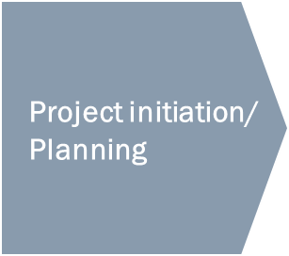
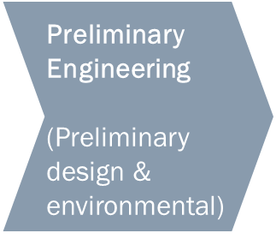
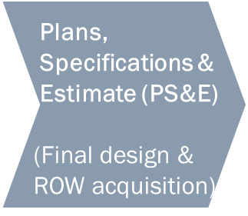
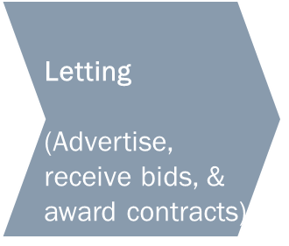
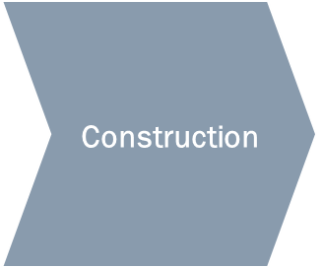
Summary and Review
Participants should now be able to:
Understand the many steps and their interdependencies to
successfully develop and construct transportation projects
1
1
…

Slide 34
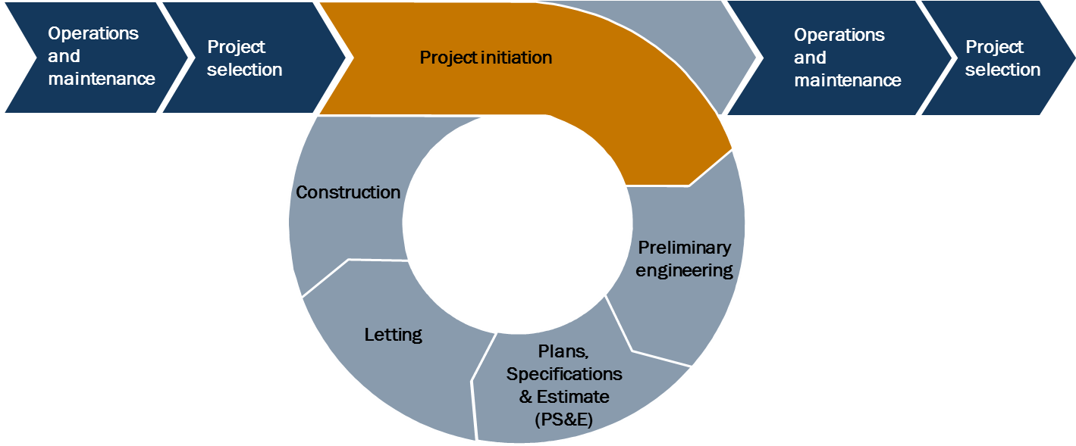
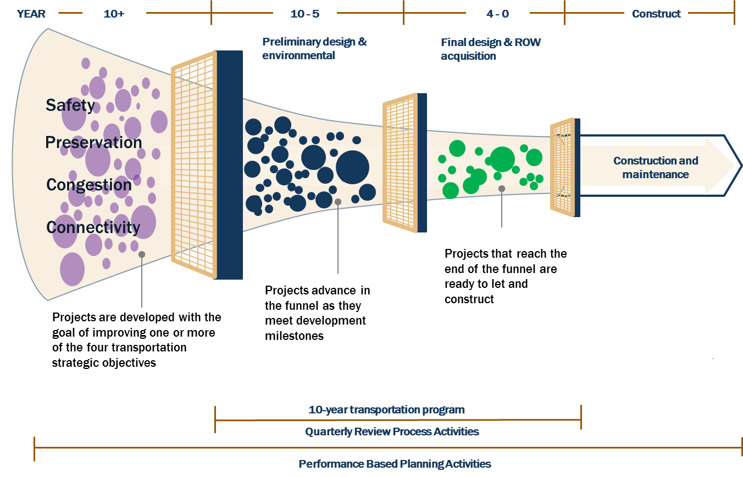
Key learning objectives
Participants should now be able to:
  Define how projects are created and move through a funnel as
  part of a portfolio that is actively managed by each district
2
2
…
PRELIMINARY DRAFT

Slide 35

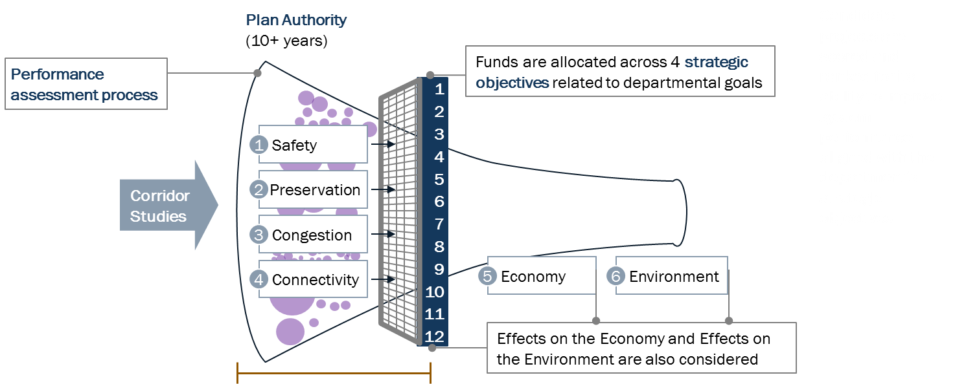
Key learning objectives
Participants should now be able to:
  Describe how Performance Based Planning facilitates alignment
  of project selections with the department’s strategic objectives
3
…

Slide 36
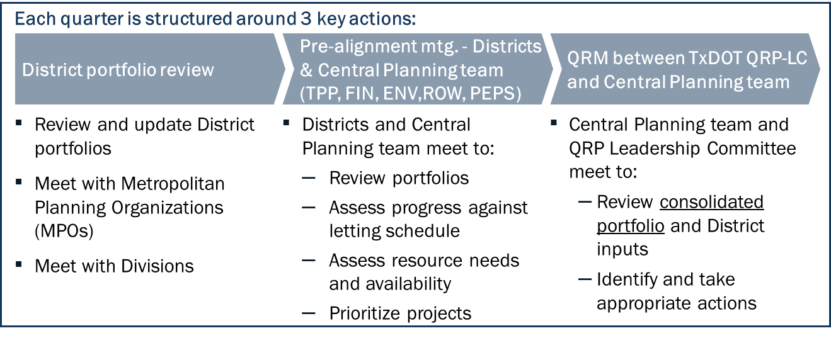
Key learning objectives
Participants should now be able to:
  Describe how the Quarterly Review Process facilitates accurate
  tracking of each project’s progress
4
…

Slide 37
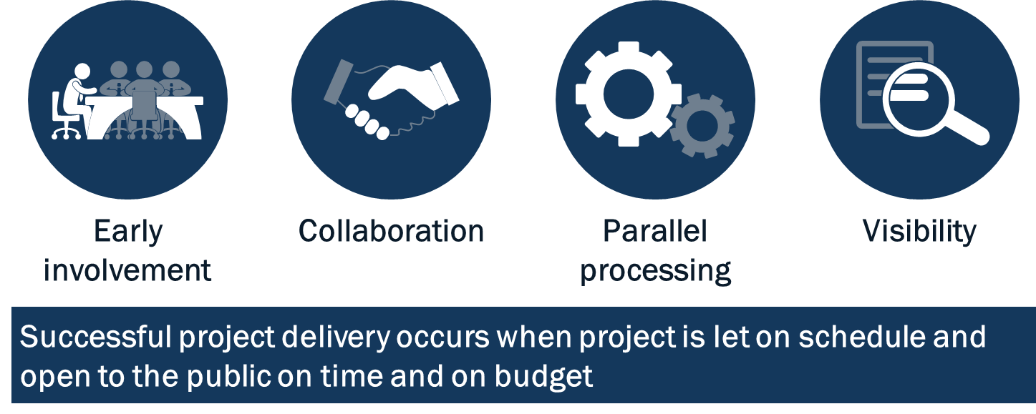
Key learning objectives
Participants should now be able to:
  Describe how the Project Delivery & Governance process
  ensures on-time and on-budget completion of projects
5
…
PRELIMINARY DRAFT

Slide 38
Questions
Thanks

