Slide 1
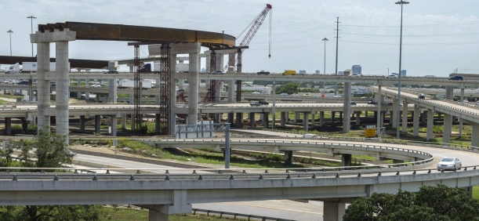
Project Administration
Mark Patterson, P.E.

Slide 2
CONSULTANT SELECTION PROCEDURES - (2 MONTHS)
LG required to submit consultant selection procedures for all projects where federal or State funds will be used to reimburse consultants
General requirements
Advertise in paper of highest regional circulation
Qualifications-based selection
Approved DBE/HUB goals
No geographic preference
TxDOT will send LG example selection procedures
LG submits formal selection procedure to TxDOT for approval
TxDOT approves and authorizes LG to advertise
LG advertises / makes selection based on performance / qualifications
LG submits consultant selection information / TxDOT approves

Slide 3
CONSULTANT CONTRACT - (2 TO 3 MONTHS)
TxDOT must approval contract between LG and consultant prior to execution
Approval of scope, contract format, and fee is required for all contracts where federal or State funds will be used
Approval of scope only is required for contracts that are not using federal funds
TxDOT sends LG sample standard contract
Contract must be either lump sum or cost plus, fixed fee
LG and consultant negotiate a contract and submit to TxDOT for review
TxDOT reviews /approves draft contract (meet if necessary)
LG and consultant finalize negotiations and send contract to TxDOT
District submits to TxDOT Audit office for review
If Audit approves, TxDOT submits final approval
LG executes contracts and schedules kick off meeting
LG sends TxDOT fully executed consultant contract
All supplemental agreements to consultant contract require prior approval

Slide 4
ENGINEERING PLAN PREPARATION
Project design kick-off meeting is held
TxDOT assigns project manager
Plan review at 30, 60, 90, and 100 percent completion
TxDOT requires five month review of final plans
Plans will utilize TxDOT specifications and plan format for TxDOT lettings
Local specifications and plan format can be used for local lettings
Local lettings require TxDOT prior approval and adherence to local let guidelines

Slide 5
DESIGN STANDARDS AND SPECIFICATIONS
Design must match design criteria in TxDOT’s Operations and Procedures Manual Chapter IV and AASHTO Guidelines
Deviation from design criteria requires exception / waiver approved by TxDOT
Pedestrian facilities must meet ADA standards
Bicycle facilities must meet AASHTO Bicycle Guidelines

Slide 6
CONSTRUCTION
Projects may be let and managed by TxDOT or LG
Local let projects are reimbursed on a monthly basis depending upon the percentage contract completion
State lets: LG’s 20 percent match is due 60 days prior to letting
Field changes must be approved by TxDOT
TxDOT charges a construction management fee for TxDOT let projects
TxDOT and LG must agree on final acceptance of completed project
Many federal requirements must be met for TxDOT and local let projects
Local Government Project Procedures

