Slide 1
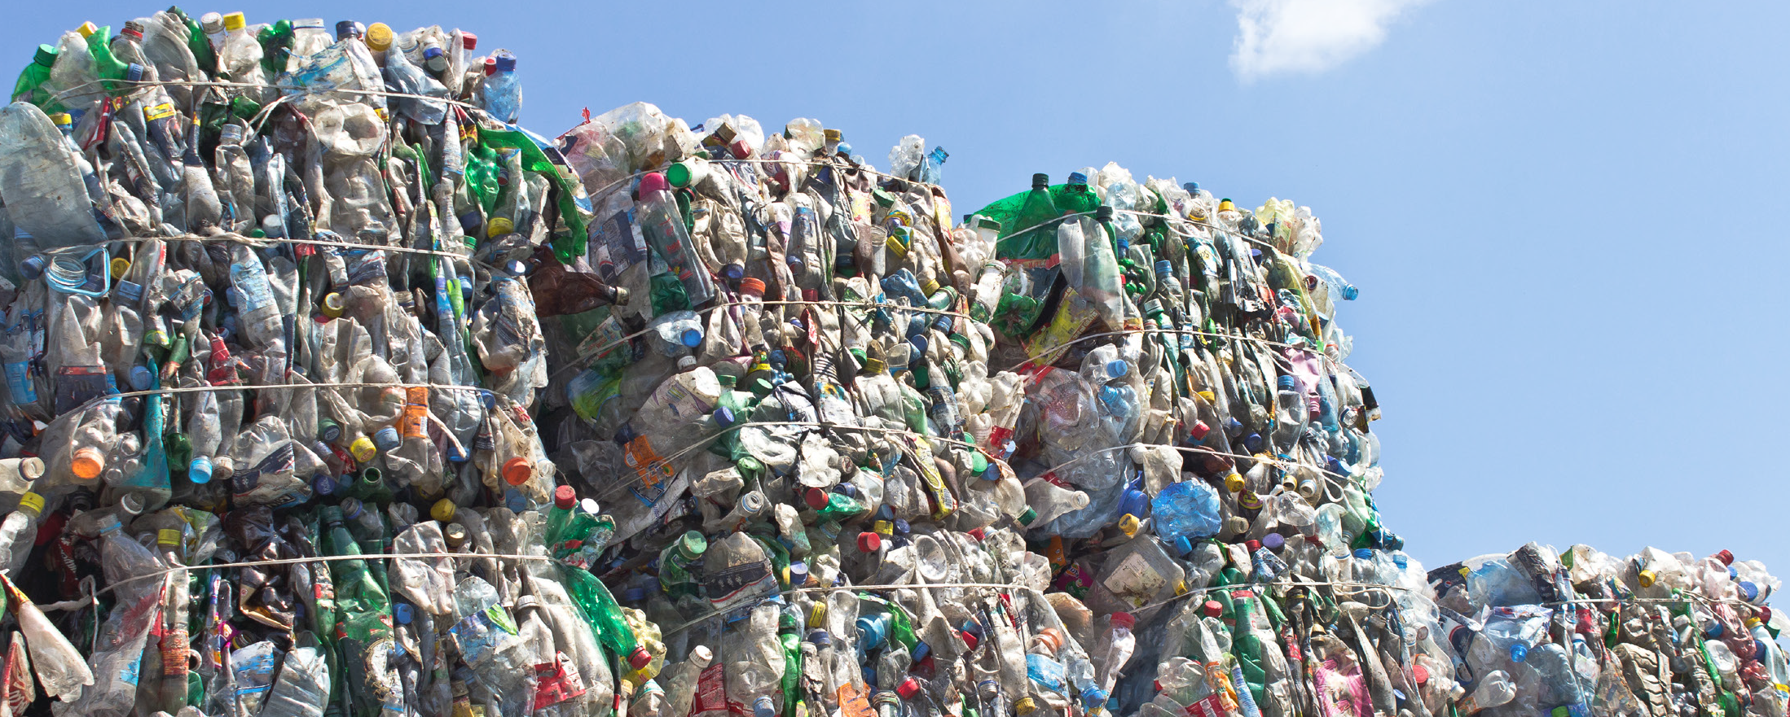
Regional Recycling Roundtable
Houston-Galveston Area Council
5/17/2018

Slide 2
Policy landscape
Positive state economics of recycling
Changing consumer habits and brand owner response
Constituent pressures
State budget
😳

Slide 3
Study on the Economic Impacts of Recycling
Scott Pasternak
(512) 872-7141
spasternak@burnsmcd.com
Notes:
84th Session HB 2763

Slide 4
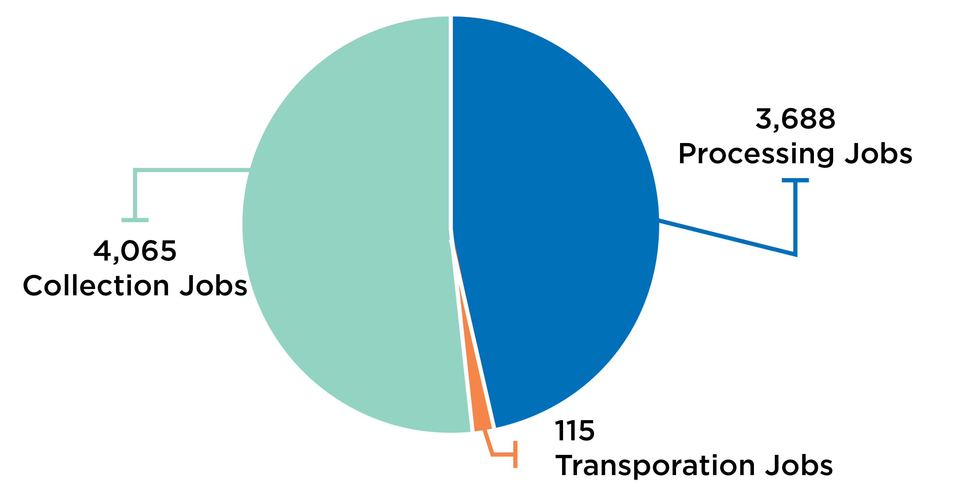
Texas Recycling Direct Employment
Notes:
*More than 7,000 people directly employed
*115 transportation jobs methodology

Slide 5
Summary of Total Economic Impact of Recycling on the Texas Economy
Measure | Direct | Indirect | Induced | Total
Employment | 7,868 | 5,040 | 4,129 | 17,037
Labor Income | $342,862,641 | $314,883,480 | $199,242,509 | $856,988,630
Value Added | $793,557,644 | $490,200,422 | $343,903,017 | $1,627,661,083
Output | $1,894,943,170 | $875,280,989 | $606,533,341 | $3,376,757,500

Slide 6



Economic Impacts of Recycling on the Texas Economy
With more than $3.3 billion of economic output and 17,037 jobs, the recycling sector is similar in size to:
Paper Manufacturing
16,843
Pipeline Transportation
18,831
Broadcasting
18,721

Slide 7

Changing Markets and Marketplaces
Notes:
Millennials are different.
*They could all be shopping right now! = purchasing for ‘purpose’ (ex. Ocean Plastics, ACC 100% plastic recovery by 2040)
RE Jerry Powell
*Water and juice drinks outpacing sugary drinks = PET markets
*not having as many babies = HDPE markets (tied so closely to milk)
ALL THAT BEING SAID…
...an interesting alignment of brand owners, marketing, and system needs could bring about policy movement.

Slide 8


Constituent Pressures
Notes:
*People want to recycle! Local governments balance the economics with ‘wishful’ recyclers, contamination, not necessarily recycling for markets (glass, cartons, bags), geography and moving material to markets.
*People don’t want landfills in their backyards nor state legislative members in their districts. (Sen Nelson, Rep Thompson) but capacity may be a real problem on our current course.
NOTE: House EReg Committee interim charge re: landfills
NOTE: House Appropriation Committee interim charge re: SW 5000 & 0549 accounts
*Response to Chinese actions may force action to spur domestic processing infrastructure. People don’t want to give up what they have. State may want to support an important sector of economy.

Slide 9
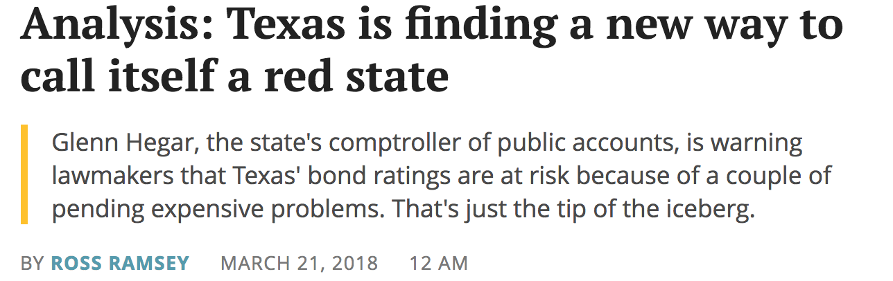
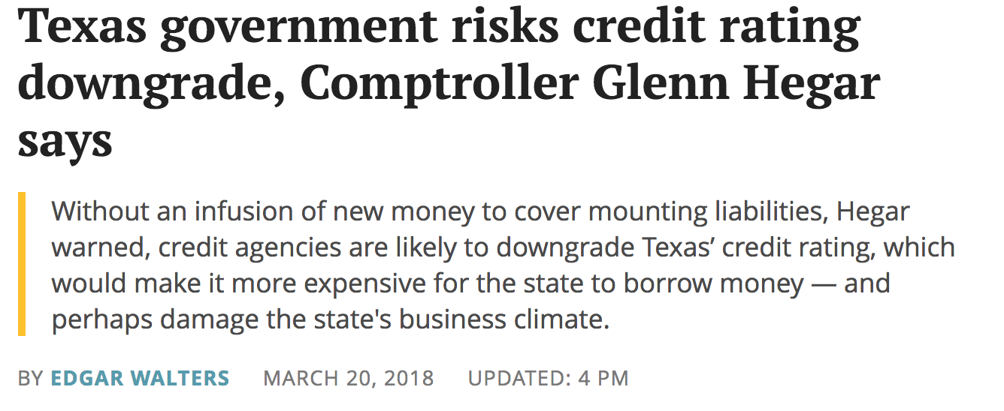
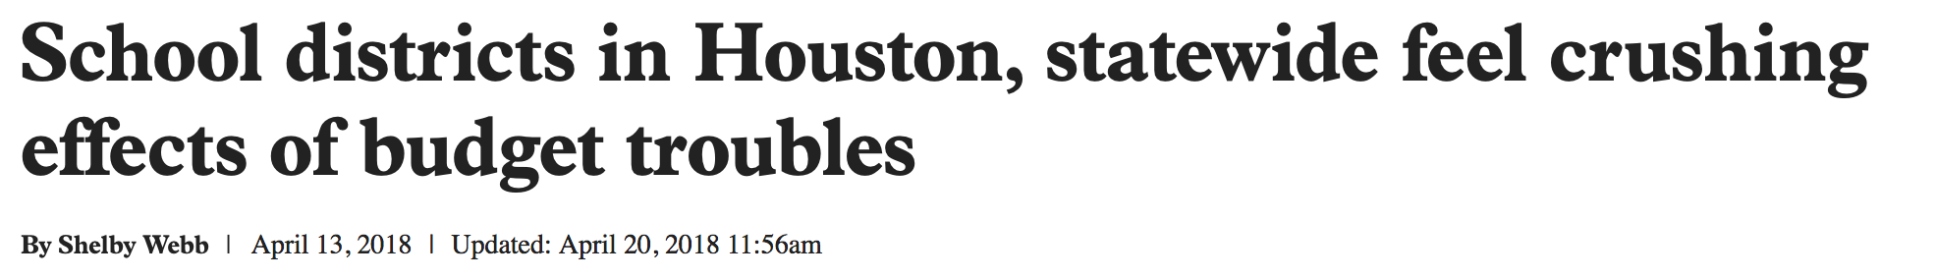
State budget
Notes:
“In January, the comptroller cautiously predicted that state coffers will only have a $94 million “beginning balance” when lawmakers convene in 2019. By comparison, lawmakers had an $880 million beginning balance in 2017, which was a tight year for the state budget.”
*AAA bond rating at risk over unfunded liabilities (School finance, retirement system, etc)
*big budget short fall ~$8B budget deficit
Crisis yet? Changes to Rainy Day Fund, sports gambling w/ taxes, new policy that supports and attracts recycling industries?

Slide 10

Policy Potentials and Opportunities
Texas Supreme Court: Laredo Merchants Association v. The City of Laredo
Texas House interim charges in Environmental Regulations & Appropriations committees
Landfill permitting process
Innovative approaches to Funding!

Slide 11
Thank you!
Maia Corbitt
(512) 472-3263
mcorbitt@baw.com

Slide 12
Plastics
2017 Don’t Mess With Texas Attitudes and Behaviors Study respondents ranked plastic bags/other plastic as the highest “very serious” form of litter
13 million plastic film items & 17 million water bottles littered in 2014
Plastics accounted for 44% of items removed from Adopt a Beach Program
Nine Texas cities spend $50 million annually on litter & illegal dumping
TxDOT spends $47 million annually on clean-ups

Slide 13

Plastic to Work System
Create monetary incentive for aggregation and return of plastics with end markets in Texas – PET and plastic film – while funding critical state needs.
Notes:
Why plastic?

Slide 14
Plastic to Work
Place a 1¢ collection at the point of sale for non-alcoholic PET beverage bottles and plastic bags/film used to carry or transport purchased items
Consumers can then receive an initial rebate of 25¢ per pound for redeemed PET beverage bottles and plastic bag/film material, including additional film plastic not included in collection amount (ex. clean, dry film packaging)
Processors would receive handling fees (60¢ per pound in an urban area, 90¢ per pound in a rural area) once material is sold to an end market for ‘recycling’
A consortium of system representatives would have ability to adjust variables to ensure viable incentive to return material, appropriate amount in handling fee to support redemption options for public convenience, and provide for positive program funding.

Slide 15
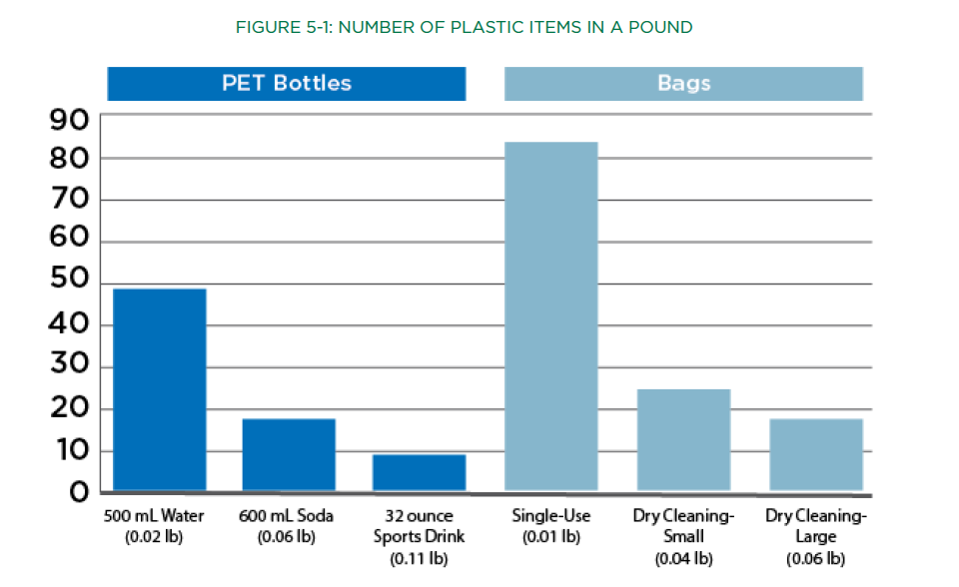
Number of plastic items in a pound

Slide 16






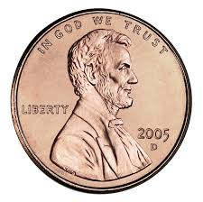
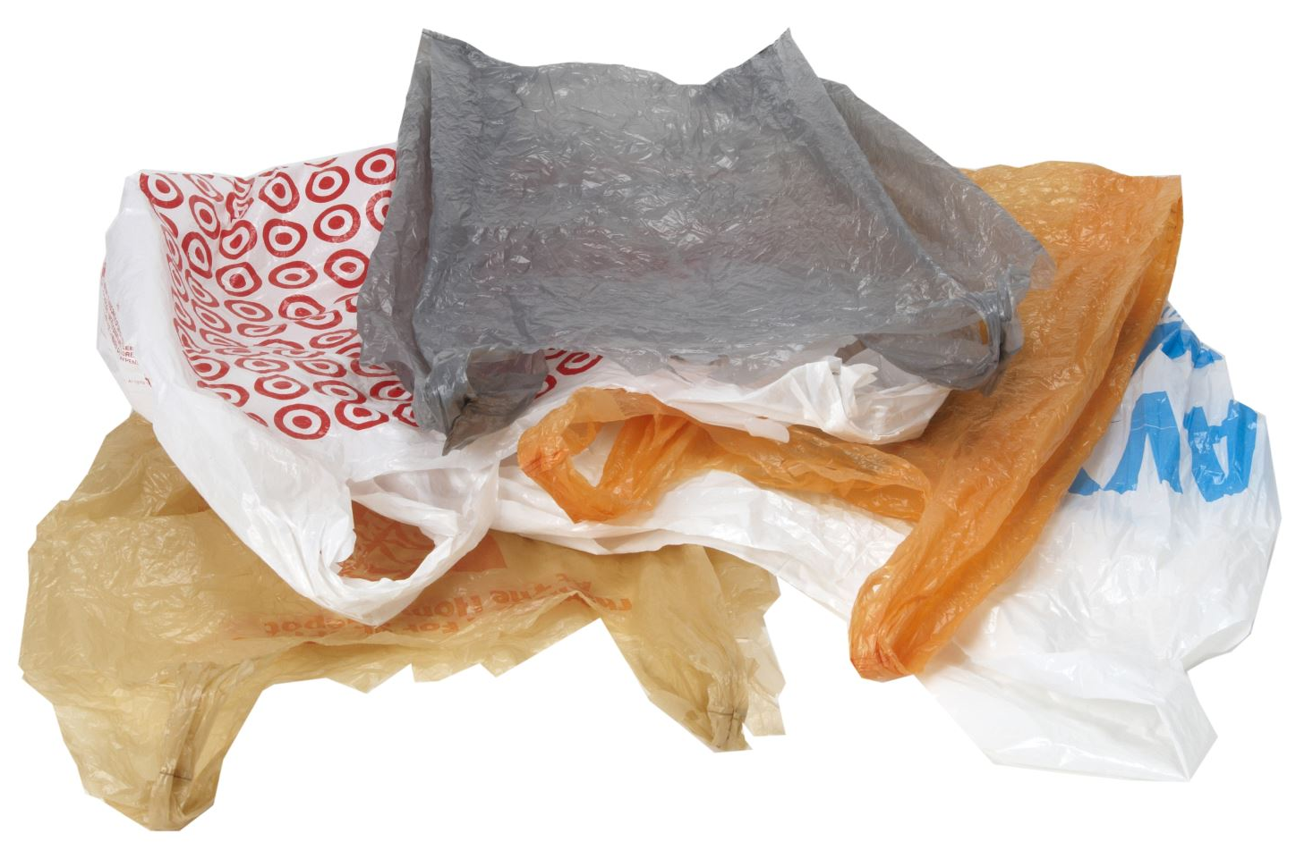



Consumer penny/item
State penny/item --> quarter/lb
Redeemer quarter/lb + handling
Quarter to consumer
Retail penny/item
Redemption
Store
$ lb
$ collected – ($ redemption + handling fee) = administration, savings, program funds

Slide 17
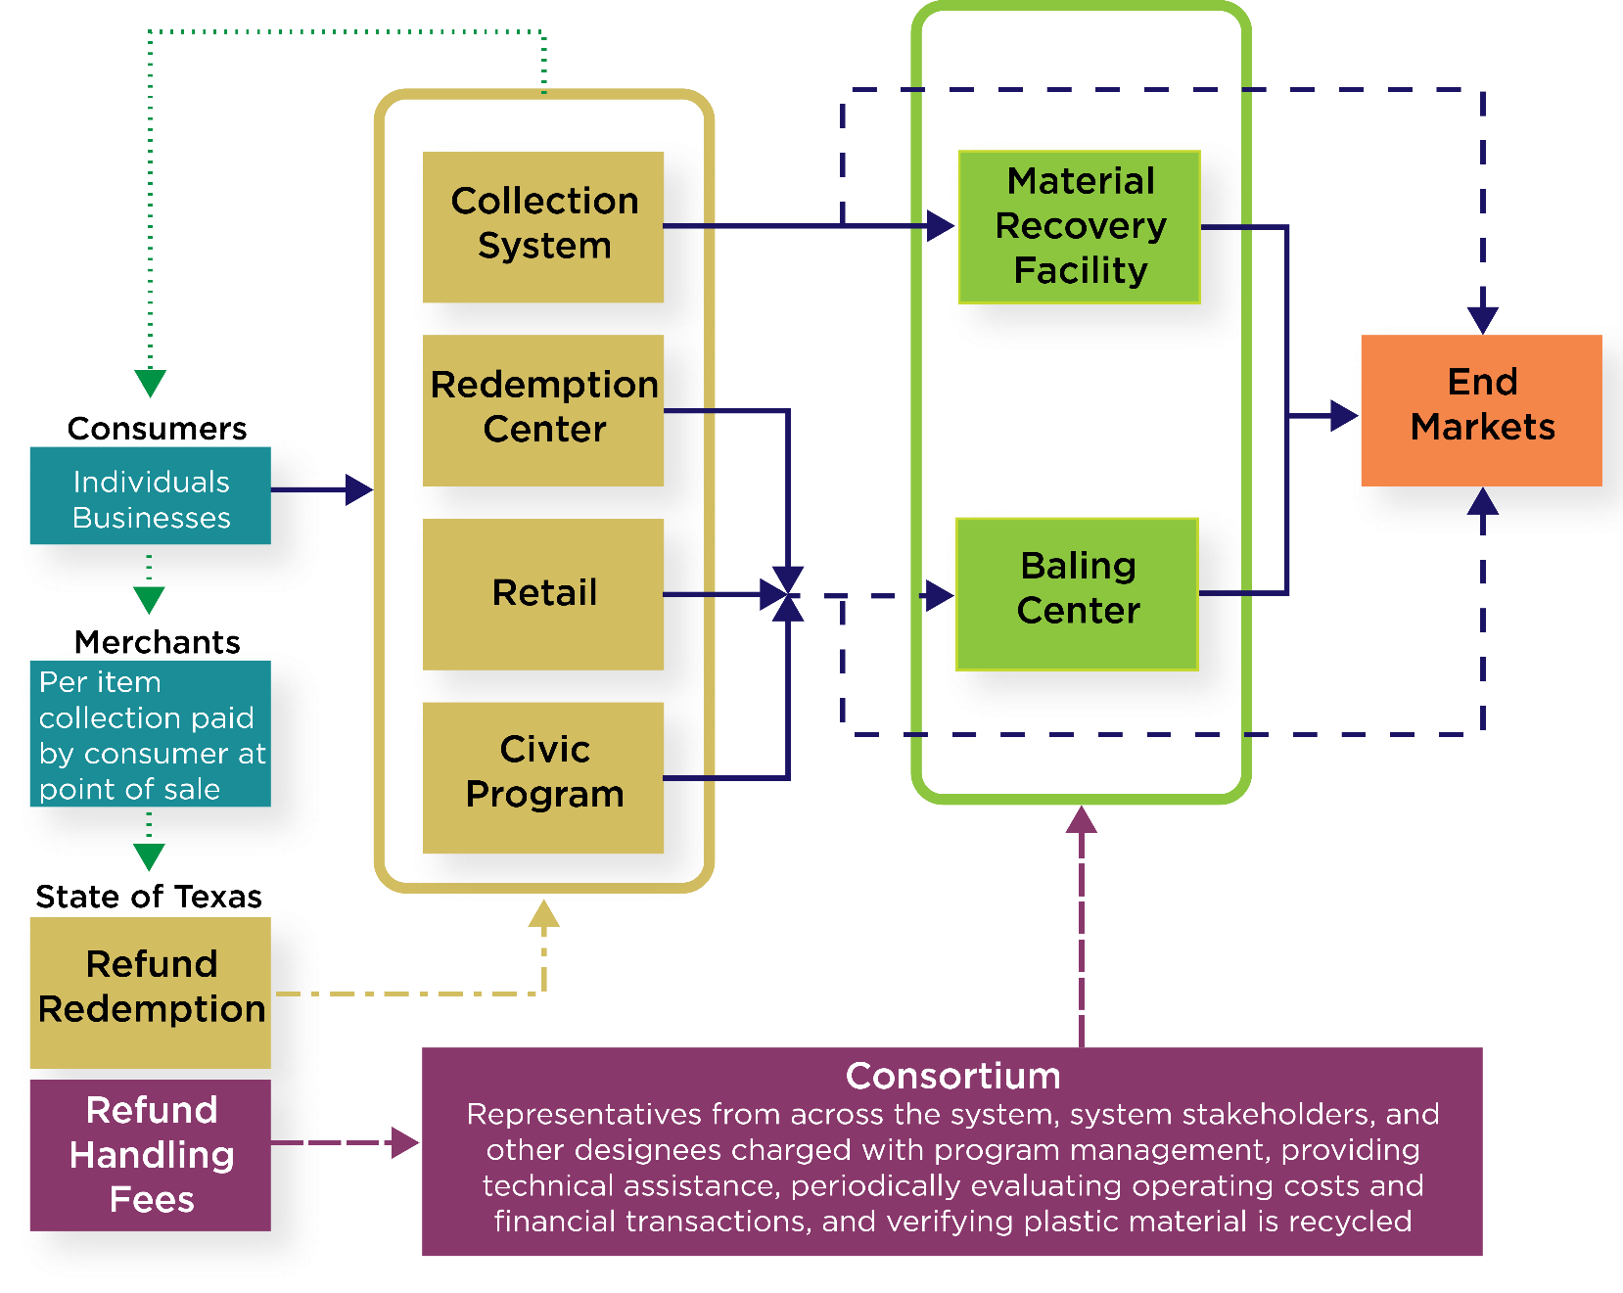



Plastic To Work Financial and Material Flow
Notes:
Narrative notes:
Delineation of duties between State and Consortium

Slide 18
Who are the Consortium and what would they do?
Stakeholders along the value chain and participating in the system, including plastic manufacturers and end users of recycled plastics, retailers and processors/material redeemers.
Receive information regarding material flow through the system including amount purchased, weight returned and sold to end market.
Adjust financial variables as necessary to …
support entities that process material and provide consumer rebates through handling fee
incentivize consumers to aggregate and return material through per pound rebate amount
ensure positive returns as participation increases by adjusting per item amount and included materials
Certify end market entities are utilizing material per ‘recycling’ definition to verify handling fee payments.

Slide 19





Flexible Variables that Maximize Material Capture while Maintaining a Positive Balance
COLLECTION
REBATE
HANDLING FEES
1¢-5¢
(at point of sale for PET beverage containers & film bags)
25¢/lb – 50¢/lb
(includes PET beverage containers & clean, dry film packaging)
60¢/lb urban 90¢/lb rural
(once material is sold to recycling markets)

Slide 20
Funding and Impacts
Sustained funding to local communities for litter/illegal dumping education, abatement, and enforcement programs
Substantial amount in early program years for flood mitigation planning and infrastructure
Provide economic development funds to further attract recycling infrastructure and end market growth
Support Texas markets for post consumer PET beverage containers and film plastic recycling
Remove difficult film plastic from municipal curbside recycling stream and/or incentivize a ‘better mousetrap’
Provide expansive employment potential from entrepreneurial opportunities for material redemption facilities to low-skill, entry collection, sorting, etc.
Notes:
Narrative notes:
*Program will provide an incentive for public to aggregate clean, dry plastic bags and other post-consumer plastic film (clean, dry food packaging, produce bags) outside of the curbside collection systems where it can be problematic. Program will also providing MRFs and processors financial assistance to deal with film material and additional funding incentive to get material to market for the handling fee.
*Program handling fee provides price floor for PET to help unstable markets.
*Consortium representatives would include producers, processors, and end users that have understanding of the material, current and future market needs.
*Portion of net program funding would support comprehensive litter prevention strategies, including education and enforcement. Early balances could also fund natural disaster community resiliency, recovery, planning, and preparedness – which is a real need right now.

Slide 21
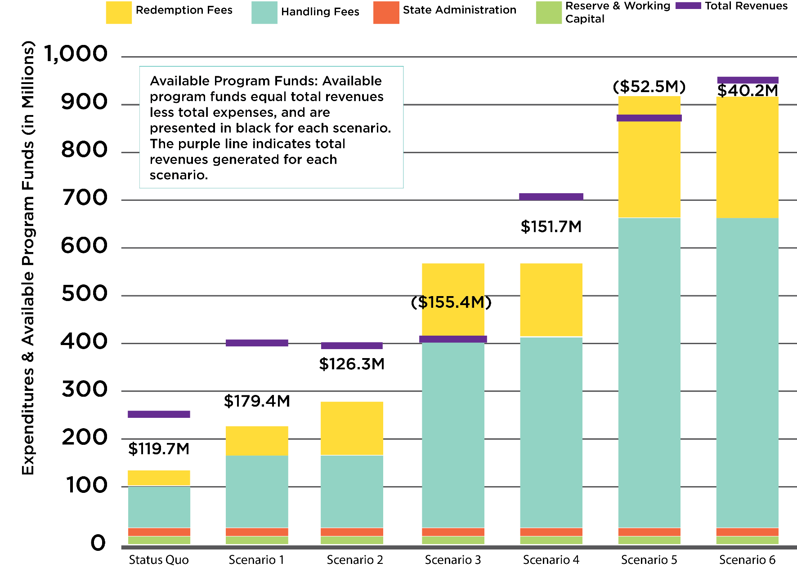
Long Term, Extensive Positive Economic Impacts
Paid to consumers, non-profit/civic groups, municipalities, etc
Paid to retailers, processors, entrepreneurs, non-profit/civic groups, etc participating in system
Notes:
Narrative notes:
Scenarios are intended to convey robust flexibility in the system allows continues positive funding.
**focus on handling fee, how/why calculated in model**
*Handling fee adjusted by Consortium with ability to differentiate material type and rural/urban to maintain viable system to redeem and recycle material.
*Reserve fund set aside for unexpected fluctuation or otherwise as needed.

