Slide 1
Educational Outreach Presentation
July 15, 2026
Notes:
Introduction

Slide 2
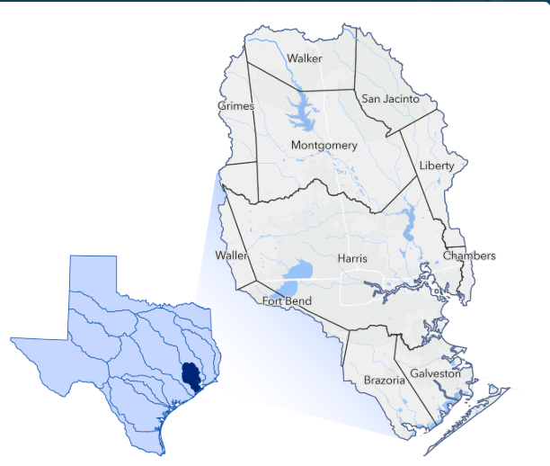
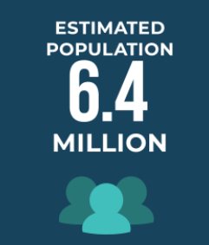
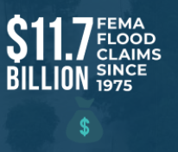

New Beginnings
Post Harvey, the 2019 Texas Legislature passed legislation to create Texas’ first-ever regional and state flood planning process.
Legislature created a state flood planning framework and charged the Texas Water Development Board (TWDB) with creating flood planning regions based on river basins
San Jacinto Regional Flood Planning Group (San Jacinto Region) is one of the 15 Regional Flood Planning Groups (RFPGs)
SJRFPG includes 92 Municipalities. Counties represented in SJRFPG include:
  Brazoria* Galveston* Liberty*
  Walker* Chambers* Grimes*
  Montgomery* Waller* Fort Bend*
  Harris* San Jacinto*
From 1975 to 2019, the San Jacinto region recorded the highest number of National Flood Insurance Program (NFIP) claims in Texas
Second smallest flood planning region (5089 sq miles) by area but the second most populous, population of 6.4 million. Densest RFPG with 1,200 people per square mile.

Slide 3
Project Types Explained (“The Lingo”)
Flood Management Evaluations (FME’s): Studies or assessments aimed at better understanding flood risks for a region, identifying areas with highest flood risk, and developing potential flood risk solutions.
  Master Drainage Plans
  Feasibility Studies
  Preliminary Engineering (Up to 30% Design)
Flood Management Strategies (FMS’s): Policies, regulations, or non-structural measures aimed at reducing flood risks.
Flood Management Ordinances
Flood Warning Systems
Public Awareness Programs
Flood Management Projects (FMP’s): Detailed design and construction of infrastructure improvement projects designed to reduce flood risks (i.e. levees, reservoirs, detention ponds, drainage conveyance improvements, street level drainage improvements, low impact development projects.)
Detailed Design Engineering
Construction
Flood Mitigation Actions (FMX’s): Broader, more flexible term used to encompass various actions that fall under flood management evaluations (FMEs), projects (FMPs), or strategies (FMSs). It refers to any specific steps taken to identify or mitigate flood risks, whether structural or non-structural.

Slide 4

Why Participate
Access to Funding Eligibility
Legislative and Political Visibility
Official Record of Total Need
Strengthens Grant Competitiveness Outside of the TWDB
Supports Regional Coordination
Supports Future CIP and Bond Programs
Supports Resilience and Land Use Planning

Slide 5
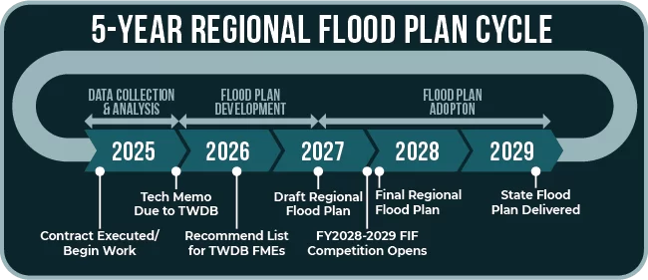
Second Flood Planning Cycle
Projects were due to SJRFP on July 2nd, 2026. Possible future amendment opportunities. Please let me know if you missed the deadline!
First regional flood plans were submitted in July 2023. First State Flood Plan submitted to Texas Legislature September 2024.
Second SJRFP is due to TWDB by January 10, 2028.
Recommended studies and projects (all FMX’s – FME’s, FMS’s, FMP’s) are due for the 2nd Flood Planning Cycle on July 2nd, 2026.
The Flood Infrastructure Fund Program will be accepting applications for projects that are in the 2024 Amended State Flood Plan

Slide 6
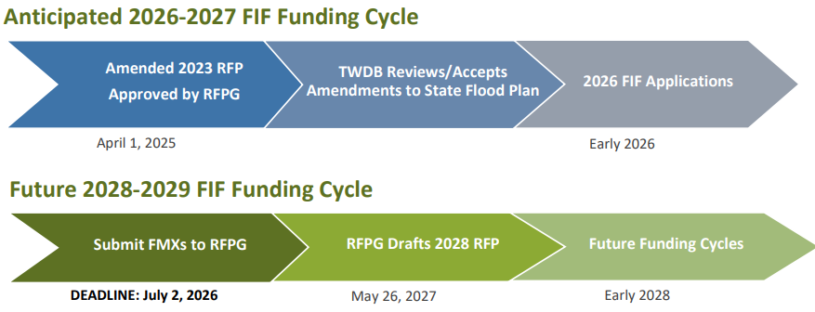
Flood Infrastructure Fund (FIF)
2026 Flood Infrastructure Fund (FIF) Intended Use Plan was released in May and comments were returned in June.
Expect FIF Application to open soon.
To be eligible for FIF funding:
  Flood risk reduction solution(s) (FMX’s) must be included in the Regional Amended 2024 State Flood Plan submitted to the TWDB in April 2025.
  Visit sanjacintofloodplanning.org to review the draft plan and confirm your project’s eligibility. (Link for Interactive Amended 2024 State Flood Plan)

Slide 7
Flood Infrastructure Fund (FIF) – 2026-27 Schedule
Intended Use Plan was released in May and Public Comments accepted in June 2026.
Table of Approximate Timing
Step | Estimated Time
Review comments | Mid June–Late July
Board approval of final IUP | Late July or August
Abridged application opens | Late July to August 2026
Abridged applications due | Roughly 45–60 days later (likely September–October)
Project Priority List development | Fall 2026
Invitations for full applications | Late 2026
Funding commitments | Late 2026 into early 2027

Slide 8
Flood Infrastructure Fund (FIF) – Eligible Applicants
FME’s, FMP’s, FMS’s - Eligible Political Subdivisions:
  Cities
  Counties
  District or Authorities created under Article III, Section 52 of the Texas Constitution
  District or Authorities created under Article XVI, Section 59 of the Texas Constitution
FME’s Only - Eligible Political Subdivisions:
  Political Subdivisions and Nonprofit Water Supply Corporations operating under Chapter 67 of the Texas Water Code

Slide 9
Flood Infrastructure Fund (FIF)
* Requirements Spreadsheet is available to assist project sponsors in preparing complete and compliant submissions. This spreadsheet provides additional guidance, examples, and data requirements to help ensure your submittal meets all TWDB and RFPG standards. Visit sanjacintofloodplanning.org to download the latest version.
Minimum Requirements for FIF Applications
FME | FMS | FMP | Requirements
q | q | q | Project/Study Name
q | q | q | Scope Description
q | q | q | Shapefile (Study area or Project Area)
q | q | q | Estimated Study Cost (Non-Construction)
 |  | q | Estimated Construction Cost
 |  | q | Hydrologic & Hydraulic Models
 |  | q | Pre & Post Project 100yr Floodplains
 |  | q | Benefit Cost Analysis
 | Potentially | q | No Negative Impacts Certification

Slide 10
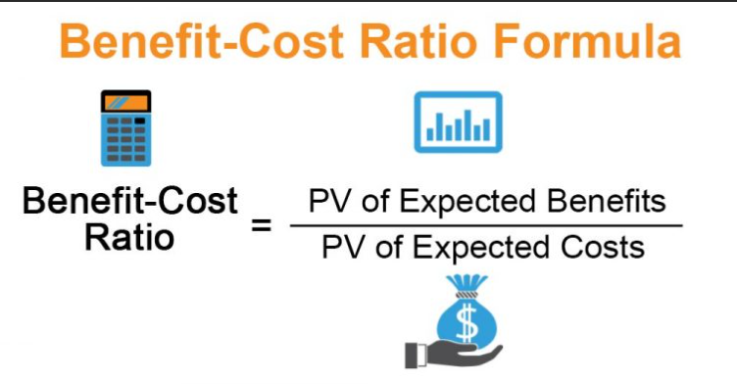
Flood Infrastructure Fund (FIF) – Tips
FMP’s require a Benefit Cost Analysis for Construction Projects with a Benefit Cost Ratio greater than 1.0. BCA’s are now more open to Non-Typical Benefits. Alternatively, can provide written description of benefits and why BCA should not be the focus.
In Kind Services must be clearly stated in the application and justification must be provided..
Projects receiving Federal funding are viewed very favorably and FIF funds may be used to cover a portion of the applicant’s “Local Match”.
United States Iron and Steel Requirements, Texas Government Code 2252
TWDB adds points for communities with lower economic capacity
Adjusted Median Household Income (AMHI) ≤ 85% of statewide AMHI – 10 Extra Points. Important for funding options. Less important for project ranking.
Nature Based Solutions receive a scoring advantage.
Social Vulnerability Index has previously served as a tiebreaker.

Slide 11
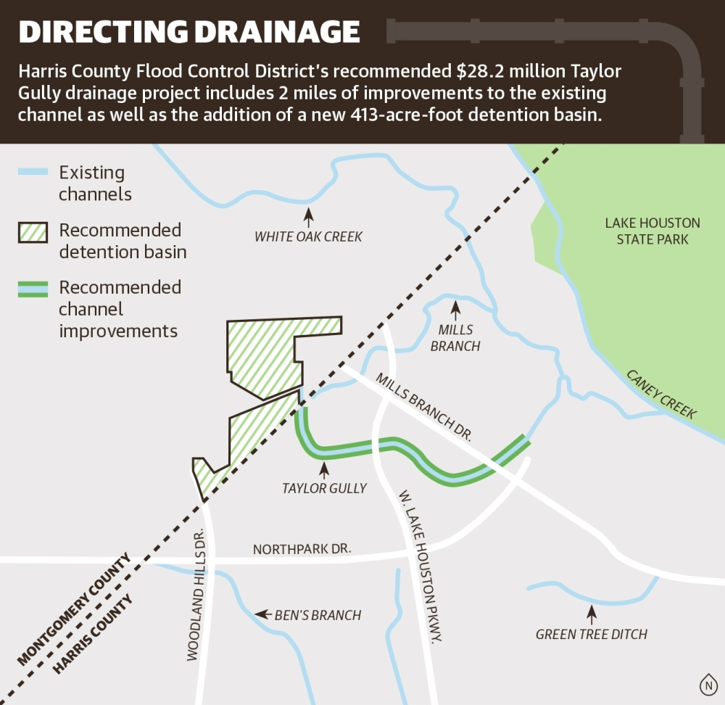
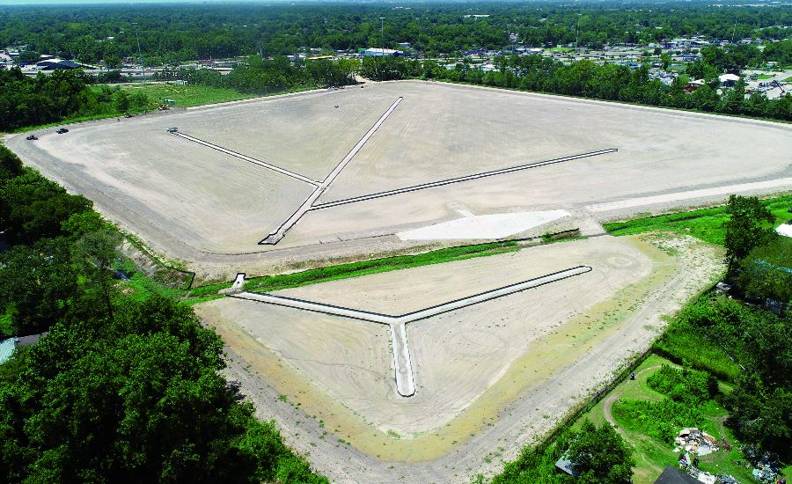
Flood Infrastructure Fund (FIF)
Highest Scoring Projects – Those that protect the most people and structures.
      Regional detention basins
      Channel bottleneck improvements
      Culvert / bridge expansions
      Major storm sewer outfalls
      Levee / pump improvements
      Why they score well?
        Large number of structures protected.
      Measurable flood depth reduction.
      Clear avoided damages.
      Strong hydraulic modeling support.
Example: Lauder Stormwater Detention Basin (Greens Bayou)
Harris County Flood Control District received $2.2 million in TWDB Flood Infrastructure Fund grant funding for Phase 2

Slide 12
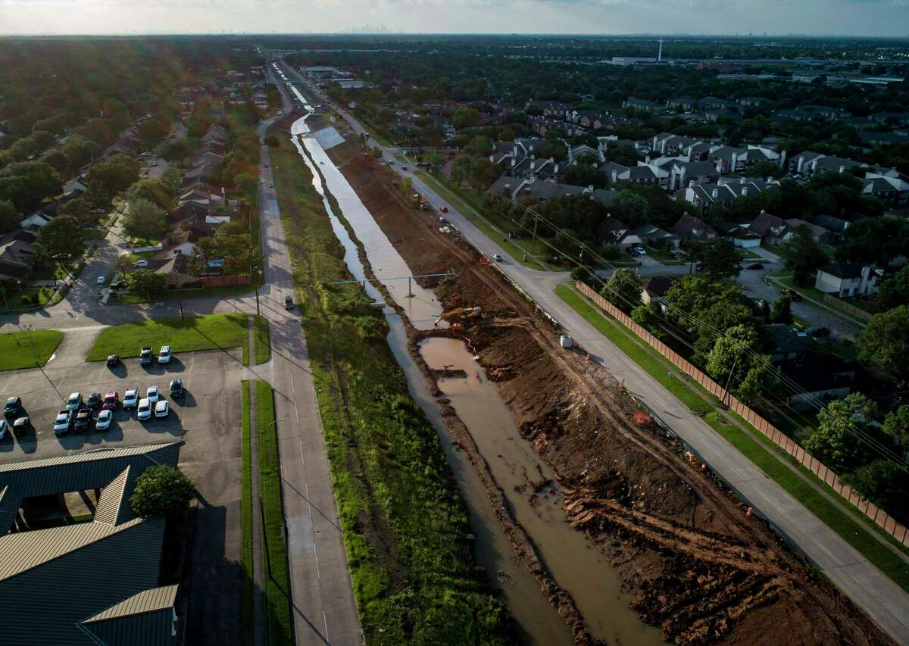
Flood Infrastructure Fund (FIF)
Regional watershed projects and projects with Multi-Jurisdictional Benefits tend to score well.
  Watershed-scale drainage studies
Creek corridor improvements
Upstream detention that benefits multiple cities
Countywide drainage master plans
These are strong because they align directly with the regional flood planning process.

Slide 13
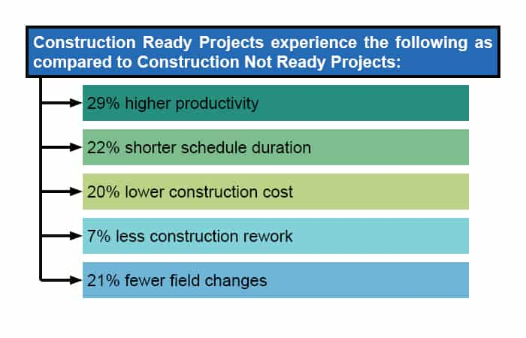
Flood Infrastructure Fund (FIF)
Ready-to-go projects: Projects that already have:
Planning completed
H&H models
Concept design
Easements / ROW identified
Environmental path known
Local support
Even if TWDB does not list “readiness” as a single line item, projects that are easier to move into funding tend to be favored in practice.

Slide 14

Flood Infrastructure Fund (FIF) – Low Interest Loans
Why Consider a FIF Loan?
Available to eligible communities regardless of AMHI (grant percentage may vary).
Below-market interest rates reduce the cost of financing compared to traditional municipal bonds.
Lower annual debt service preserves capacity for future CIP projects.
Can be combined with FIF grants to maximize project affordability.
Enables communities to advance larger or additional flood mitigation projects with less local financial burden.
Key Takeaway
Evaluate the entire financing package—not just the grant. Even communities receiving smaller grants may save millions in interest costs over the life of a project through TWDB low-interest financing.
Community | Likely Outcome
Low AMHI | Large grant + small loan
Moderate AMHI | Moderate grant + loan
High AMHI | Smaller grant + very favorable loan

Slide 15
Flood Infrastructure Fund (FIF) – Guidance Documents Open for Public Review
1. Nature-Based Solutions (NBS) for Flood Resilience Guidance Manual
Purpose: Statewide guidance for integrating nature-based solutions into flood mitigation planning and design.
Includes:
  Texas-specific NBS design guidance
  Planning and implementation framework
  Example ordinances
  Case studies and best practices
  Integration of green and gray infrastructure
Public Review: July 10 – July 24, 2026
Access:https://www.twdb.texas.gov/home/tabs/doc/hot/NBS-Public-Comment-Notice.pdf
2. Benefit-Cost Analysis (BCA) Guidance
Purpose: Improve consistency in evaluating flood mitigation project benefits for FIF applications.
Focuses on:
  BCA best practices
  Expanded consideration of environmental and community benefits
  Reporting Benefit-Cost Ratios (BCRs)
  Guidance supporting future FIF applications
Public Review: Open through July 15, 2026
Access:https://www.twdb.texas.gov/financial/programs/fif/bca.asp

Slide 16
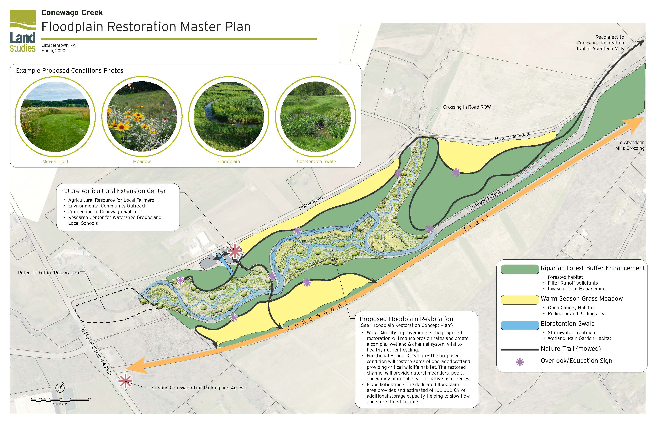
Flood Infrastructure Fund (FIF)
Nature-based and floodplain restoration projects are increasingly competitive.
  Floodplain acquisition and green space
Wetland restoration
Preserved storage corridors
Buyouts
Green stormwater infrastructure
Bioswales and distributed detention
The 2024–2025 IUP specifically referenced green / nature-based components and included nature-based cost share considerations. The 2026 TWDB Nature Based Solution’s guidance is out for public comment right now.
Nature-based solutions can improve competitiveness when they provide measurable storage, floodplain reconnection, and permanent risk reduction.

Slide 17

Flood Infrastructure Fund (FIF)
Projects that do not score well are small isolated local drainage fixes.
One neighborhood inlet upgrade
Local curb improvements
Small isolated pipe upsizing
Projects that do not benefit structures
Why do these score worse?
Fewer structures benefited
Weaker regional significance
Lower statewide visibility

Slide 18
How to Get Involved
Attend in person public meetings for the SJRFP Committee.
  https://sanjacintofloodplanning.org/meetings/
Register for SJRFP Committee emails:
  https://sanjacintofloodplanning.org/distribution-list/
View the amended 2024 State Flood Plan: sanjacintofloodplanning.org
Take the survey:
  https://freese.mysocialpinpoint.com/san-jacinto-flood-plan/home/
Contact the SJRFP committee (or myself) to make sure you get your projects incorporated into the 2028-2029 State Flood Plan
    📧 Email: SJRFPG.TechCon@freese.com
    🌐Website: sanjacintofloodplanning.org
If you have projects in the 2024 Amended State Flood Plan now is the time to start working on your Flood Infrastructure Fund project applications.
Once the Intended Use Plan is released you will have a short window to submit applications to the TWDB (through the SJRFP Committee).
Provide comments/input:
  https://sanjacintofloodplanning.org/contact-us/

Slide 19
QUESTIONS
📧 Email: SJRFPG.TechCon@freese.com
🌐Website: sanjacintofloodplanning.org
Samantha Haritos, CFM, ENV SP
Coastal Communities Voting Member
SJRFP Committee
sharitos@ardurra.com

