Slide 1
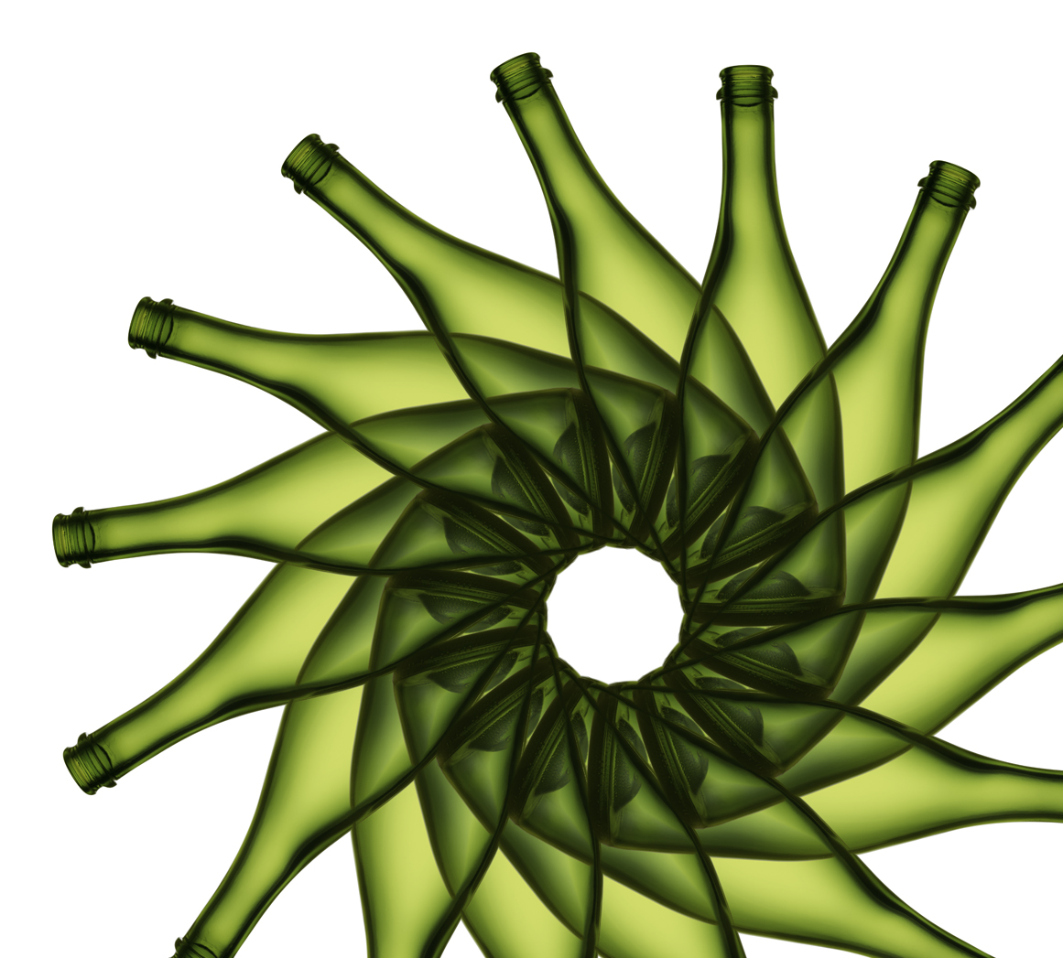
Glass in the MRFs
Glass Recycling Strategies and Processes at MRFs
Presented to:
Houston-Galveston Area Council
February 23, 2016

Slide 2
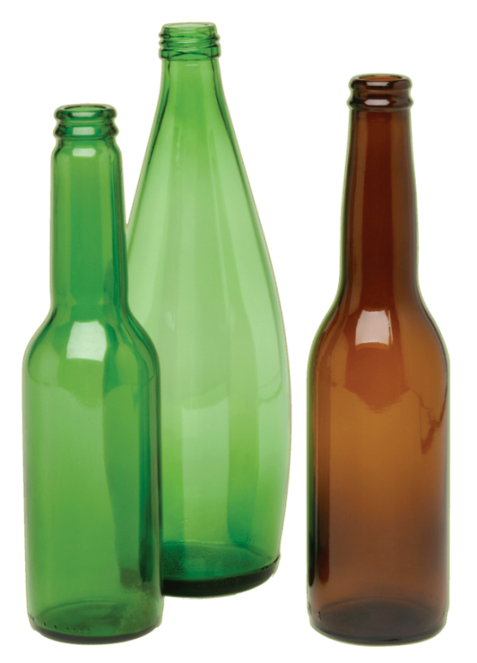
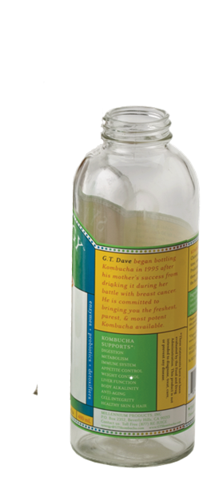
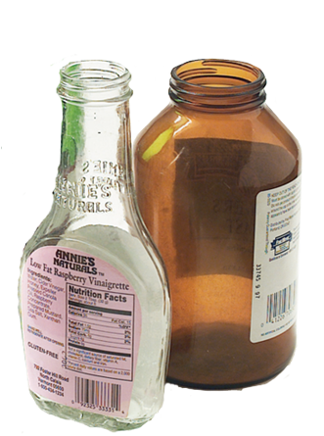
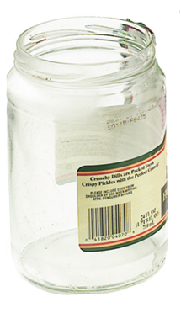
Glass
Glass recycling facts
Glass makes up 4.5% of the overall waste stream and 13.1% of material recycled (US EPA 2013). Glass plays in important role in achieving recycling goals in many communities.
Glass makes up 18% of the average WM MRF stream. As material has become lighter, glass makes up a higher percentage of the MRF stream.
Glass beneficiation. Glass flows from MRFs to beneficiation plants for sorting, crushing and cleaning before delivery to the bottle manufacturers. These are not located everywhere.
The inelasticity of glass supply impacts markets. Constant supply from curbside collection combined with uneven demand creates imbalanced markets across the U.S.
Notes:
Let’s start with glass.
The first rule is to know the facts around these topics. Glass makes up a meaningful portion of the waste stream and a significant portion of the recycling stream – 17%-18% on average. Cities with high recycling goals will have a tough time meeting their recycling goals without glass…. And with less paper and more lighter plastic in the waste stream, glass makes up a growing percentage of the MRF stream.
So if we are going to talk about glass coming out of the system, we’ll need to be prepared to talk about recycling goals. It’s important to understand local policies and goals when talking about glass recycling programs in local communities.
Other important facts about glass:
Glass beneficiation. Glass flows from MRFs to beneficiation plants for sorting, crushing and cleaning before delivery to the bottle manufacturers. These are not located everywhere. In some areas of the country, there are markets for glass recycling – and in other areas, there simply are not. Transparency in messaging around glass end markets is important.
The inelasticity of glass supply impacts markets. Constant supply from curbside collection combined with uneven demand creates imbalanced markets across the U.S. Whether there are markets or not, glass in curbside programs keeps coming.

Slide 3
Glass
There are multiple solutions
Solutions vary by region. Even though there may technically be sufficient demand for acceptably processed cullet by the glass bottle and fiberglass manufacturing industry, supply and demand of specific colors do not always balance by geography.
Municipal contracts are beginning to reflect the cost of recycling glass. With low commodity pricing for all materials, each must stand on its own. The high cost of recycling glass has been elevated through these efforts.
As the cost of recycling glass increases, communities are moving towards alternative collection methods for glass. These decisions are made for the health of their overall recycling programs.
Notes:
Let’s start with glass.
The first rule is to know the facts around these topics. Glass makes up a meaningful portion of the waste stream and a significant portion of the recycling stream – 17%-18% on average. Cities with high recycling goals will have a tough time meeting their recycling goals without glass…. And with less paper and more lighter plastic in the waste stream, glass makes up a growing percentage of the MRF stream.
So if we are going to talk about glass coming out of the system, we’ll need to be prepared to talk about recycling goals. It’s important to understand local policies and goals when talking about glass recycling programs in local communities.
Other important facts about glass:
Glass beneficiation. Glass flows from MRFs to beneficiation plants for sorting, crushing and cleaning before delivery to the bottle manufacturers. These are not located everywhere. In some areas of the country, there are markets for glass recycling – and in other areas, there simply are not. Transparency in messaging around glass end markets is important.
The inelasticity of glass supply impacts markets. Constant supply from curbside collection combined with uneven demand creates imbalanced markets across the U.S. Whether there are markets or not, glass in curbside programs keeps coming.

Slide 4
Glass
Key points for glass at WM
Glass “in” or glass “out” is not the issue. Rather, the markets need to be available, the specifications need to be defined, and the processing costs need to cover the cost of separation and getting the material to their end markets.
New contracts/RFPs need to be evaluated multiple ways. WM is willing to recycle nearly anything that has an available end market. Proposals will/may offer options for different materials to let municipalities and other customers choose what they want to be in their program, but will have cost options to ensure any method makes financial sense.
Notes:
Let’s start with glass.
The first rule is to know the facts around these topics. Glass makes up a meaningful portion of the waste stream and a significant portion of the recycling stream – 17%-18% on average. Cities with high recycling goals will have a tough time meeting their recycling goals without glass…. And with less paper and more lighter plastic in the waste stream, glass makes up a growing percentage of the MRF stream.
So if we are going to talk about glass coming out of the system, we’ll need to be prepared to talk about recycling goals. It’s important to understand local policies and goals when talking about glass recycling programs in local communities.
Other important facts about glass:
Glass beneficiation. Glass flows from MRFs to beneficiation plants for sorting, crushing and cleaning before delivery to the bottle manufacturers. These are not located everywhere. In some areas of the country, there are markets for glass recycling – and in other areas, there simply are not. Transparency in messaging around glass end markets is important.
The inelasticity of glass supply impacts markets. Constant supply from curbside collection combined with uneven demand creates imbalanced markets across the U.S. Whether there are markets or not, glass in curbside programs keeps coming.

Slide 5
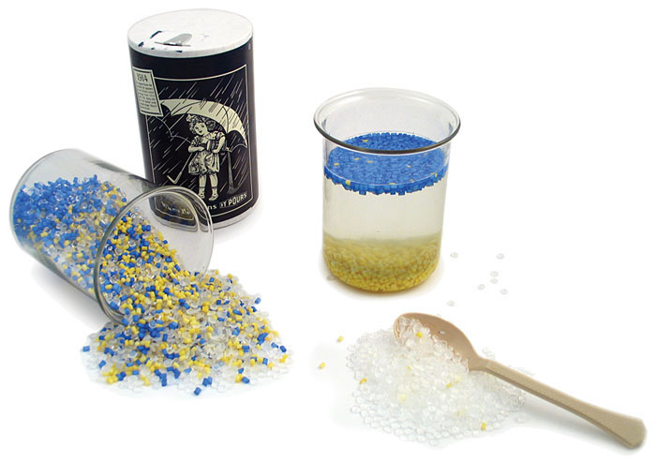
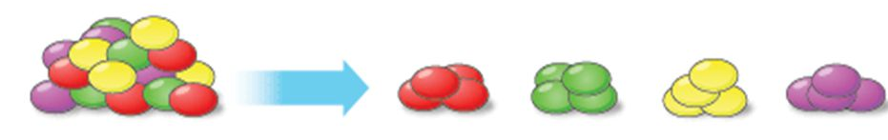
Glass Process

Slide 6
Glass Process (cont.)
Consumer Glass
Clean, whole 3D bottles / containers.
Single Stream
Container Stream
Very few whole bottles, mostly broken bottles, more broken glass.
Mostly whole bottles, many cracked bottles, some broken glass.
3D / 2D Separation
Collection

Slide 7
Glass Process (cont.)
Glass Breaker / Fine Screen
Glass is converted to >90% broken glass and removed from the stream.
Glass Cleanup System
Outbound Glass Pile
Glass and other small heavy objects w/ some small medium weight objects.
Both air and vibration- screening are used to remove lightweight material and fines.
Size Separation
Density Separation

Slide 8
Glass Process (cont.)
Glass Shipped to End Market
50% to 70% usable glass; fines (<1/4” or <3/8” depending on end market).
Usable glass sent to either a secondary processor, glass recycling company, or manufacturer.
Depending on market and region, fines are landfilled or have other beneficial use.
Freight

Slide 9
MRF Economics – Increasing Costs
18% of inbound recyclables are glass and 16% are contaminants
34% of MRF inbound materials have a net cost, not revenue.
Benefits of reducing contamination by 10% outweigh the cost of glass
Notes:
This is the average of the composition of recyclables at our single stream MRFs.
If you notice the two bright pieces of the pie in the lower left, you’ll see that glass makes up 18% of the material that we handle and residue is 16-19%.
We pay to get rid of this material at the back end of our facilities. So – for every 100 tons in to our MRFs, we are paying to get rid of 34 tons of material out the back end. For production facilities, that is not a receipt for success.

Slide 10
What’s in the Residue?

Slide 11
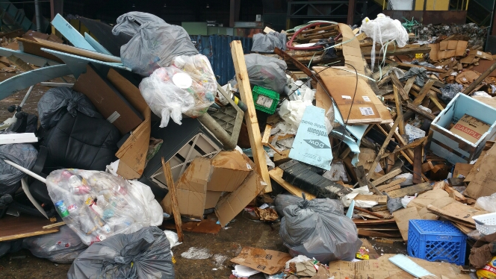
What’s in the Residue?

Slide 12
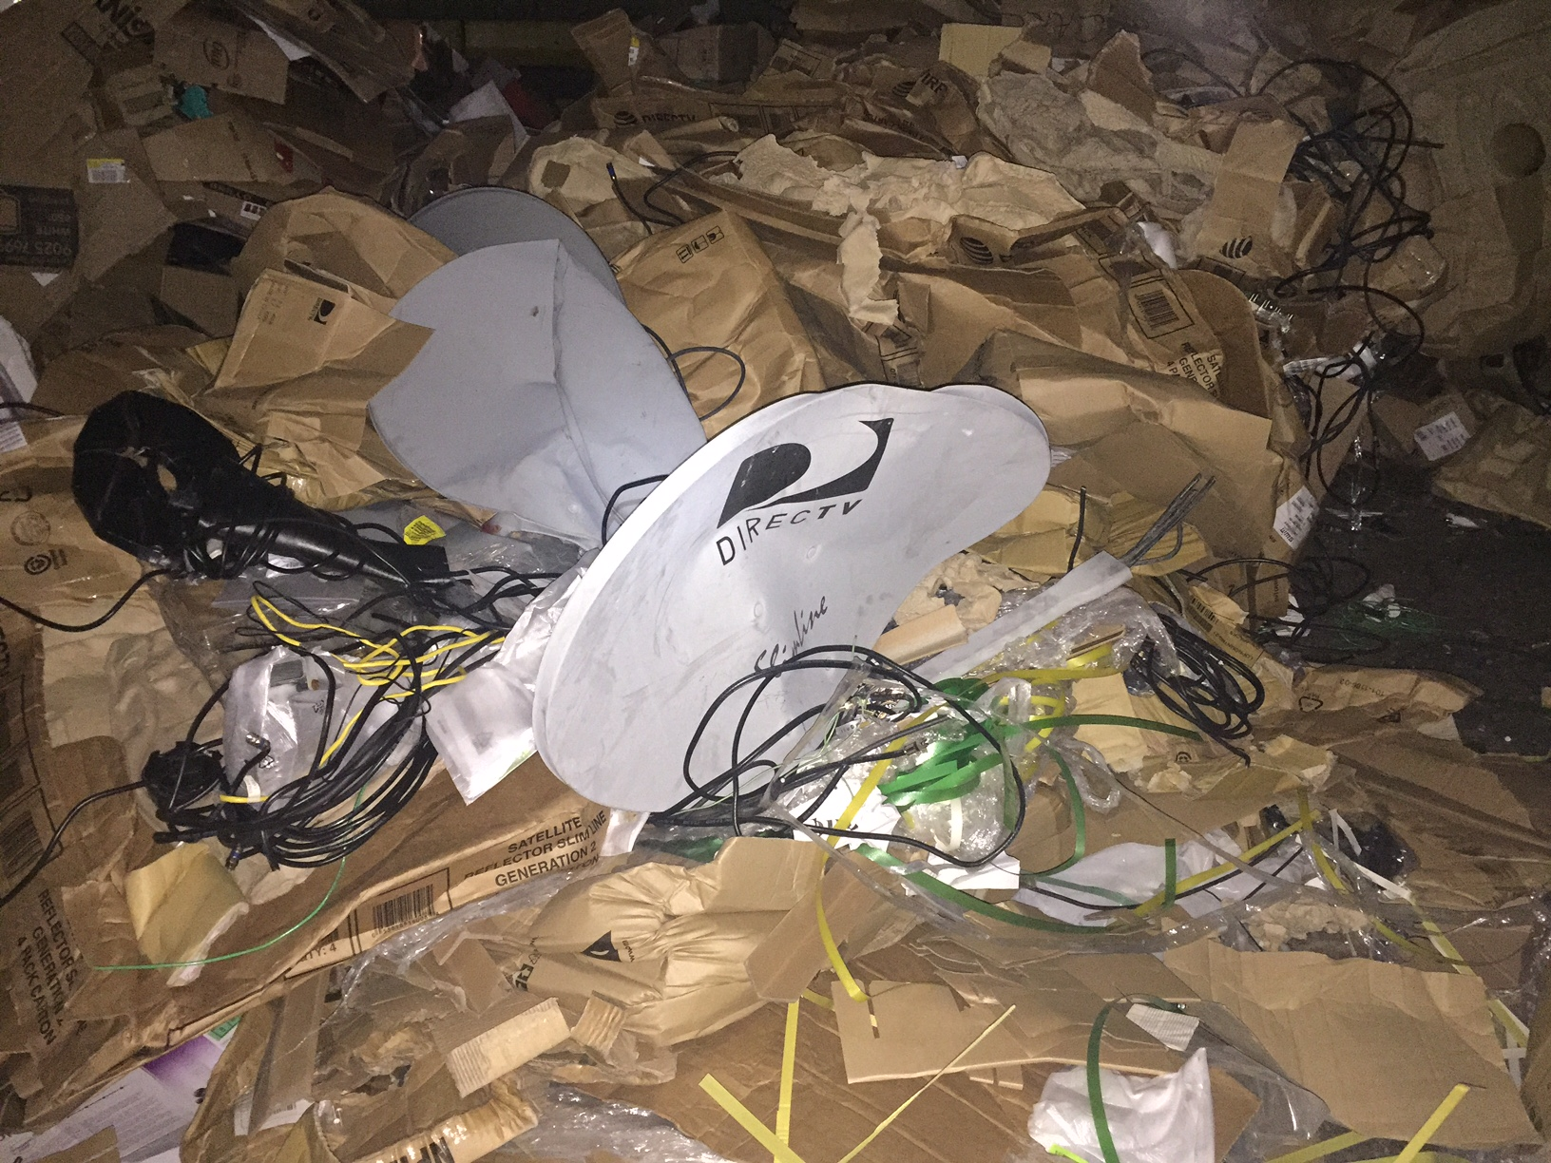
What’s in the Residue?

Slide 13
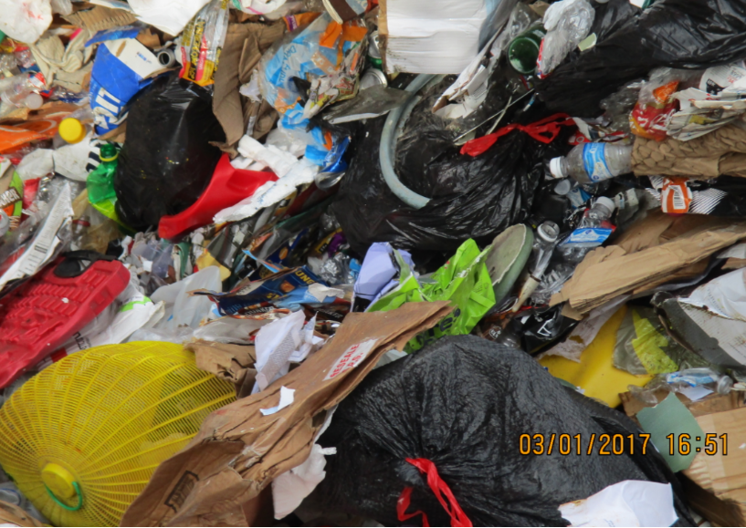
What’s in the Residue?

Slide 14
Glass Audit Results

Slide 15
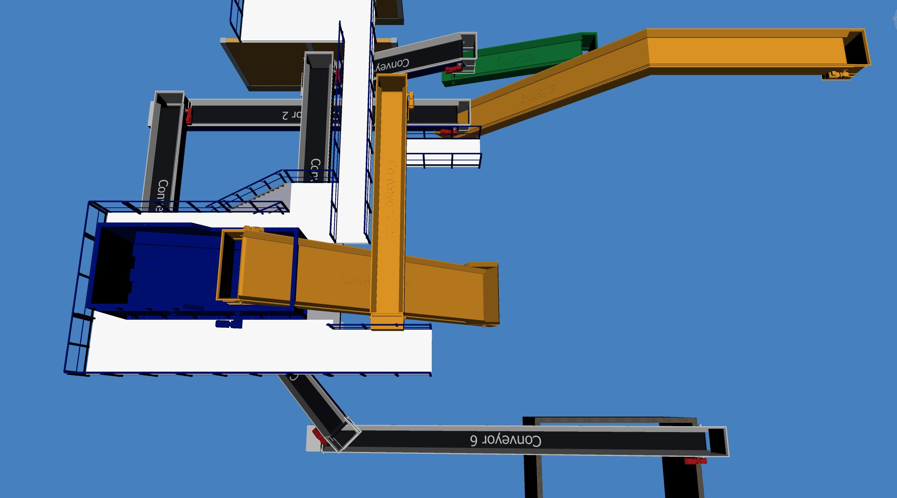
Further Investment

