Slide 1

Project Sponsor Workshop
Stephen Keen
Wednesday, May 15, 2024

Slide 2
Workshop Agenda
Regional Transportation Plan: Background (5 minutes)
RTP Project Development Process: Overview (25 minutes)
How to submit a project (15 minutes)
Coffee Break (~5 minutes)
RTP Goals: Data Application Presentations
  RTP Goal 1 (15 minutes)
  RTP Goal 2 (20 minutes)
  RTP Goal 3 (15 minutes)
  RTP Goal 4 (15 minutes)
  RTP Goal 5 (20 minutes)
Q/A Session (40 minutes)

Slide 3
Regional Transportation Plan (RTP) Background
Stephen Keen
Wednesday, May 15, 2024

Slide 4
RTP Background
The Regional Transportation Plan (RTP) is the long-range comprehensive plan for the region that guides major transportation investments over a 20+ year planning outlook.
The RTP is updated every four years, which includes a project list.
The RTP project list is:
  A reflection of the vision and goals of the most recent RTP;
  Fiscally-constrained;
  Subject to Air Quality Conformity Determination; and
  Approved by TPC.
Before the adoption of the RTP Project Development Process, H-GAC did not have a process which sole purpose was to add projects to the RTP.

Slide 5
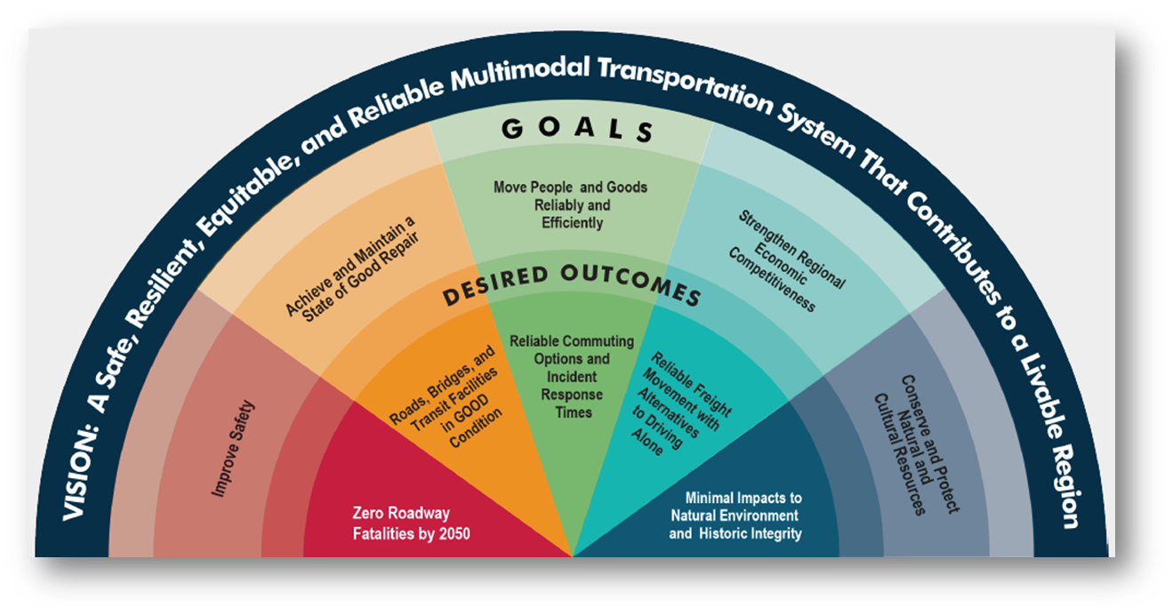
RTP Vision Statement, Goals, and Desired Outcomes
The vision statement defines the desired future transportation system for the region.
The goals are targeted achievable outcomes for the region, aligned with the vision.
The desired outcomes, along with associated performance measures, are used to understand the rate of progress toward each goal.

Slide 6
RTP Project Development Process
Purpose: Establish primary avenue to add projects to RTP.
  Project list that reflects and adheres to RTP Vision and Goals.
  Increase projects submitted and added to the RTP.
  Maximize planning efforts
    Once added to RTP, MPO Director and project sponsor collaborate to ensure project is on track to eventually be included in 10-Year Plan and TIP.
Project Development Process
  RTP
  Long-term projects (10+ years)
Project Selection Process
  TIP/10-Year Plan
  Short-term projects (0 to 10 years)

Slide 7
What is an RTP-Eligible Project?
An RTP eligible project must be 10 + years away from the letting year.
RTP eligible projects must be able to answer the following:
  Name, or Facility
  Description, or Scope of Work
  Limits
  Cost, or reasonable cost ranges
  Fiscal Year, or five-year band
  Adherence to RTP Goals
Project information can be estimated
  MPO does not expect exact information at this stage.

Slide 8
RTP Subcommittee Meeting Outcomes
May 2023 = RTP Subcommittee charged to guide process development.
June 2023 = Peer reviews with NP&EDC, NCTCOG, ARC, and SCAG.
July 2023 = RTP Subcommittee recommended development of process.
August 2023 = Discussed how to translate the vision and goals into process.
September 2023 = Draft proposal
October 2023 = Proposal feedback and key terms discussion.
November 2023 = RTP Subcommittee recommends proposal to Transportation Advisory Committee (TAC).
December 2023 = TAC addresses proposal and sends comments to Subcommittee
January 2024 = Response to comments from December TAC meeting.
February 2024 = Adoption of Process is Recommended by TAC.
February 2024 = Adopted by Transportation Policy Council

Slide 9

Regional Transportation Plan
Project Development Process: Overview
Stephen Keen
Wednesday, May 15, 2024

Slide 10
Step-by-Step
ACCESS: Online application opens.
SUBMISSION: Sponsor completes and submits individual project application.
EVALUATION: Projects are evaluated, scored, and verified based on application information only.
RECOMMENDATION: Staff will recommend projects be RTP-eligible or selected for further refinement.
PRESENTATION: Fiscally constrained RTP Project List and Illustrative List presented to TPC for approval.

Slide 11
Step 1: Access
Open Application Period – 60 days
    Open: May 22nd at 9:00 AM
    Close: July 22nd at 5:00 PM.
        WHY: Public outreach, administrative approvals, data gathering, and other necessary procedures.
    750-word limit for each response (H-GAC encourages concise responses)
Project list will update every two years
    Coordination with the Project Selection Process.
    Compliant with organizational Air Quality Conformity procedures.

Slide 12
Step 2: Submission
Applicant Information
  Name, email/phone number, organization
Project Name
Project Description/Scope of Work
Project Limits (Shapefile if available)
Project Cost, or Cost Ranges
Project Fiscal Year, or five-year band
Project Need
Project Desired Outcome
Documented public outreach
  Source of documented public outreach
  Explanation for no public outreach
Present in previous studies/plans
  If yes, name the study/plan with link and page number
  If no, how did this project come to be?
Regionally Significant
  If yes, explain how
RTP Goal(s) addressed
  Five Questions (one for each RTP goal)
  Provide verification information in form of data or narrative.

Slide 13
RTP Goal 1: Improve Safety
Question: Does your project improve safety within the transportation network?
Scoring
  Does it decrease transportation network fatalities?
  Does it decrease transportation network serious injuries?
  Other (please explain in narrative).
Verification Examples
  Data: Provide map that shows fatalities and serious injuries within the project limits.
  Narrative: Explain how this project improves safety within the transportation network.

Slide 14
RTP Goal 2: Achieve and Maintain a
State of Good Repair
Question: Does your project achieve and maintain a state of good repair?
Scoring
  Does it help achieve and maintain good condition for roads and/or bridges?
  Does it help achieve and maintain good condition of transit facilities and equipment?
  Other (please explain in narrative).
Verification Examples
  Data: Provide PASER or IRI Ratings.
  Narrative: Explain how this project will help achieve and maintain a state of good repair.
  Narrative: Complete Road Condition Form

Slide 15
RTP Goal 3: Move People and
Goods Reliably and Efficiently
Question: Does your project help move people and goods reliably and efficiently?
Scoring
  Does it improve or maintain travel time index?
  Does it decrease annual peak hours of excessive delay?
  Other (please explain in narrative).
Verification Examples
  Data: Calculate travel time index of current corridor.
  Narrative: Explain how the project decreases annual peak hours of excessive delay.

Slide 16
RTP Goal 4: Strengthen Regional and Economic Competitiveness
Question: Does your project help strengthen regional and economic competitiveness?
Scoring
  Does it improve or maintain truck travel time index (TTTR)?
  Does it offer alternatives to driving alone to combat traffic congestion on the roadway?
  Other (please explain in narrative).
Verification Examples
  Data: Calculate truck travel time index.
  Narrative: How does project help provide or encourage alternatives to driving alone?

Slide 17
RTP Goal 5: Conserve and Protect
Natural and Cultural Resources
Question: Does your project help conserve and protect natural and cultural resources?
Scoring
  Does your project avoid or mitigate impacts to natural or cultural resources?
  Does your project contribute to reduction of NOx, VOC, or GHG emissions?
  Other (please explain in narrative).
Verification Examples
  Data: Identify natural or cultural resources within 0.25 mi buffer of project limits.
  Narrative: Explain how this project conserves and protects natural and cultural resources within a 0.25 mi buffer of project limits.

Slide 18
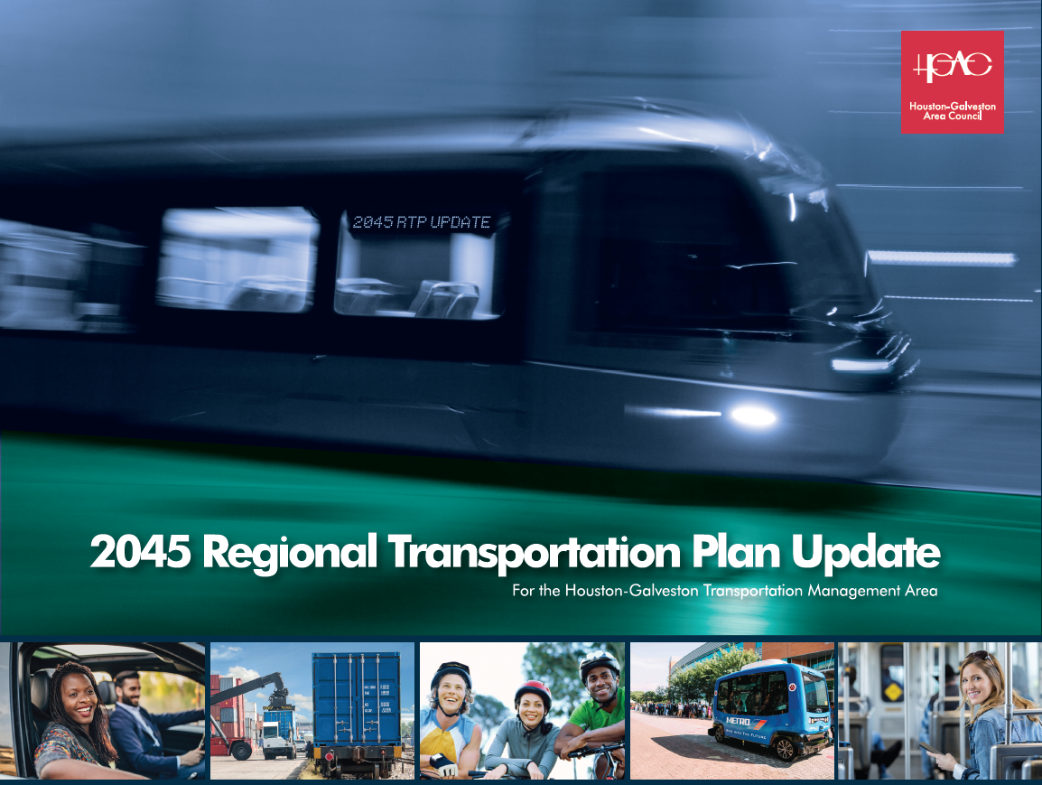
RTP Goals and Criteria
RTP Goal 1: Improve Safety
  Decrease transportation network fatalities
  Decrease transportation network serious injuries
  Other (Provide narrative)
RTP Goal 2: Achieve and Maintain a State of Good Repair
  Good conditions for roads and/or bridges
  Good condition of transit facilities and/or equipment
  Other (Provide narrative)
RTP Goal 3: Move People and Goods Reliably and Efficiently
  Improve or maintain travel time index
  Decrease annual peak hours of excessive delay
  Other (Provide narrative)
RTP Goal 4: Strengthen Regional and Economic Competitiveness
  Improve or maintain truck travel time index
  Offer alternatives to driving alone to combat traffic congestion
  Other (Provide narrative)
RTP Goal 5: Conserve and Protect Natural and Cultural Resources
  Avoid or mitigate impacts to natural and cultural resources
  Contribute to reduction of NOx, VOC, or GHG emissions
  Other (Provide narrative)

Slide 19
Step 3: Evaluation
Staff will have 60 days to evaluate projects.
Evaluations will be based solely on the project information submitted by the sponsor.
  Yes/No scoring. No numerical values will be assigned.
Submissions must successfully address at least three RTP Goals to be RTP-eligible.
  If a submission does not successfully address at least three RTP goals, they are not RTP-eligible.
Evaluator may flag submission if the project could significantly, negatively affect an RTP goal.
  Flagged submissions will be brought to project sponsor for review and/or adjustment before a recommendation is assigned.
Project sponsors will be notified of their project’s status after staff evaluation.

Slide 20
Step 4: Recommendation
Staff Evaluates Project
RTP Project List
List of fiscally constrained RTP eligible projects.
RTP-Eligible
These projects are evaluated as RTP-eligible.
Fiscal Constraint
The RTP-eligible list of projects will undergo fiscal constraint.
Illustrative List
List of RTP-eligible projects not included in the RTP Project list is developed, if necessary.
Refinement
Projects that need refinement are not RTP-eligible.
Fiscal Constraint: Demonstrate that RTP projects can be implemented using committed, available, or reasonably available revenues.

Slide 21

Step 5: Presentation
A draft RTP Project list will be produced after staff evaluation.
Fiscal constraint will result in a fiscally constrained RTP Project List.
The finalized project list will be brought to TAC/TPC for action.
The approved, finalized Project List will undergo conformity.
Once conformity is completed, the conformity documents will undergo state and federal review and approval.
Draft Project List
Fiscal Constraint
TAC/TPC Action
Air Quality Conformity Determination

Slide 22
Informational Slide: Regional Significance
Project sponsors will answer if their project is regionally significant during the application process.
“A project that is on a facility that serves regional transportation needs and would normally be included in the modeled area’s transportation network. This includes all principal arterial highways and all fixed guideway transit facilities that offer an alternative to regional highway travel. (23 CFR 450.104.).”
Examples include, but are not limited to, connecting:
  Major activity centers;
  Major planned developments such as retail malls, sports complexes, and employment centers;
  Intermodal transportation terminals;
  Rural population centers; and
  Key destinations within the region.

Slide 23
Informational Slide: Illustrative List
The Illustrative List includes projects that would be included in the Regional Transportation Plan if additional resources beyond those identified in the financial plan were to become available (2045 Regional Transportation Plan Update: Appendix F).”
An Illustrative List is developed if forecasted expenditures are more than expected revenues.
Projects on the Illustrative List are:
  Not fiscally constrained;
  Not placed on the modeled transportation plan;
  Not subjected to air quality conformity determination; and
  Not automatically added to the RTP project list if additional funds are identified.
If an Illustrative List is developed, it will be presented to TAC and TPC for approval as an official MPO project list.

Slide 24
Informational Slide: Air Quality Conformity Determination
Conformity demonstrates that projected emissions from transportation projects do not exceed the region’s motor vehicle emission budget.
For every new approval of the RTP project list (or TIP/10-Year Plan), MPO must demonstrate conformity.
Conformity to be completed every two years, which will allow:
  Biennial updates to the project lists for the TIP, 10-Year Plan, and RTP;
  Aligns scheduling of RTP Project Development Process and Project Selection Process; and
  Allows further planning efforts that will be coordinated with conformity dates.

Slide 25
Closing Points
Slides and recording of presentation will be available on H-GAC’s website after workshop.
Project sponsors may submit applications starting May 22nd at 9:00 AM.
  The online portal will close on July 22nd at 5:00 PM.
We are here to work with you!
Contact Information
    Stephen Keen
    stephen.keen@h-gac.com
    713–993-4574

