Slide 1
Item 11: Safety Performance Measures and Proposed Measures
.

Slide 2
Background
The Houston-Galveston Area Council and Texas Department of Transportation are required to annually submit safety performance measures to the Federal Highway Administration.
  The MPO supports the State’s Safety Performance Measures.
The five safety performance measures are listed below:
  Number of Fatalities
  Rate of Fatalities (per 100 million vehicle miles traveled)
  Number of Serious Injuries
  Rate of Serious Injuries (per 100 million vehicle miles traveled)
  Number of non-motorized fatalities and serious injuries

Slide 3
2024 Performance Proposed Measures v. Actuals
Measure | 2024 Proposed Measures | 2024 Actuals
Fatalities | 765 | 767
Fatality Rate | 1.25 | 1.15
Serious Injuries | 3,911 | 4,099
Serious Injury Rate | 6.41 | 6.15
Non-motorized fatalities and serious injuries | 764 | 821

Slide 4
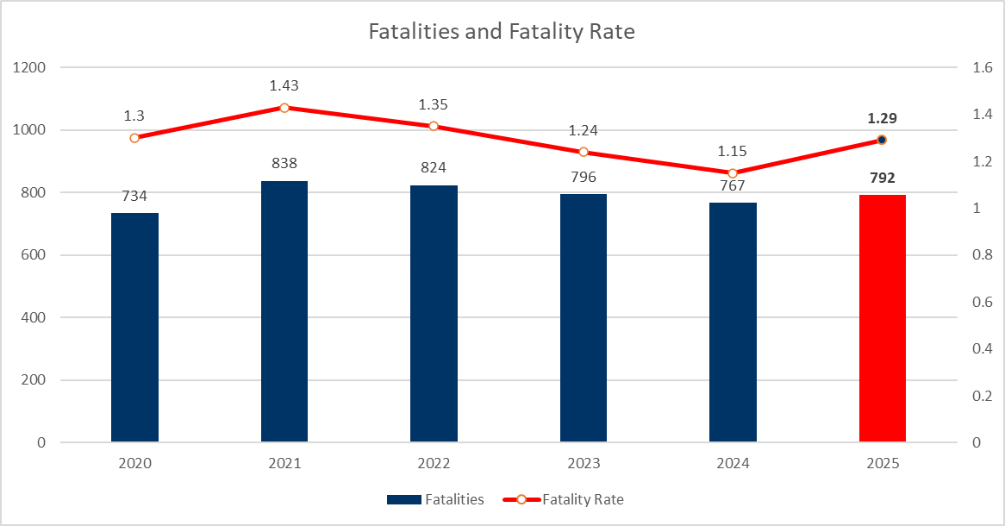
Fatalities

Slide 5
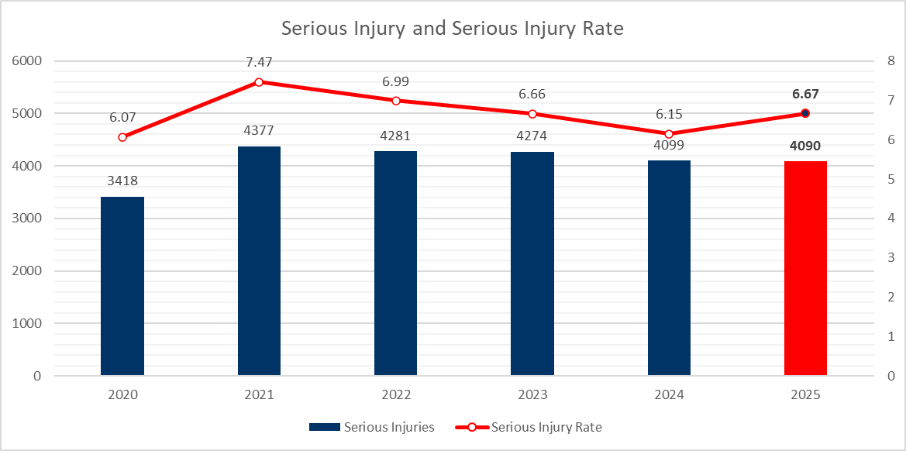
Serious Injuries

Slide 6
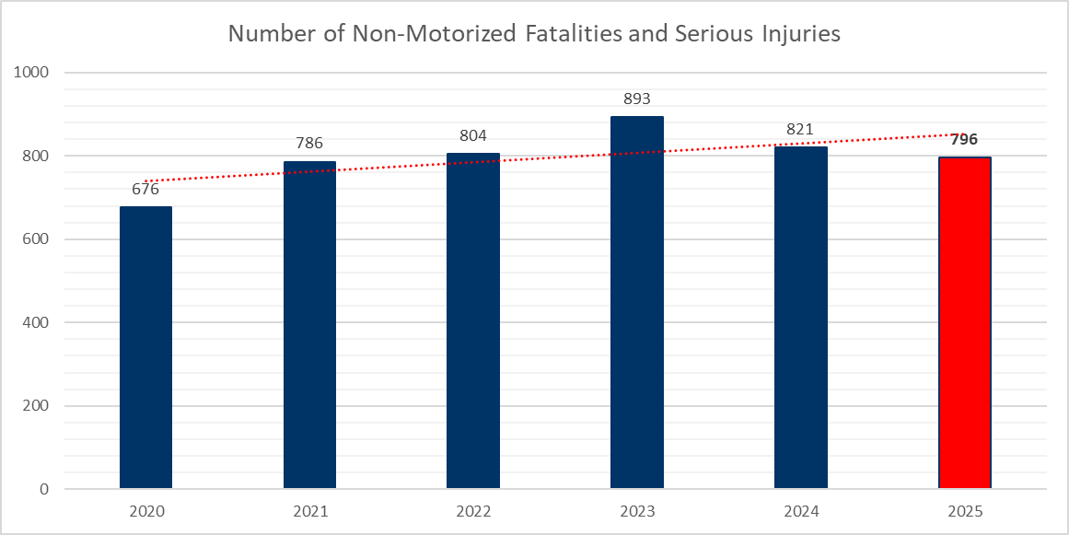
Non-Motorized Fatalities and Serious Injuries

Slide 7
2025 Performance Proposed Measures
Measure | Targets
Fatalities | 792
Fatality Rate | 1.29
Serious Injuries | 4090
Serious Injury Rate | 6.67
Non-motorized fatalities and serious injuries | 796

Slide 8
What are we doing? What do we plan to do?
Current
Transportation Safety Committee
Tow and Go
$30m annual safety project funds
Vision Zero Policy
Road Safety Audits (RSAs)
ITS Architecture Update
Hurricane Evacuation
Safety programs
  Regional Safety Campaign
  Teen Driver Safety
  Youth Traffic Safety
Going Forward
Safety Action Plans
State of Safety Report Revamp
Congestion Management Plan
2050 Regional Transportation Plan
Safety Updates to TAC/TPC

Slide 9
Questions/Comments
Stephen Keen
  Senior Planner
  stephen.keen@h-gac.com
  713-993-4574
Notes:
Again this is for information only. Here is my contact information if you have any questions or need more information.

