Slide 1
Recycling Glass
Our single stream challenge

Slide 2
Agenda
Who is Strategic Materials?
Why glass?
Our challenge
How can we do better together?
Current drop off activity in Houston

Slide 3
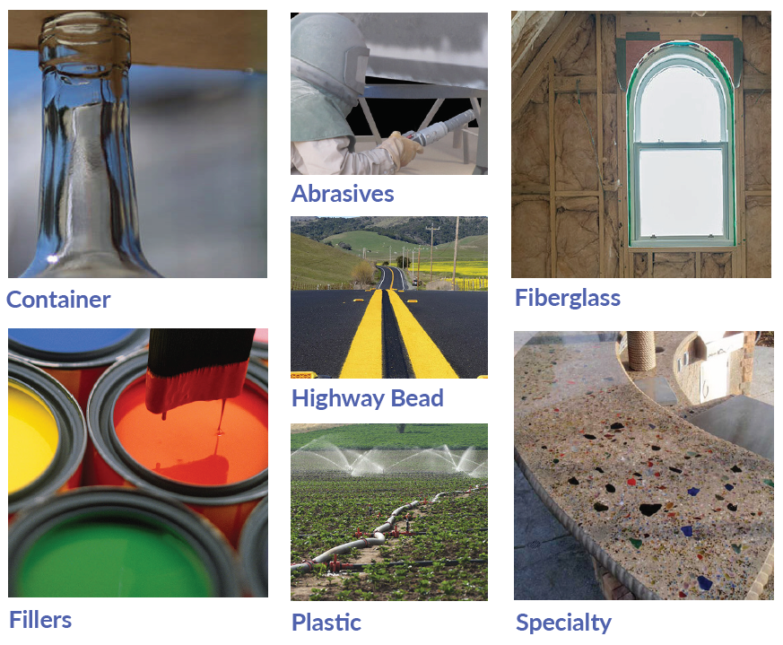
Strategic Materials
Markets Served
We are the largest glass recycler in North America, with 50 plants.
With over 100 years of experience, we are a recycling market leader for glass and plastics.
The markets we serve with our recycled glass helps to reduce manufacturing costs and improve sustainability.

Slide 4
Strategic Materials
Supplier Services
When you work with Strategic Materials, our experts can work with you to assess your operations and develop areas of improvement such as:
  new site construction suggestions to maximize value
  quality improvement suggestions to maximize value
  handling suggestions (i.e. spotted equipment, containers)
  improvement financing
  training

Slide 5
Strategic Materials
Service Detail
  Want to become a supplier? Greg Vargas, gvargas@strategicmaterials.com, 713-795-9800
  General inquiries and customer service for existing suppliers or receiving at Houston , TX plant: Greg Vargas; gvargas@strategicmaterials.com or 713-795-9800
  All other inquiries or if you’re unable to contact any of the above, please use our toll-free 1-844-256-8985 or suppliers@strategicmaterials.com. Phone is answered Monday through Friday, 7:00am - 4:00pm CST and any voicemails are typically returned within 24 hours.

Slide 6
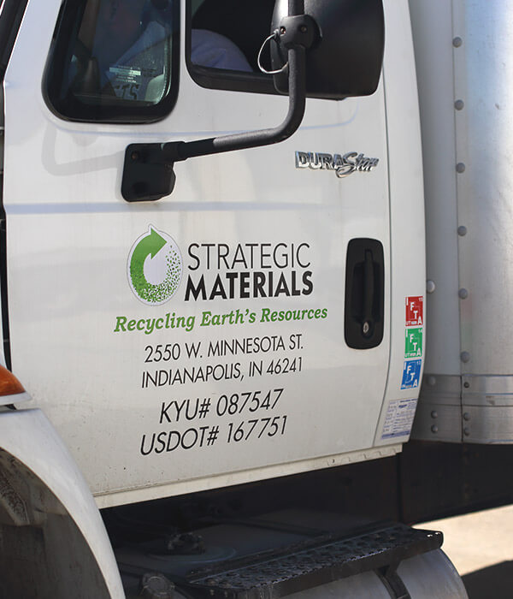
Why Glass?
We recycle nearly 3 million tons of glass a year into a variety of applications.
Recycled glass demand is more than current supply in the container glass and fiberglass insulation industries.

Slide 7
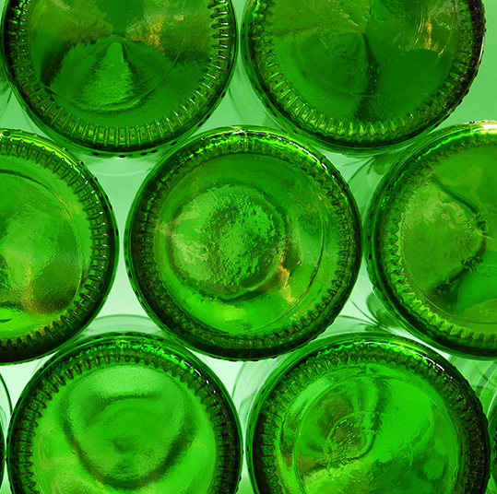
Why Glass?
It is a sustainable, versatile, cost-saving material.
Glass never wears out and can be recycled forever.
One 6-pack of recycled beer bottles produces enough fiberglass insulation to fill a standard wall cavity.
Recycling glass takes 30% less energy to produce glass from virgin materials. Recycling one glass bottle saves enough energy to light a 100-watt light bulb for 4 hours.

Slide 8
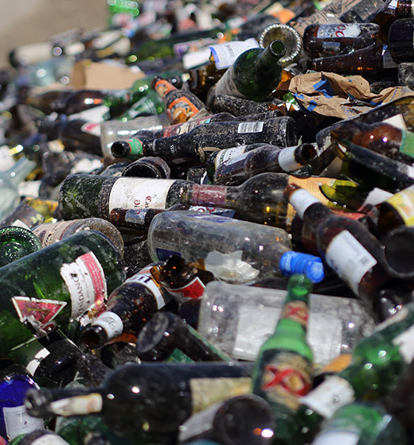
Testing Protocols
We perform inbound quality inspections on every load and rate them based on the percentage of usable glass, generally clean glass with minimal or no visible contamination, and amount of ceramic, rock, or color contamination.
Our delivery inspection is either by:
  Visual inspection - in the case of Mixed Window Plate (MWP), Clear Window Plate (CWP), whole or 3-dimensional flint, amber, green or mixed color or
  Sample analysis - in the case of 3 Mix (single stream) glass from a Material Recovery Facility (MRF)

Slide 9
Pricing
Better supply = Better pricing
Our pricing for incoming glass is now tied to the quality of the supply. Key factors that drive processing:
  Non-Glass Residue % and local landfill rates
  Undersize %, plant capabilities and local disposal options
  Significant variance from these color percentages may reduce or increase the value of cullet stream.
Color | Description | Examples | Normal Target
Amber | Brown container glass | Beer bottles | 80% |20% other glass
Flint | Clear container glass | Food and beverage bottles | 95% | 5% other glass
Emerald Green (and Others) | Various shades of green, blue, and other | 7up, Sprite green, wine bottles, blue bottles | 60% | 40% other glass
3-Mixed glass | Brown container glass, clear container glass, and shades of green or blue | Beer bottles, beverage bottles, wine bottles | 50% amber, 30% flint, 20% emerald green
Single Stream | Curbside, MRF glass | Post-consumer food or beer bottles, other recyclables | 78% glass, all colors 10% non glass residuals 12% undersize

Slide 10
Glass Specifications
3-MIX Single Stream Specification
Criteria | Description | Examples | Target
NGR | Non-Glass-Residual found in municipal recycling program | Paper, Plastic, Aluminum, steel | 10% Maximum
U/S | Undersize Glass particles < 3/8” (or < 1/4”*) | Mixed color glass particles | 12% Maximum
Other Criteria |  |  | Target
Ceramics | Broken bits of household ceramic | Dinner plates, mugs, cups | 2% Maximum
Color | Flint, Amber, Green(s) & other | Food containers, beer bottles, wine/ soda bottles | 20-50%
Moisture | Excessive water mixed with glass** | Rain, snow, ice | 5% Maximum
Excluded Waste | Other, possibly hazardous waste | Any glass ceramic blends, such as PyroCeram or Neoceram, mirror, leaded glass or any CRT glass, batteries, medical waste, or any radioactive, volatile, corrosive, bio-hazardous, toxic, or hazardous material as defined by applicable law | 0% (Zero
Industry specifications are a key component of our business. It is critical that our product meet or exceed the standards set by each of our manufacturing clients. Want to supply glass for our markets? Learn more about their specifications:
* Undersize target depending on plant’s capabilities
**See Additional Description in Moisture Definitions above
WARNING: Excluded Waste is NOT acceptable and is subject to immediate rejection. Examples: batteries, needles, corundum, quartz glass, gypsum, desiccants, and all types of grinding media

Slide 11


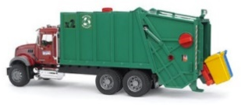
The Single Stream Challenge
As recycling becomes more prevalent in American households, the amount of single stream glass material has become a larger part of our supply base. We perform a sample analysis of the material for to determine glass content and undersize, ceramics, moisture and hazardous wastes. This allows us to most accurately price the incoming material, giving each supplier a pricing matrix, based on glass content.
Pricing Matrix
Based on quality
SUPPLIER
Raw Material
Processing
Sorting
Final Product
{
{
More non-glass material yields increased disposal costs
Separating glass from non-glass items requires more equipment and more processing time.
More glass is unrecoverable and color sorting is less accurate.
Final product has unintended glass loss and must also meet stringent specifications.
Cost Drivers
CUSTOMER
SPECIFICATIONS
Allowable ceramic levels have been lowered by as much as 50%.
Allowable green (emerald) glass levels in amber (brown) mixes has been lowered significantly.

Slide 12
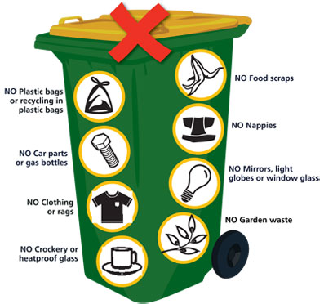
How Can We Do Better?
There are several ways to improve the cleanliness of recycled glass from single sort recycling:
Educate residents through social media or website about what is acceptable to recycle
Improve or develop regular maintenance practices for MRF equipment
Invest in new or upgrade equipment

Slide 13
We believe recycling glass is viable and should continue to be a part of city recycling programs.
Glass never wears out. Demand for recycled glass products continues to be high. Our glass recycling business employs nearly 1,200 people in North America.

Slide 14
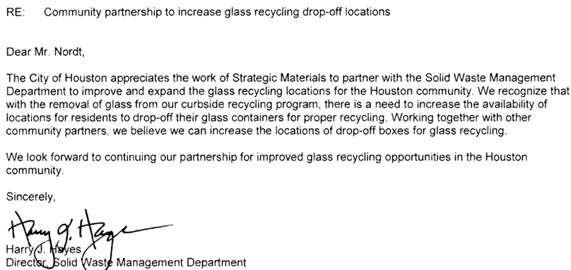
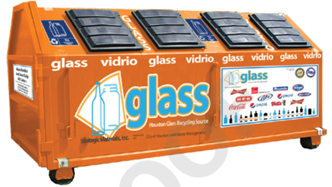
2016 Announcement: Houston- SMI Partnership in Increasing Glass Recycling

Slide 15
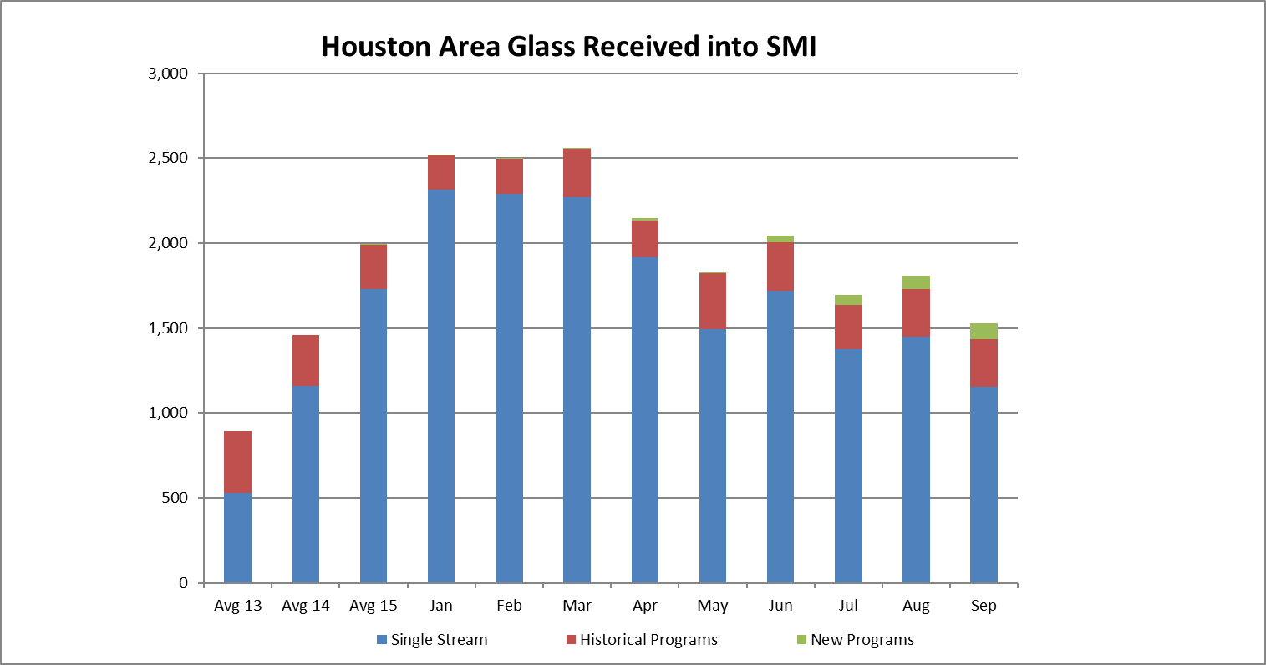
View of Total Volumes of Glass From Houston Area

