Slide 1
iRecycle Glass
H-GAC Regional Recycling Roundtable
February 23, 2017
Filling a void for glass collection
www.irecycle.glass

Slide 2
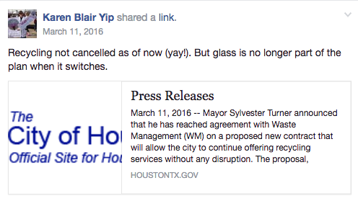
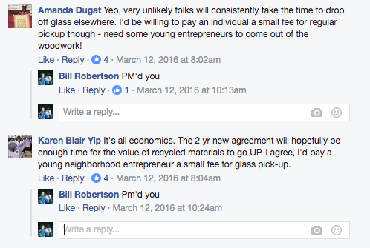
Neighbor
Neighbor
Neighbor

Slide 3
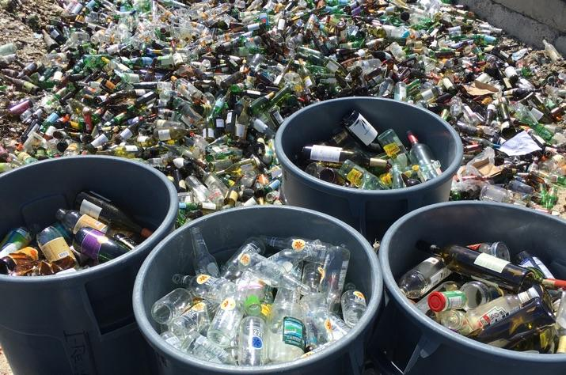
Market research
Who
What
Where
When
Why
How
Notes:
Appropriate pricing?
Are there enough people interested in this?
Would this be profitable?
Who else has already had this problem?
How would we get the glass recycled?
Is there a net energy gain from doing this?
Is this the best approach (e.g., relative to one bin for all)?

Slide 4
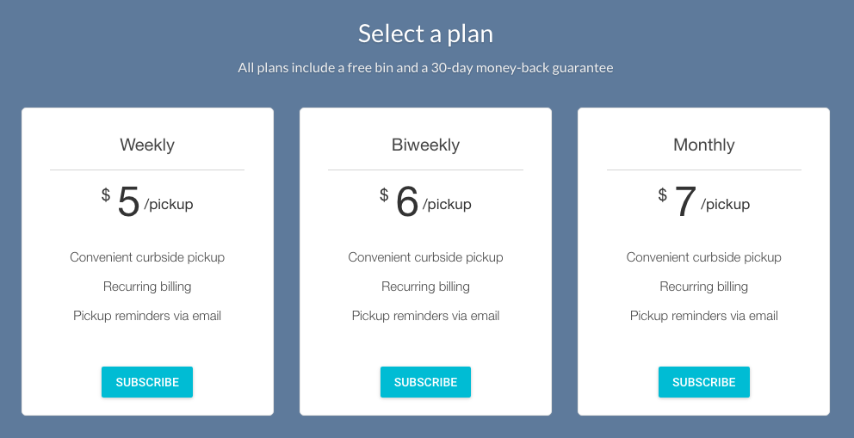

Slide 6
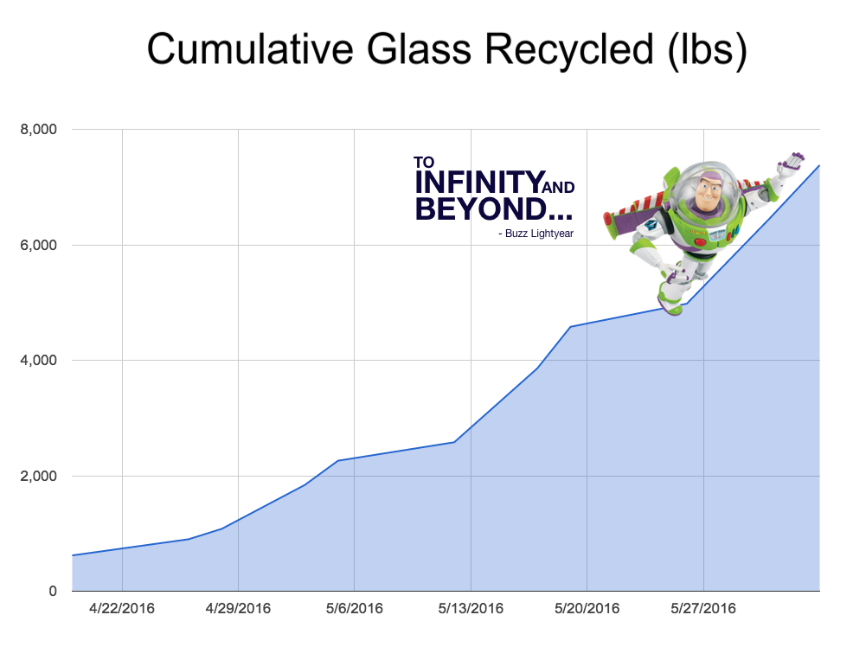

Slide 7
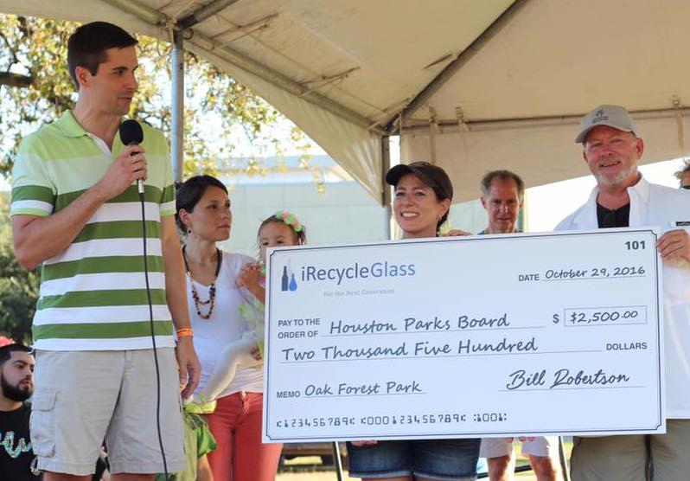
(Almost) Year in Review
Acquired over 650 customers
Collected over 110,000 lbs. of glass
Partnered with Discovery Green
Raised $2,500 for Oak Forest Park

Slide 8
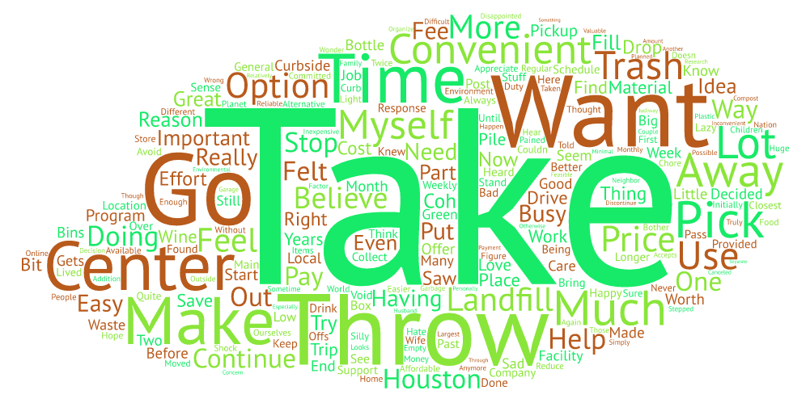
Why did this work?

Slide 9
Thank you
www.irecycle.glass
support@irecycle.glass
713-255-8374

