Slide 1
2023 Multijurisdictional Hazard Mitigation Plan Update
Liberty County
Public Meeting
September 2023

Slide 2
Meeting Agenda
Introductions
Overview
Planning Process
Timeline
Data Gathering Exercises
Notes:
Our meeting agenda for today:

Slide 3
Introductions
WHO AM I?
Amanda Ashcroft, AICP
Planner at H-GAC within the Community & Environmental Planning Department
Hazard Mitigation Planning Committee
Members Present- Introductions
(Name, Title, Jurisdiction represented)
Last Plan
FEMA approval: 11/6/2018
Expires: 11/5/2023
New FEMA Policy updates

Slide 4
Overview
What is a natural hazard?
naturally occurring event vs. man-made
destructive or negative impact on health, safety, life, and/or property
WHAT IS MITIGATION?
Steps, or actions, taken by the public, municipal leadership, or private entities to reduce the negative impacts
Hazard mitigation is any sustainable action that reduces or eliminates long-term risk to people and property from future disasters.
Mitigation Action Examples
Removing property or infrastructure from the hazard areas (elevation and acquisition)
Assisting and supporting naturally occurring resilient areas (wetlands, dunes, reefs)
Hardening the built environment (seawalls, electrical micro grids, hurricane straps)
Strategic planning (building codes, zoning restrictions, higher standards)

Slide 5
Overview- Funding
Federal funding
Hazard Mitigation Grant Program (HMGP)
Flood Mitigation Assistance (FMA)
Pre-Disaster Mitigation Grant Program (PDM)
Building Resilient Infrastructure and Communities (BRIC)
Buyout Program Implementation/Residential Elevations
Residential and Commercial Floodproofing
Flood Control Projects
Coastal Resilience
Nature Based Solutions
Infrastructure and Utility Hardening
Hazard Mitigation Grant Program- Post Fire
Notes:
HMGP-FEMA’s Hazard Mitigation Grant Program provides funding to state, local, tribal and territorial governments so they can develop hazard mitigation plans and rebuild in a way that reduces, or mitigates, future disaster losses in their communities. This grant funding is available after a presidentially declared disaster. In this program, homeowners and businesses cannot apply for a grant. However, a local community may apply for funding on their behalf.
All state, local, tribal and territorial governments must develop and adopt hazard mitigation plans to receive funding for hazard mitigation project application. Rebuilding my community after a major disaster in a way that reduces future disaster losses.
FMA- Flood Mitigation Assistance is a competitive grant program that provides funding that can be used for projects that reduce or eliminate the risk of repetitive flood damage to buildings insured by the National Flood Insurance Program. Reducing the risk of flood damage to NFIP-insured buildings.
PDM- The Pre-Disaster Mitigation (PDM) grant program makes federal funds available to plan for and implement sustainable cost-effective measures designed to reduce the risk to individuals and property from future natural hazards, while also reducing reliance on federal funding from future disasters. The program is authorized by Section 203 of the Stafford Act.
BRIC- Building Resilient Infrastructure and Communities (BRIC) will support states, local communities, tribes and territories as they undertake hazard mitigation projects, reducing the risks they face from disasters and natural hazards.
The BRIC program guiding principles are supporting communities through capability- and capacity-building; encouraging and enabling innovation; promoting partnerships; enabling large projects; maintaining flexibility; and providing consistency. Helping my community reduce risks from future disasters and natural hazards.
HMGP Post Fire- Making my community more resilient after a wildfire disaster.

Slide 6
Overview- Why are we here?
Public participation and feedback are vital parts of the hazard mitigation planning process!
What can I do to stay involved?
Attend meetings
Provide data
Identify Natural Hazards
What hazards have impacted your community?
Where do hazards have the most destructive or negative impact on health, safety, life, and/or property within your community?
Locate assets, infrastructure, at-risk communities
What tools do you have to support your community through disasters?
What tools do you need?
Identify what we can we do in the future to be more resilient!
Break the disaster cycle!

Slide 7
Who Else Can We Reach Out To?
Businesses
Academia
Private Organizations
Nonprofit Organizations
Community-based Organizations
Entities that provide support to underserved communities and socially vulnerable populations
“Community Lifelines”

Slide 8
Community Lifelines
Notes:
Definition
A lifeline enables the continuous operation of critical business and government functions and is essential to human health and safety or economic security. If you think a certain community lifeline that needs to be at these meetings, Let us know! We WILL invite them!

Slide 9
Planning Process
Hazard
Mitigation
Plan
Notes:
Organize- This is where we focus on assembling the resources needed for a successful mitigation planning process. This includes securing technical expertise, defining the planning area, and identifying key individuals, agencies, neighboring jurisdictions, businesses, and/or other stakeholders to participate in the process. The planning process for local and tribal governments must include opportunities for the public to comment on the plan.
2. Assess Risks
Next, the state, local, tribe, or territory government needs to identify the characteristics and potential consequences of hazards. It is important to understand what geographic areas each hazard might impact and what people, property, or other assets might be vulnerable.
The four basic components of a risk assessment are:
Hazard identification;
Profiling of hazard events;
Inventory of assets; and
Estimation of potential human and economic losses based on the exposure and vulnerability of people, buildings, and infrastructure.
3. Develop a Mitigation Strategy
The state, local, tribe, or territory government then sets priorities and develops long-term strategies for avoiding or minimizing the undesired effects of disasters. The strategy is based on an assessment of the unique set of regulatory, administrative, and financial capabilities to undertake mitigation.
The mitigation strategy also includes a description of how the mitigation actions will be implemented and administered.
4. Adopt and Implement the Plan
Once FEMA has received the adoption from the governing body and approved the plan, the state, local tribe, or territory government can bring the mitigation plan to life in a variety of ways, ranging from implementing specific mitigation actions to changing aspects of day-to-day organizational operations. To ensure success, the plan must remain a relevant, living document through routine maintenance. The state, tribe, or local government needs to conduct periodic evaluations to assess changing risks and priorities and make revisions as needed.
MUST be updated every 5 years

Slide 10
Timeline
 | March | April | May | June | July | August | Sept. | Oct. | Nov.
Kickoff Meeting
Risk Assessment |  | HAZUS
Capability Assessment
Public Input Workshop/ Events |  |  |  |  |  |  | We are Here |  | #2
Mitigation Action Plan Workshop
Plan Drafting
Review Final Draft
Plan Adoption
Submit Plan to State & FEMA
Notes:
And here is our updated project timeline, which is subject to change.

Slide 11
Data Gathering Exercises
Stations around the room
Instructions at each station
HMP Committee members and H-GAC staff are available to answer your questions
Online survey- Still open

Slide 12
How can I stay Informed?
www.h-gac.com/regional-hazard-mitigation-planning

Slide 13
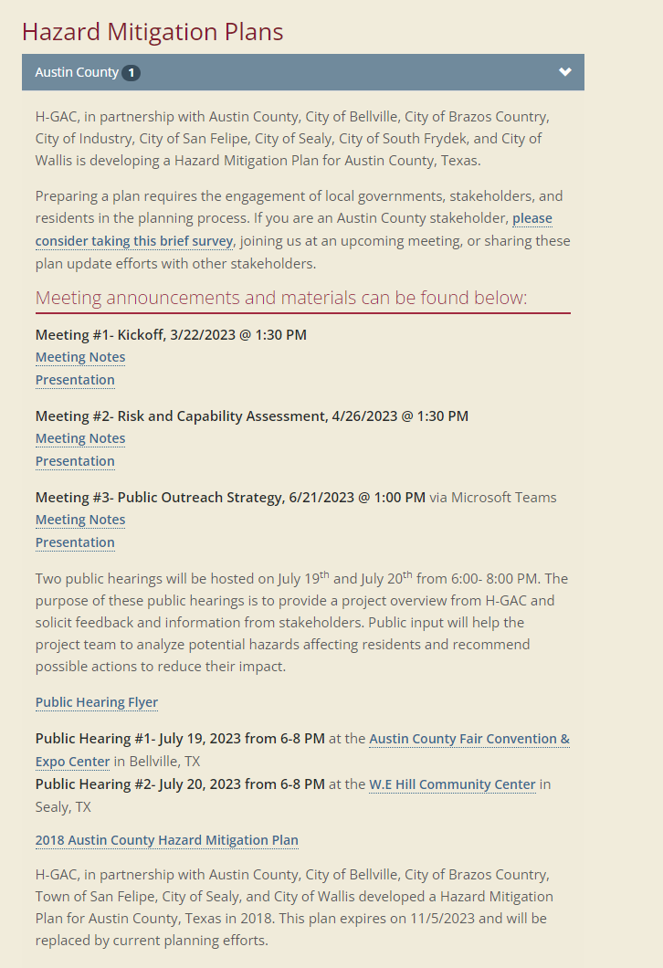

Slide 14
Contact Information
Amanda Ashcroft, AICP
Planner, Community & Environmental
Houston-Galveston Area Council
Amanda.Ashcroft@h-gac.com
713-993-4545

