Slide 1
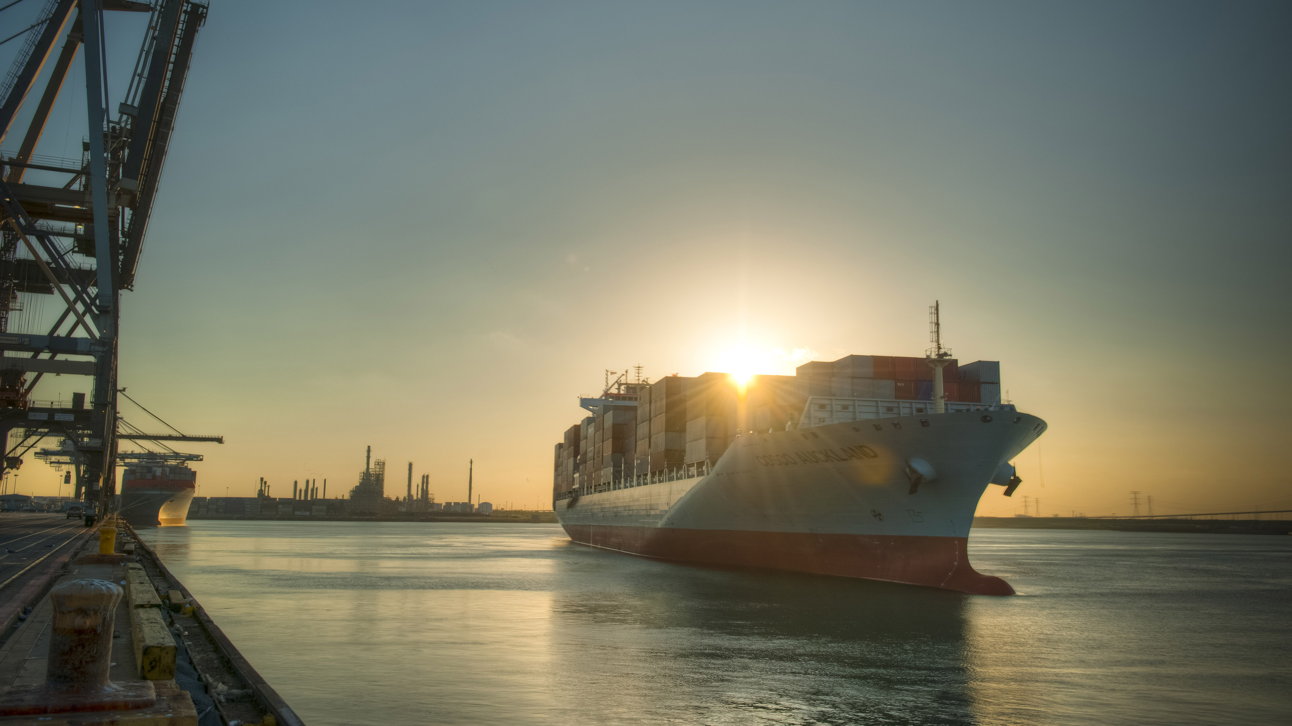
H-GAC Brown Bag Lunch
Houston's Resin Export Dominance Jordan Frisby, Port Houston, September 16 2019

Slide 2
Topics
1
Resin Production
2
Resin Export Volume
3
Resin Export Logistics
4
Port Houston Overview

Slide 3
1 Resin Production
Topic 1
Resin Production

Slide 4
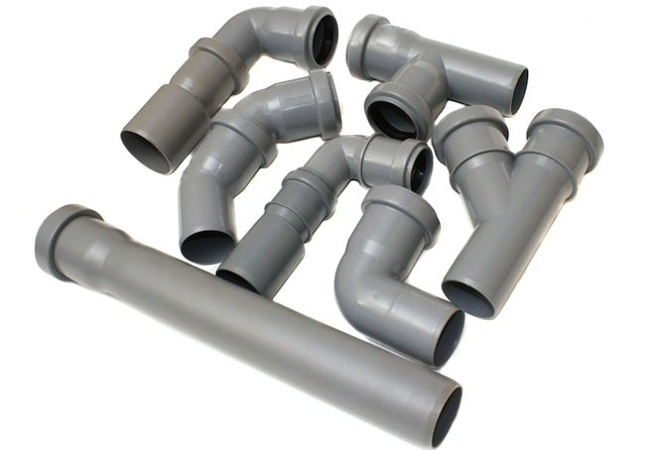
1 Resin Production
PE Polyethylene
PVC Polyvinyl Chloride
PP Polypropylene
Others

Slide 5
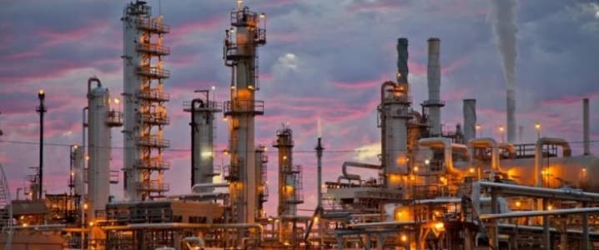
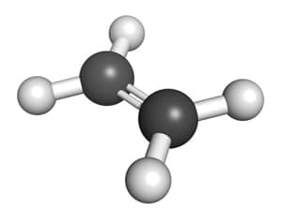
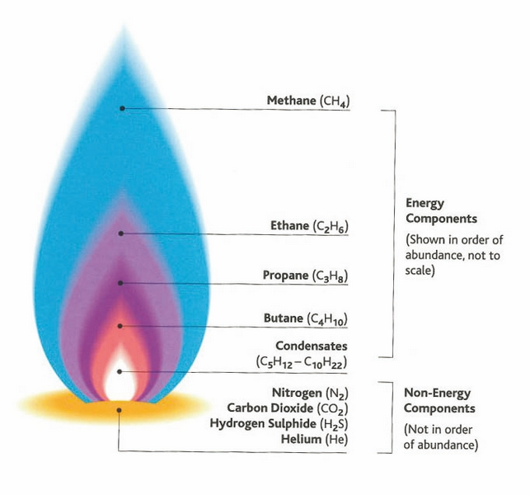
1 Resin Production
Oil Refining
Cracker
Naphtha
Cracking
Ethylene
NGLs (Natural Gas Liquids)
Ethane Cracking

Slide 6
1 Resin Production
Ethylene
Plastics Plant
Polyethylene
Polymerization

Slide 7
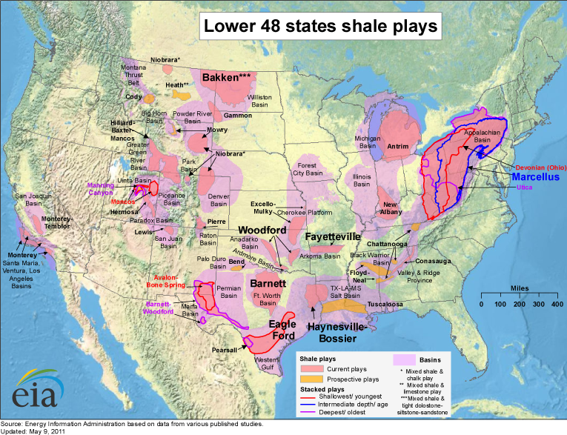
1 Resin Production

Slide 8
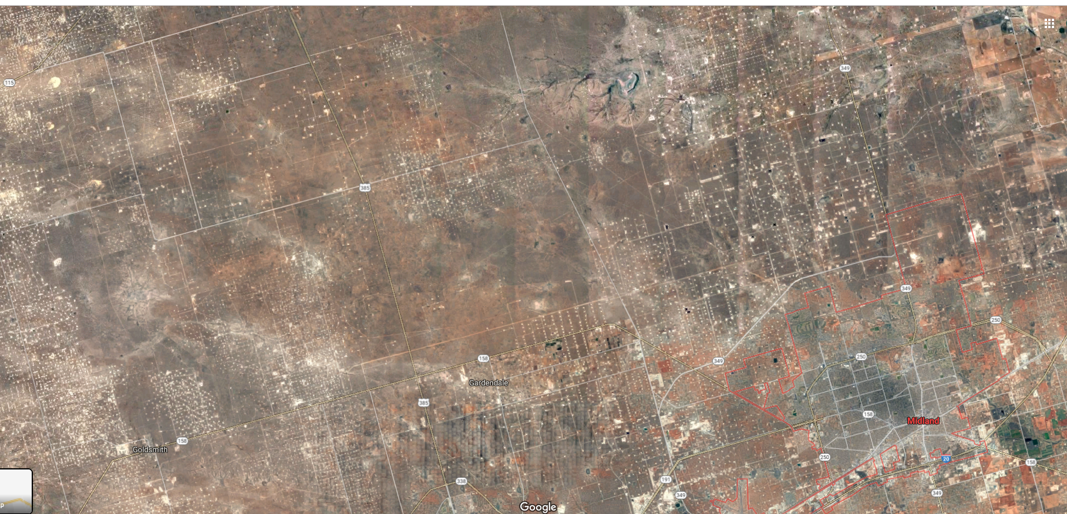
1 Resin Production

Slide 9
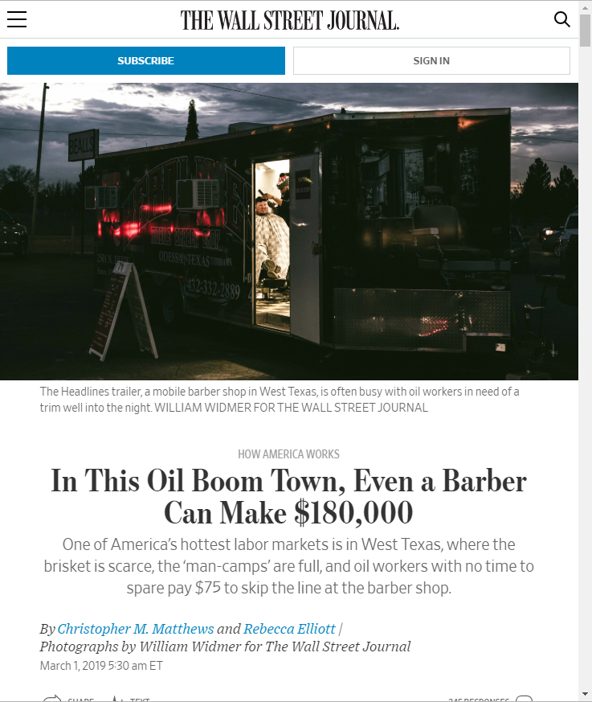
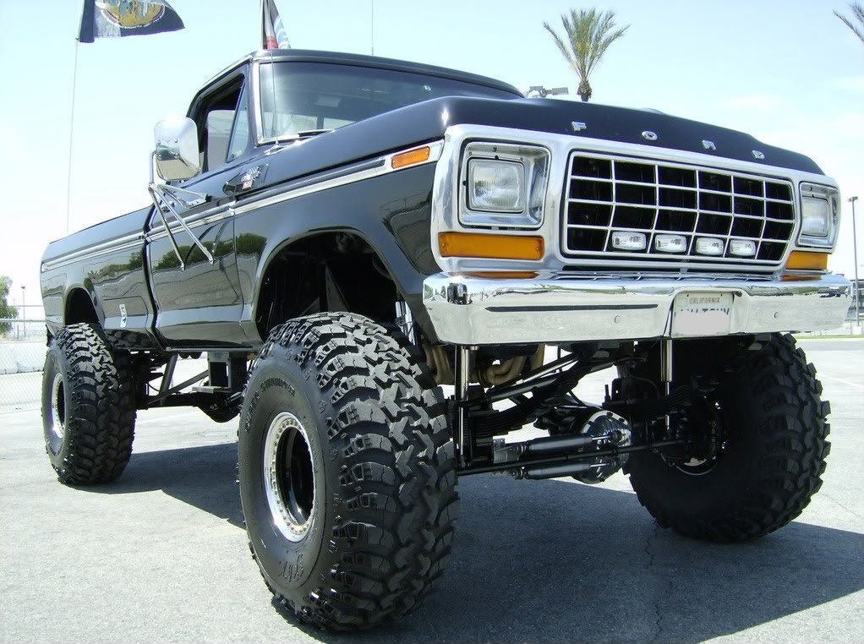
1 Resin Production

Slide 10
1 Resin Production

Slide 11
1 Resin Production
New US Gulf Coast PE plants and online dates
Owner | Location | Online Date
CP Chem | Brazoria County TX | 2017
Dow | Freeport TX | 2017
Exxon | Mont Belvieu TX | 2017
Exxon | Mont Belvieu TX | 2017
IneosSasol | La Porte TX | 2017
Dow | Plaquemine LA | 2018
Dow | Taft LA | 2018
Dow | Freeport TX | 2018
Owner | Location | Online Date
Sasol | Lake Charles LA | 2019
Formosa | Victoria TX area | 2019
Exxon | Beaumont TX | 2019
Lyondell | La Porte TX | 2019
Sasol | Lake Charles LA | 2019
Exxon/Sabic | Corpus TX area | 2022
Total | Bayport TX | 2022
Dow | TBD Gulf Coast | 2022
Formosa | TBD Louisiana | 2024
Formosa | TBD Louisiana | 2030
Dates are approximate. Consult an industry source for exact information

Slide 12
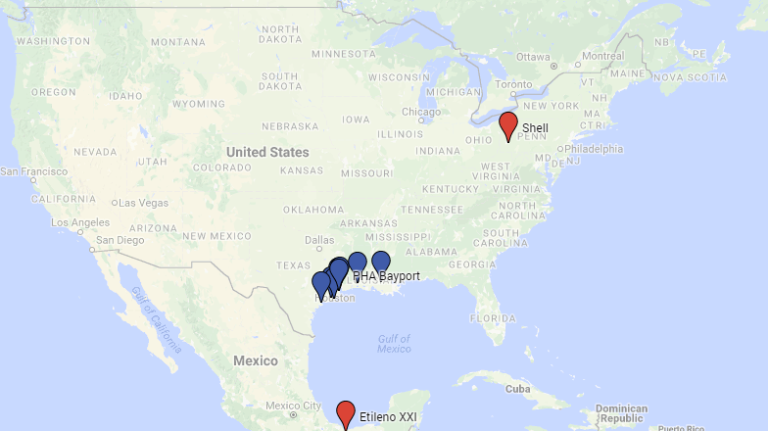
1 Resin Production
New US PE plant locations
Port of New York
Port of Norfolk
Port of Charleston
Port of LA /
Port of Long Beach
Port of Savannah
Port of New Orleans
Port of Houston
Port Freeport

Slide 13
2 Resin Export Volume
Topic 2
Resin Export Volume

Slide 14
2 Resin Export Volume

Slide 15
2 Resin Export Volume

Slide 16
2 Resin Export Volume

Slide 17
PE export routing depends on destination region
2 Resin Export Volume

Slide 18
Polyethylene is a key national export
2 Resin Export Volume
US Total PE Export: $10.1 billion
Total US Export of Goods: $1.7 trillion
Total US Trade Deficit in Goods: $891 billion
2018 values

Slide 19
3 Resin Export Logistics
Topic 3
Resin Export Logistics

Slide 20
US Polyethylene export logistics
3 Resin Export Logistics
PE Plant
Packager/ Bagger
Truck
Seaport
Ship
Rail
Truck
Railcar
World Market
NAFTA Market
65%
of US PE Export in 2018
35%
of US PE Export in 2018

Slide 21
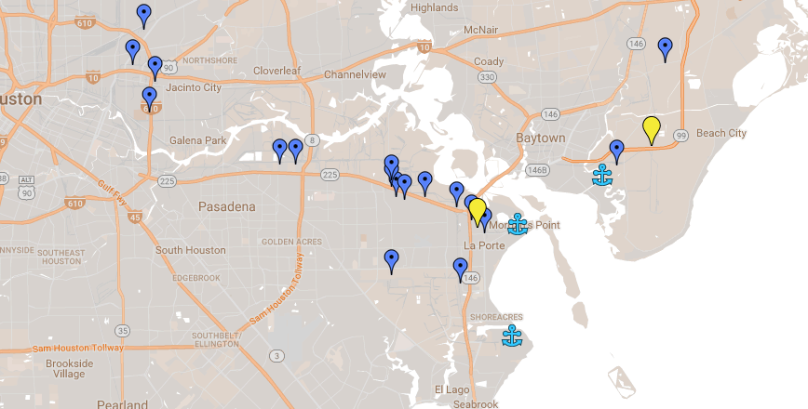
Houston Metro Area boasts the nation’s largest concentration of plastics packagers
3 Resin Export Logistics
Cedar Port
Public Barge Dock
PHA Barbours Cut Container Terminal
PHA Bayport
Container Terminal

Slide 22
3 Resin Export Logistics

Slide 23
4 Port Houston Overview
Topic 4
Port Houston Overview

Slide 24
4 Port Houston Overview
What is the Port of Houston?

Slide 25
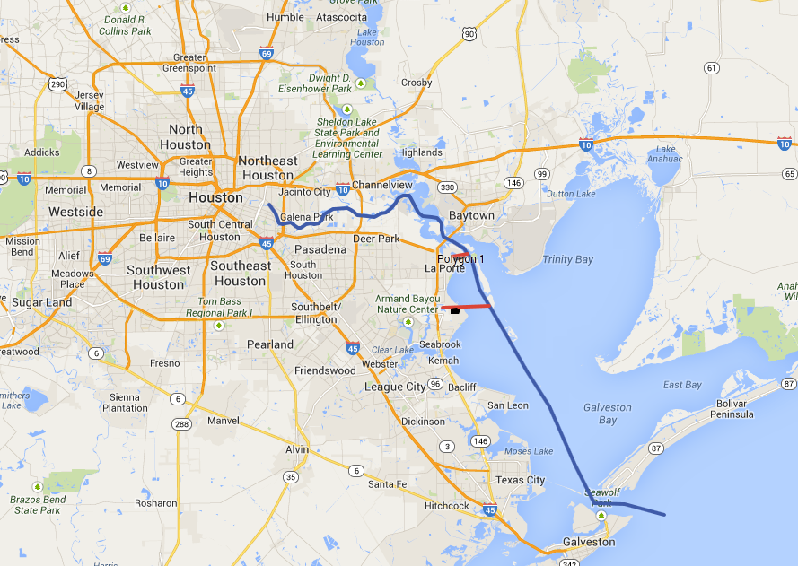
4 Port Houston Overview
Houston Ship Channel
52
mi

Slide 26
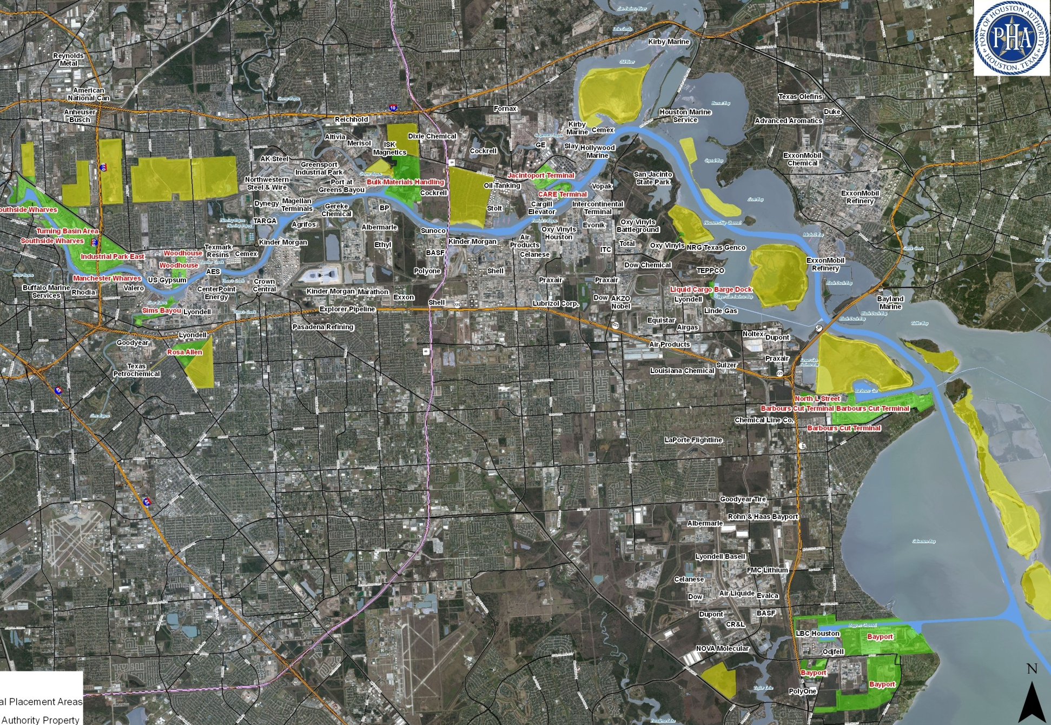
4 Port Houston Overview
Houston Ship Channel

Slide 27
Greater Port of Houston Rankings
4 Port Houston Overview
#1
#1
#6
#15
U.S. Port by Foreign Waterborne Tonnage – 169.9M Tons
in Petroleum, Steel and Project Cargo
US Container Port by Total loaded TEUs
Port in the World by Tonnage

Slide 28
4 Port Houston Overview
& Many Others

Slide 29
Port Commissioners of the Port of Houston Authority set port policies and guide executive staff
4 Port Houston Overview
Dean Corgey
Clyde Fitzgerald
Theldon Branch
Ric Campo
Chairman
Stephen.
DonCarlos
Roy Mease
Wendy Montoya Cloonan
PORT HOUSTON: THE INTERNATIONAL PORT OF TEXAS

Slide 30
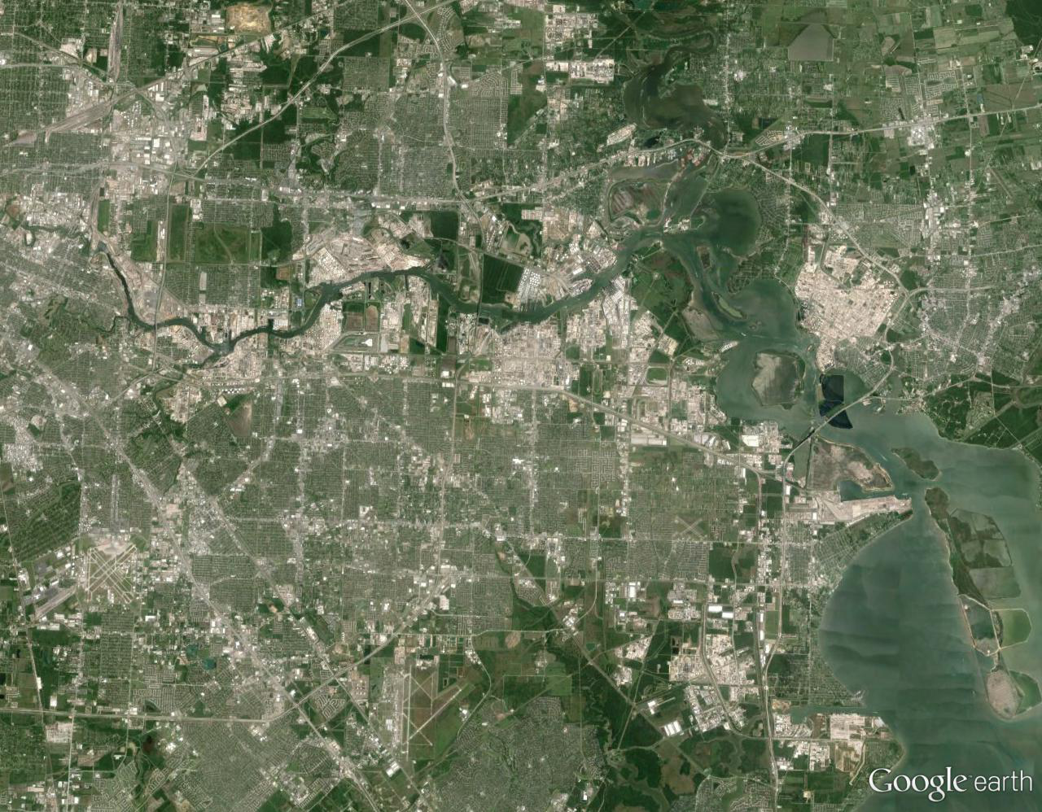
Port Houston Terminals
4 Port Houston Overview
Turning Basin
Bulk Handling
Jacintoport
Woodhouse
Grain Elevator
CARE
Barbours Cut
Bayport
Notes:
The Port of Houston Authority operates two Container Terminals and leases 6 general cargo facilities.

Slide 31
4 Port Houston Overview
Notes:
Here is an overview of the project. It has 8 segments labeled 1-ABC, and 2 through 6.
This plan is the result of a 4-year study where we partnered with the federal government and paid half the $10MM cost to produce the report – we’ve largely completed the study and that report is now in review process, and we aim to culminate in a report signed by the Army Corps Chief of Engineers next May, and start building ASAP after that…
But I’ll get to that in a minute. Let me describe the parts.
First, and this is important to be clear on, is the main Bay Reach. We are aiming to wide from 530 feet to 700 feet in this project. Some of you are asking about more widening and more deepening but we are taking a one step at a time approach so that's the aim for this project.
It is arranged in three segments because the Corps initial economics deemed it only justifiable to widen the reach from the sea buoy to Redfish. We and Industry and the Pilots expressed the need to widen all the way up… like building a four lane highway to a two lane bridge
And I need to stop and make it also clear that we are continuing to work with the Corps and things are getting a lot better in terms of alignment – it seems each day there is more clarity on the national strategic importance of this channel…but there are processes to follow so let me explain the plan as it is.
While the Corps initially did not approve widening further up, we have agreed that the upper segments can be widened – for the moment that means local interests need to pay for it – you may have heard the term “LPP” which means “Locally Preferred Plan”– so it’s a financing issue not a physical one. And we have asked for and received approval to include all of the three segments in the plan that will get the Chief’s Report signature.
All the other segments 2-6 by the way are part of the initial approved plan as well as 1A.
To be more specific, each element is planned for widening, deepening or both. As we move in from the Gulf, widening is the priority to accommodate the volume of ships which are growing in size and to maintain two way traffic that we enjoy today. That means going from 530 feet to 700 in the main reach and also widening the Bayport and Barbours cut channels to 455’
As we go up the Channel, the plan looks to widen to 530 feet and deepen from 41 to 46.5 feet from Shell/Boggy Bayou to Sims or from just outside the Beltway 8 to just outside the 610 , and then deepen from about 37 feet to between 39 and 41 feet from Sims (the 610) up to the turning basin.
There are several enhancements to turning basins and other features along the way as well, and a dredge material management plan including offshore and marsh island areas that is being finalized as we speak, but this is the big picture.

Slide 32
Timetable for widening requires acceleration
4 Port Houston Overview
2010
2015
2020
2025
2030
2035
“Business As Usual”
Pre-Plan
Construction
Pre-Plan
4 Year Study
Construction
Yr Study
Design
Appropriation - Part 1
Authorization
Post Construction
Pre-Plan
4 Year Study
Accelerate
Pre-Plan
4 Yr Study
Construction
Design
Funding
Construction
Authorization
32
Notes:
Regarding feasibility – we need to get to a successful Chiefs Report, but also need to get off the “Business As Usual”
Here’s a critical point – if we take the business as usual path, that means multiple years getting authorization, and then appropriations, and we see that federal funds do not flow as fast as they will be needed
In short, the business as usual path would rely more on the federal government for making these improvements and paying for it, and that optimistically could take to 2028 or 2030 or beyond to get it all done.
We need it sooner, so will need to all put skin in the game
Someone called this a “Jesse Jones Moment” – like 100 years ago, we need challenge the way to continue the road to more prosperity
So what that means is move from Series approach to Parallel
Move Dirt by 2021 and be finished in a few years, not take more than a decade

Slide 33
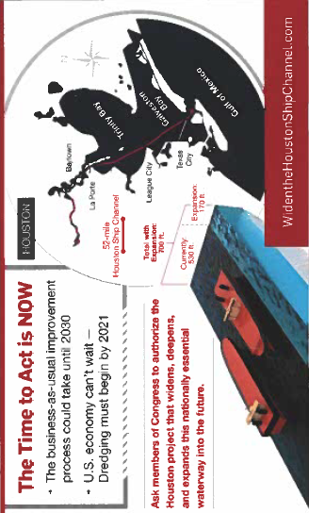
4 Port Houston Overview
Notes:
Advocacy needs to be consistent – we all need to be on the same page
We are working productively at every level
With Colonel Vail at the Corps Galveston District
With the Corps Division and HQ in Dallas and in Washington
And the Assistant Secretary of the Army for Civil; Works, the ASA, RD James, in DC
As well as the Texas Delegation, the Administration and others
So being on the same page is critical so everyone hears the same message – which is
the national importance of this channel requires improvements as soon as possible
The economy cant wait – the importance of energy exports to trade and national interests are compelling
We are willing to contribute to make this happen

Slide 34
4 Port Houston Overview
Port of Houston History

Slide 35
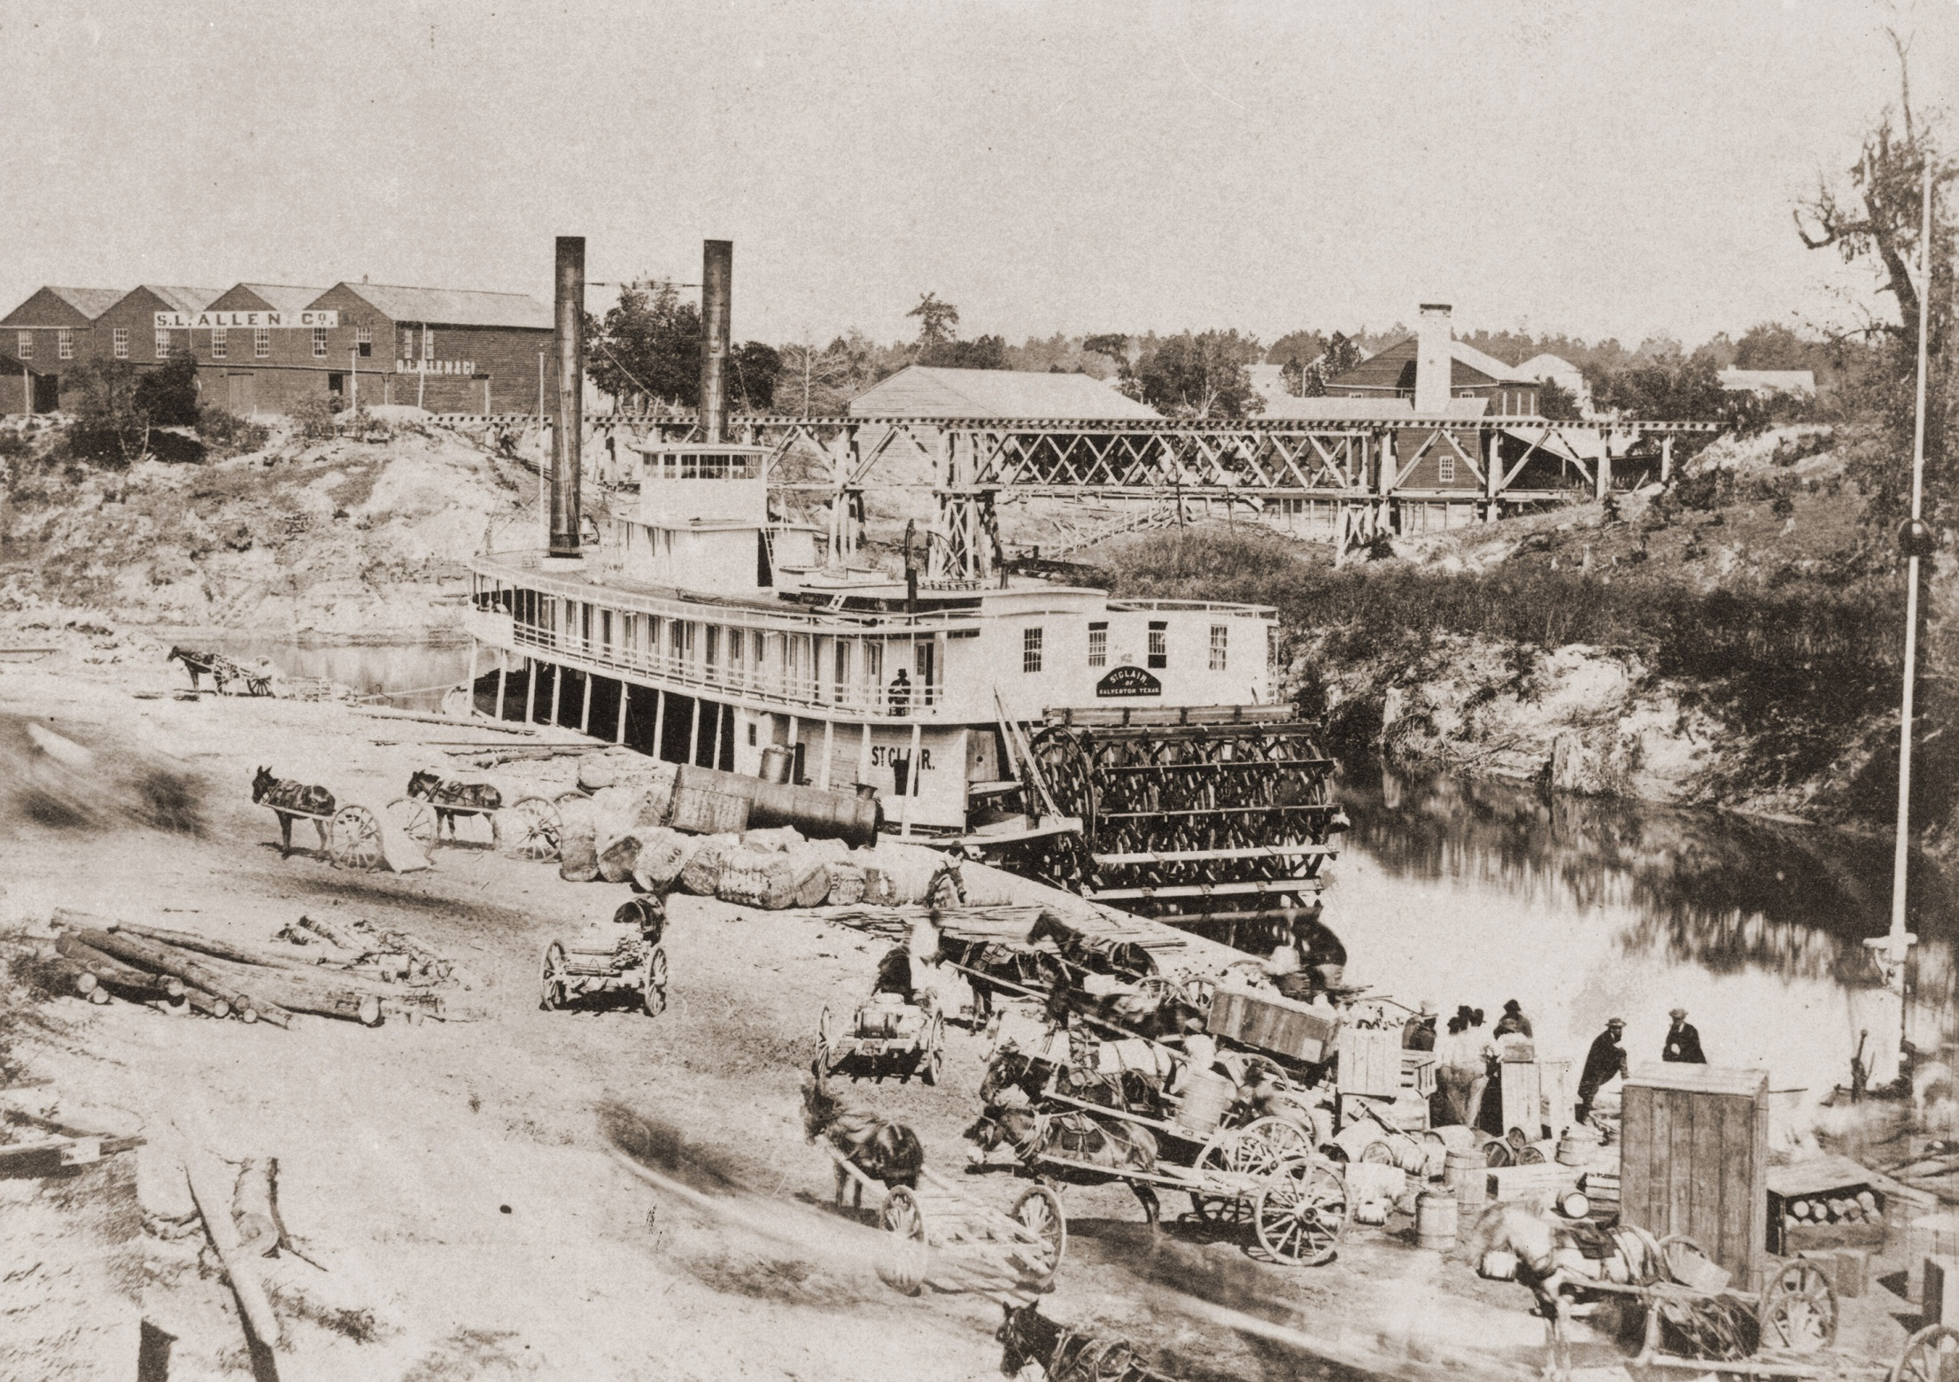
4 Port Houston Overview
1856

Slide 36
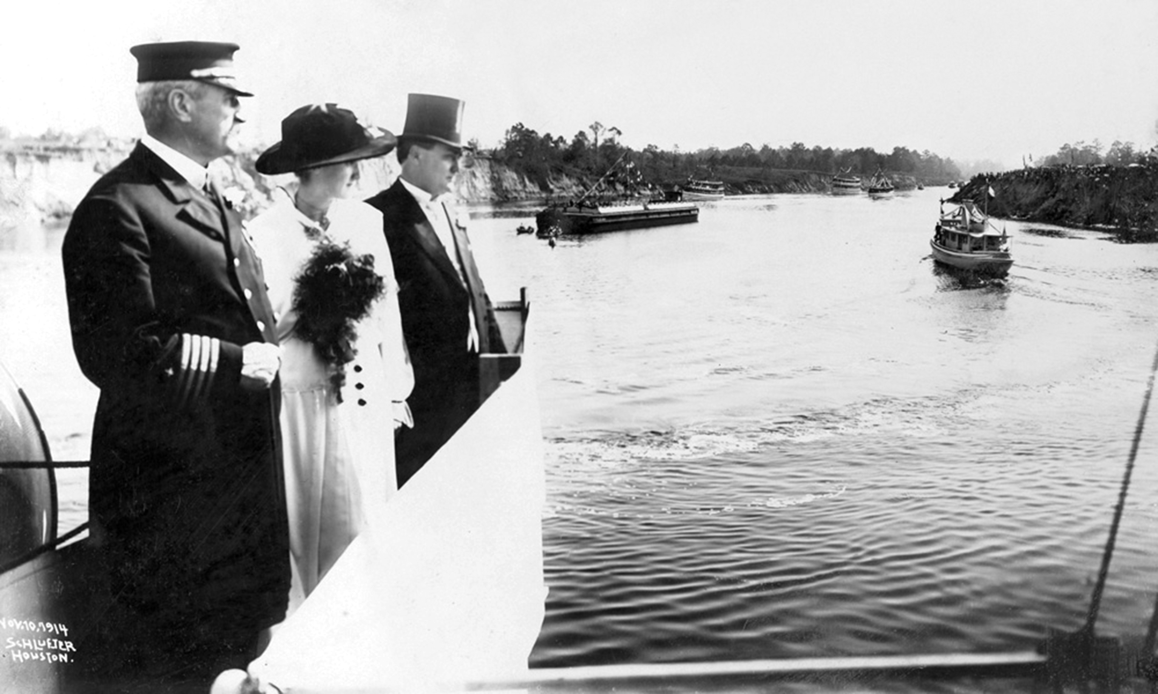
4 Port Houston Overview
1914

Slide 37
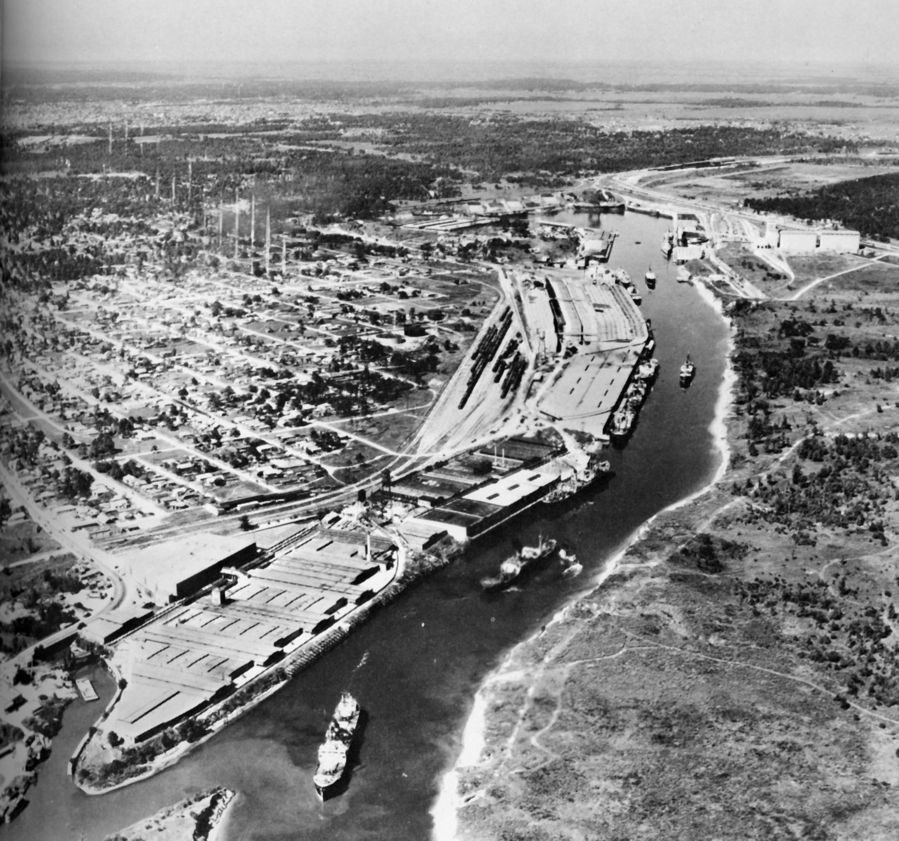
4 Port Houston Overview
1930s

Slide 38
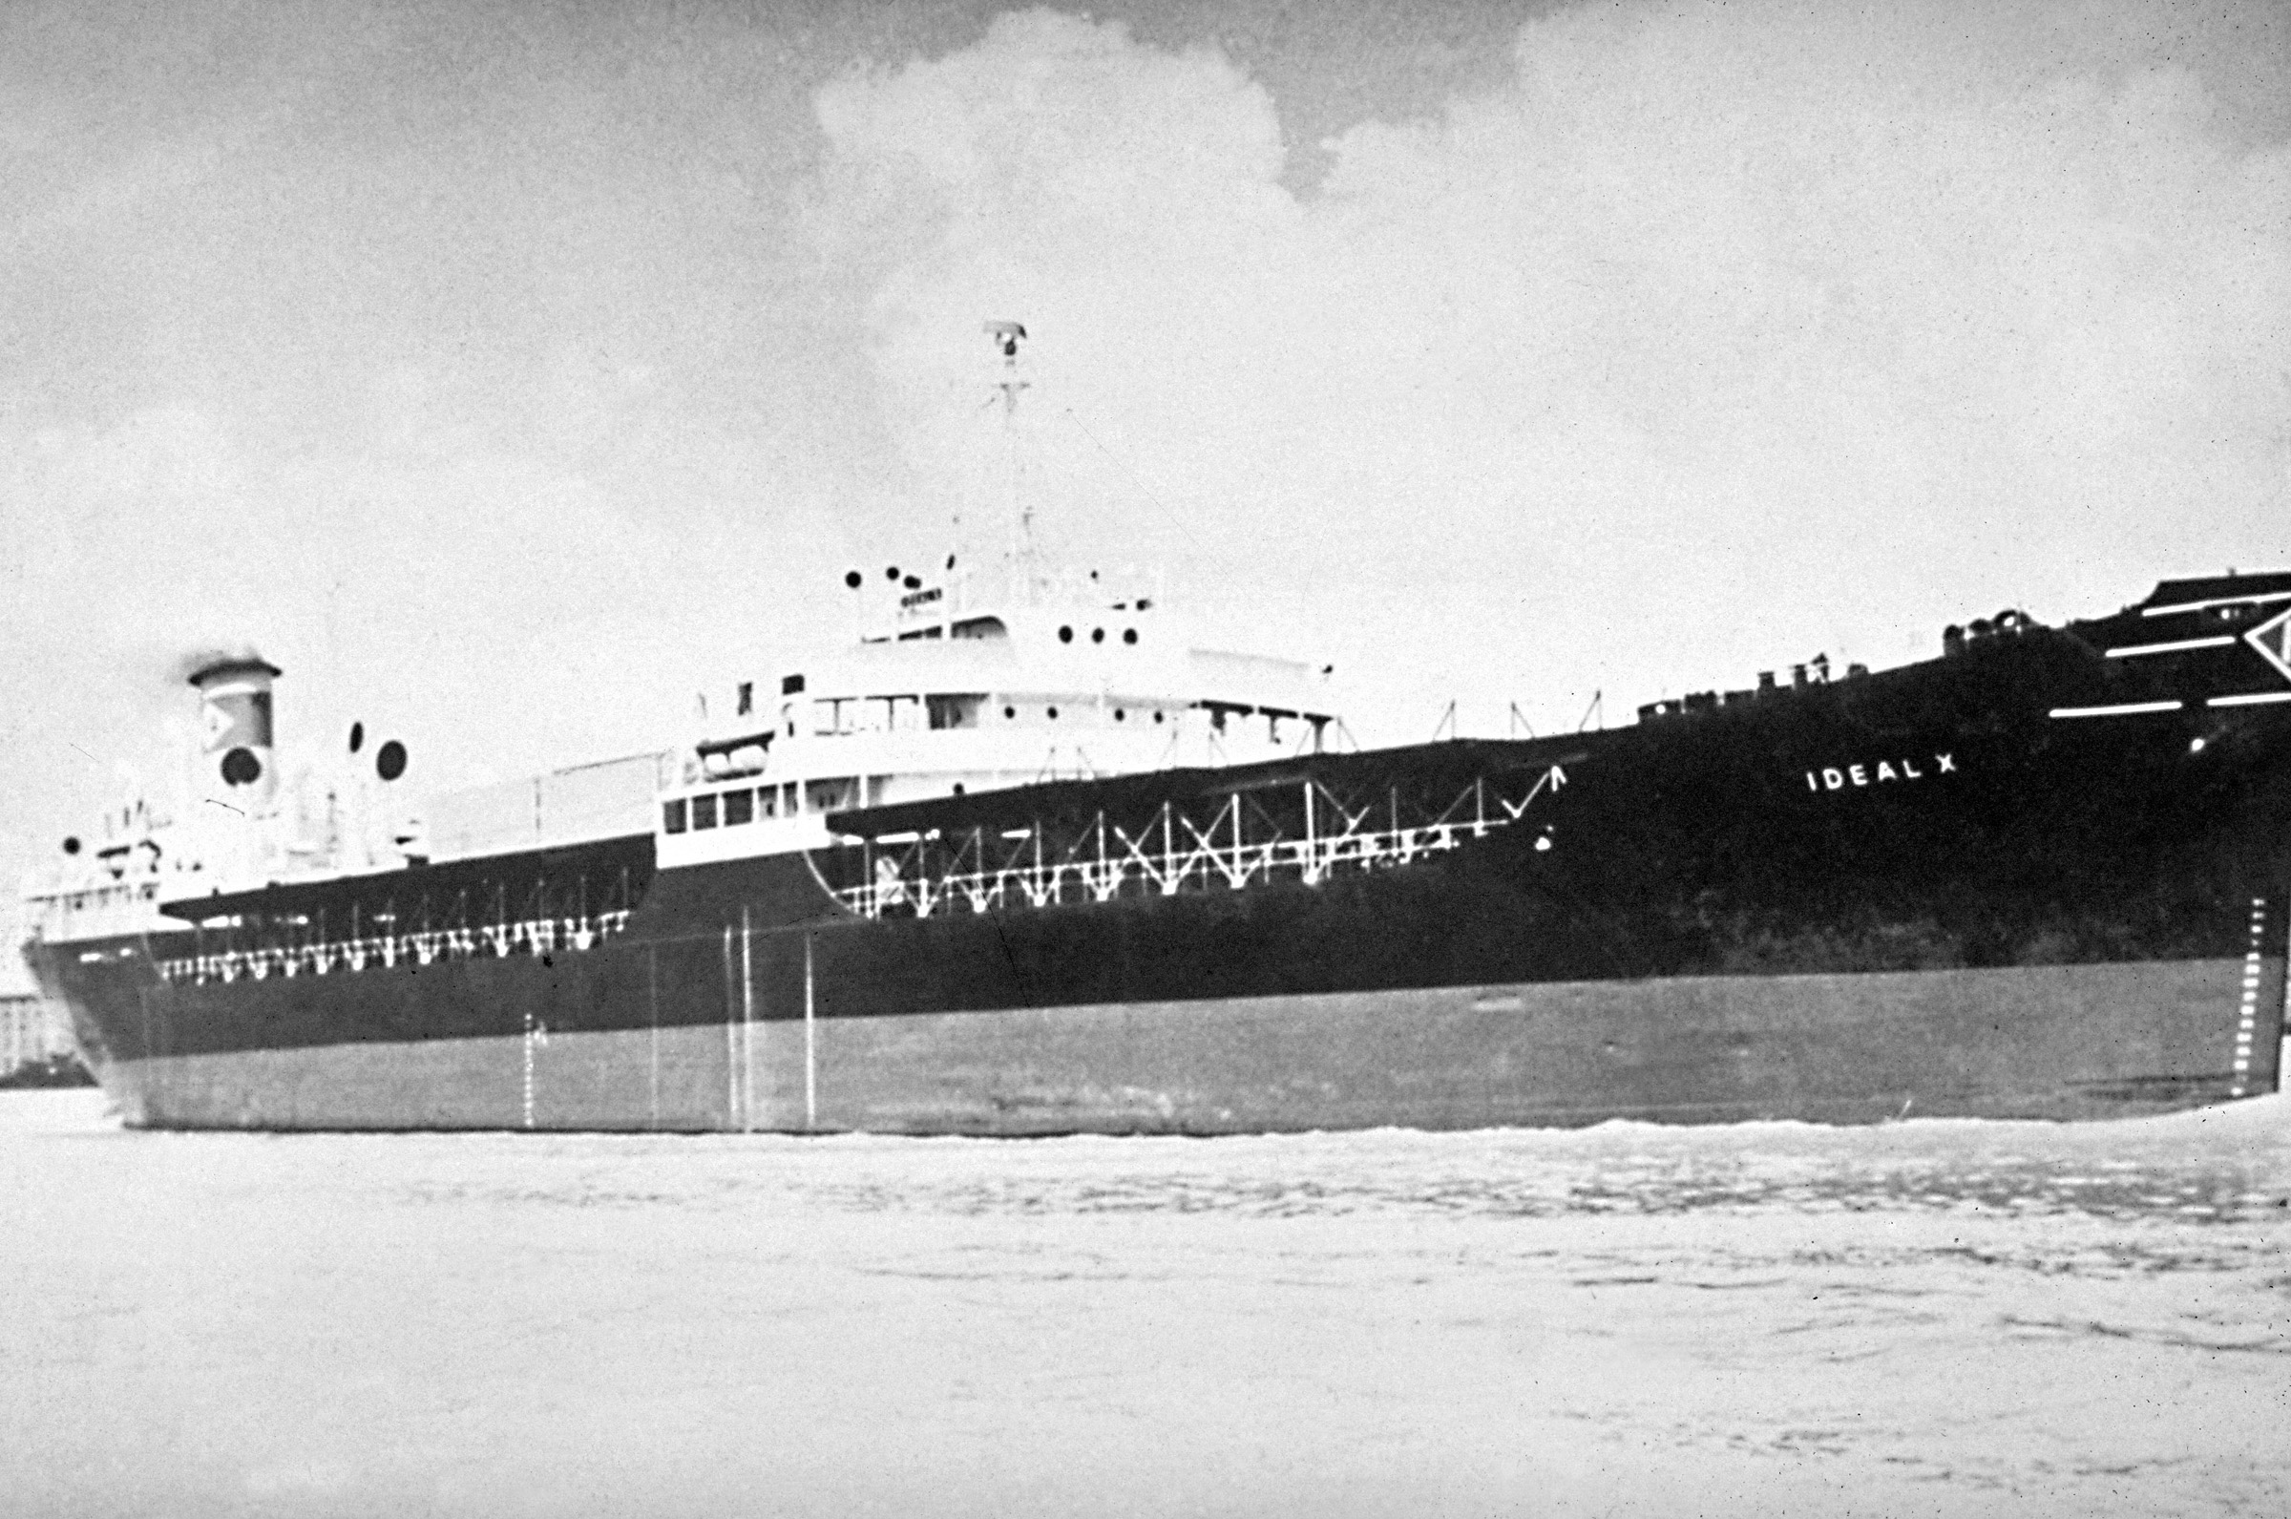
4 Port Houston Overview
1956

Slide 39
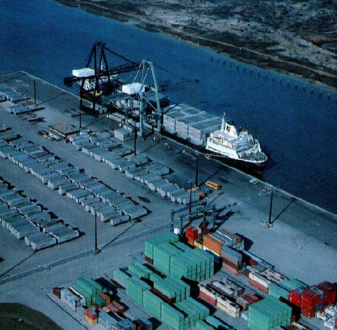
4 Port Houston Overview
LASH: 1972
Containers: 1977
This photo: 1979

Slide 40
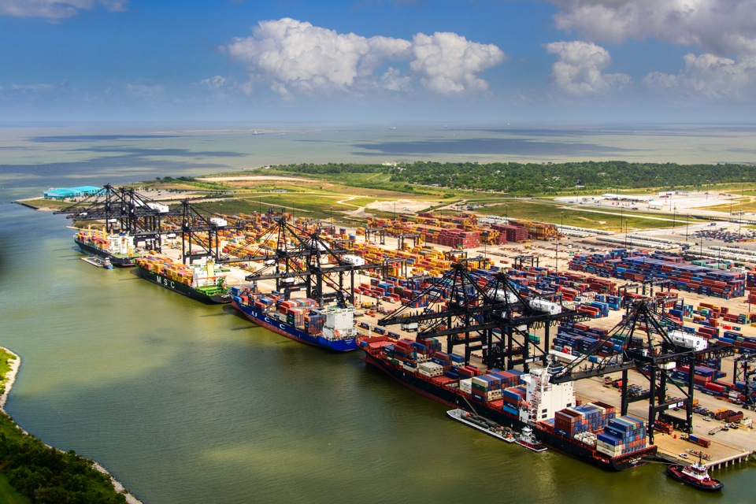

Slide 41
4 Port Houston Overview
Container Trade

Slide 42
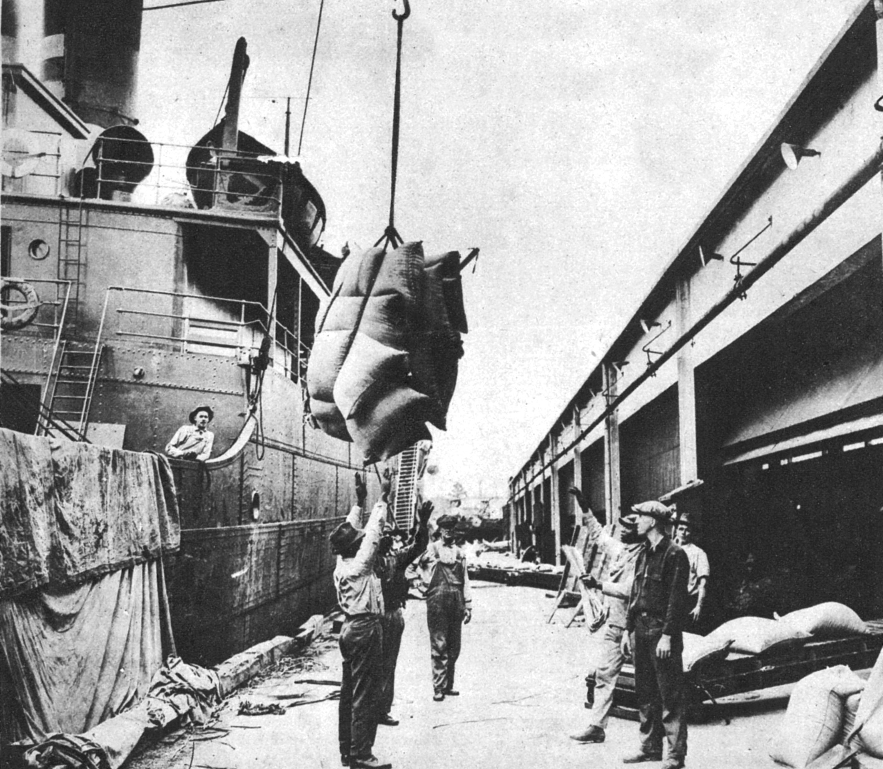
4 Port Houston Overview
1922

Slide 43
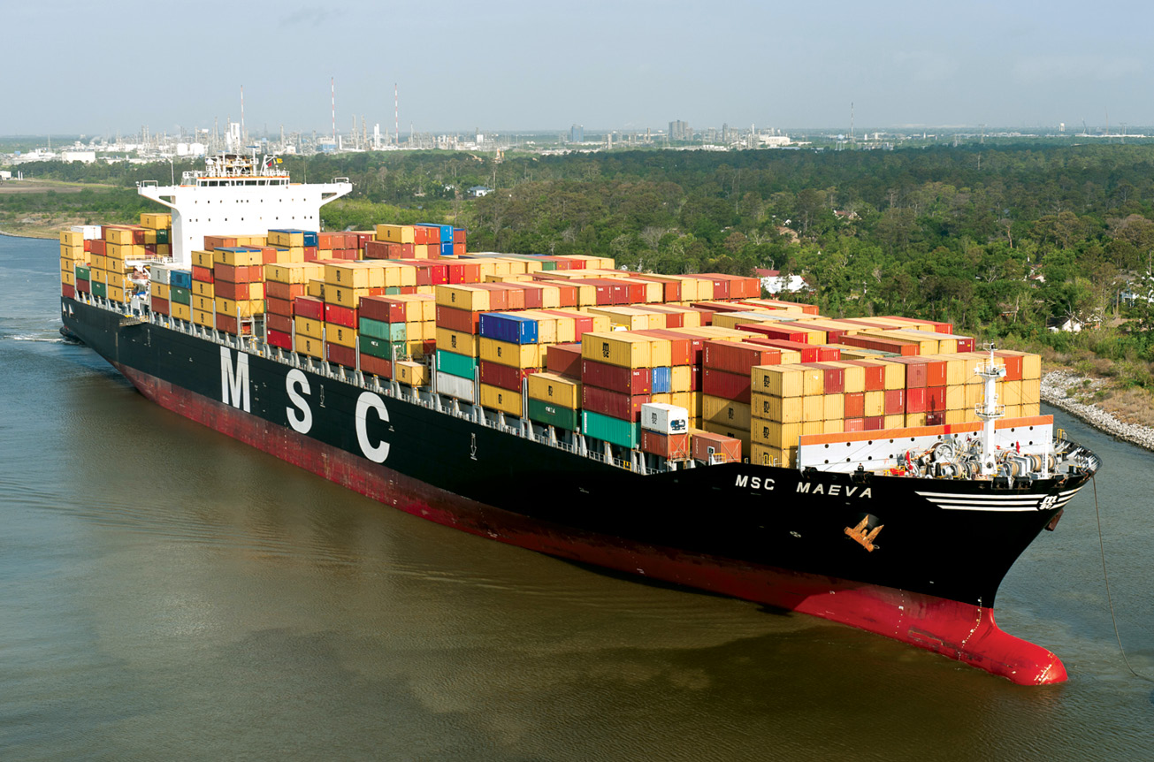
4 Port Houston Overview
Notes:
To accommodate the rapid growth that lies ahead, we have been diligent in our preparations. The demands on our facilities are quickly changing. Worldwide vessel fleets are getting larger, requiring channels that are deeper and wider. We are committed to investments in our facilities to meet the demands of the industry, as well as excellence in our processes to maintain a competitive cost, and an efficient and quality service to our customers.
1. Dredging
We are already seeing ships coming to Port of Houston Authority’s container terminals that are too large to pass through the Panama Canal. Even though the main Port of Houston Federal Channel is 45 ft deep, our Barbours Cut channel and Bayport channel are currently only 40 ft deep, limiting how much cargo the largest containerships can load. The Port Authority must deepen our container terminals to better serve the vessels we are already seeing and to remain competitive with other ports.

Slide 44
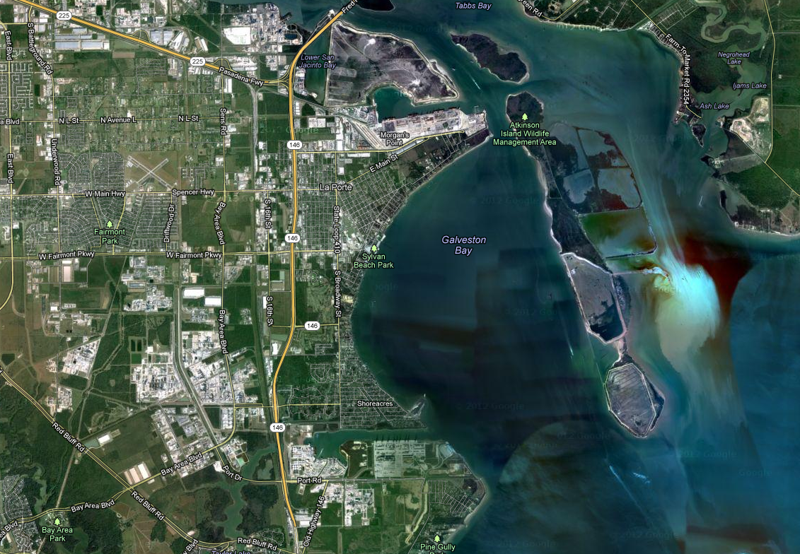
4 Port Houston Overview
Barbours Cut Terminal
Bayport Terminal
Notes:
I would like to give you an overview of the investments being made at our two container facilities, as this cargo sector is expected to provide the most growth opportunities.

Slide 45
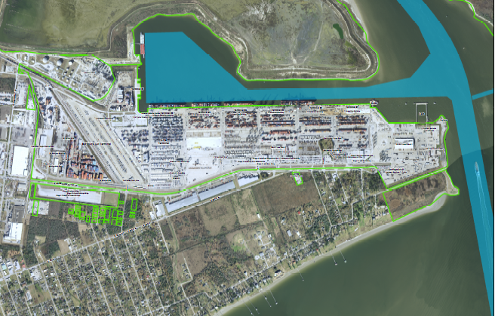
4 Port Houston Overview
Barbours Cut Container Terminal

Slide 46
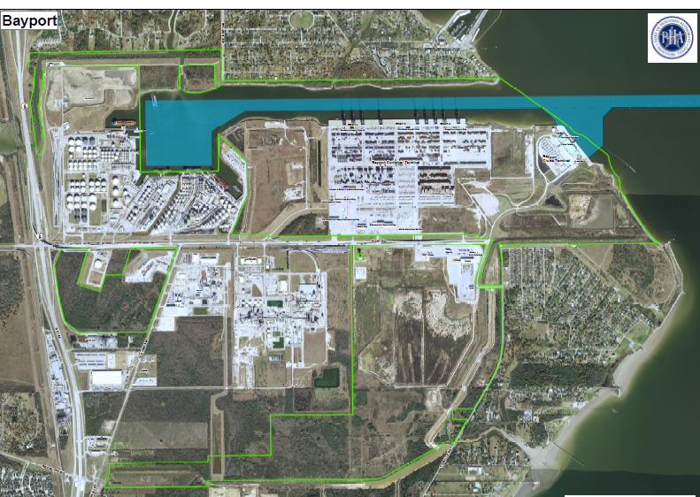
4 Port Houston Overview
Bayport Container Terminal

Slide 47
1 Internal Data
4 Port Houston Overview
Topic: 2018 US Container Port Rankings
Notes:
U:\Monthly Work\2019 2 February\2018 FY PIERS work
2018 PIERS port rank.xlsx

Slide 48
4 Port Houston Overview
Total Port Houston Containers
 | TEUs | % Change
Loaded Imports | 715,849 | +8%
Loaded Exports | 726,962 | +15%
Total Loaded | 1,442,811 | +12%
2019 YTD July vs. 2018 YTD July

Slide 49
Port Houston continues strong momentum into Q2 2019, with resin boosting exports and imports growing as we head toward peak season
4 Port Houston Overview

Slide 50
4 Port Houston Overview
Growth continues to be broad-based across lanes in Q2
East Asia

Slide 51
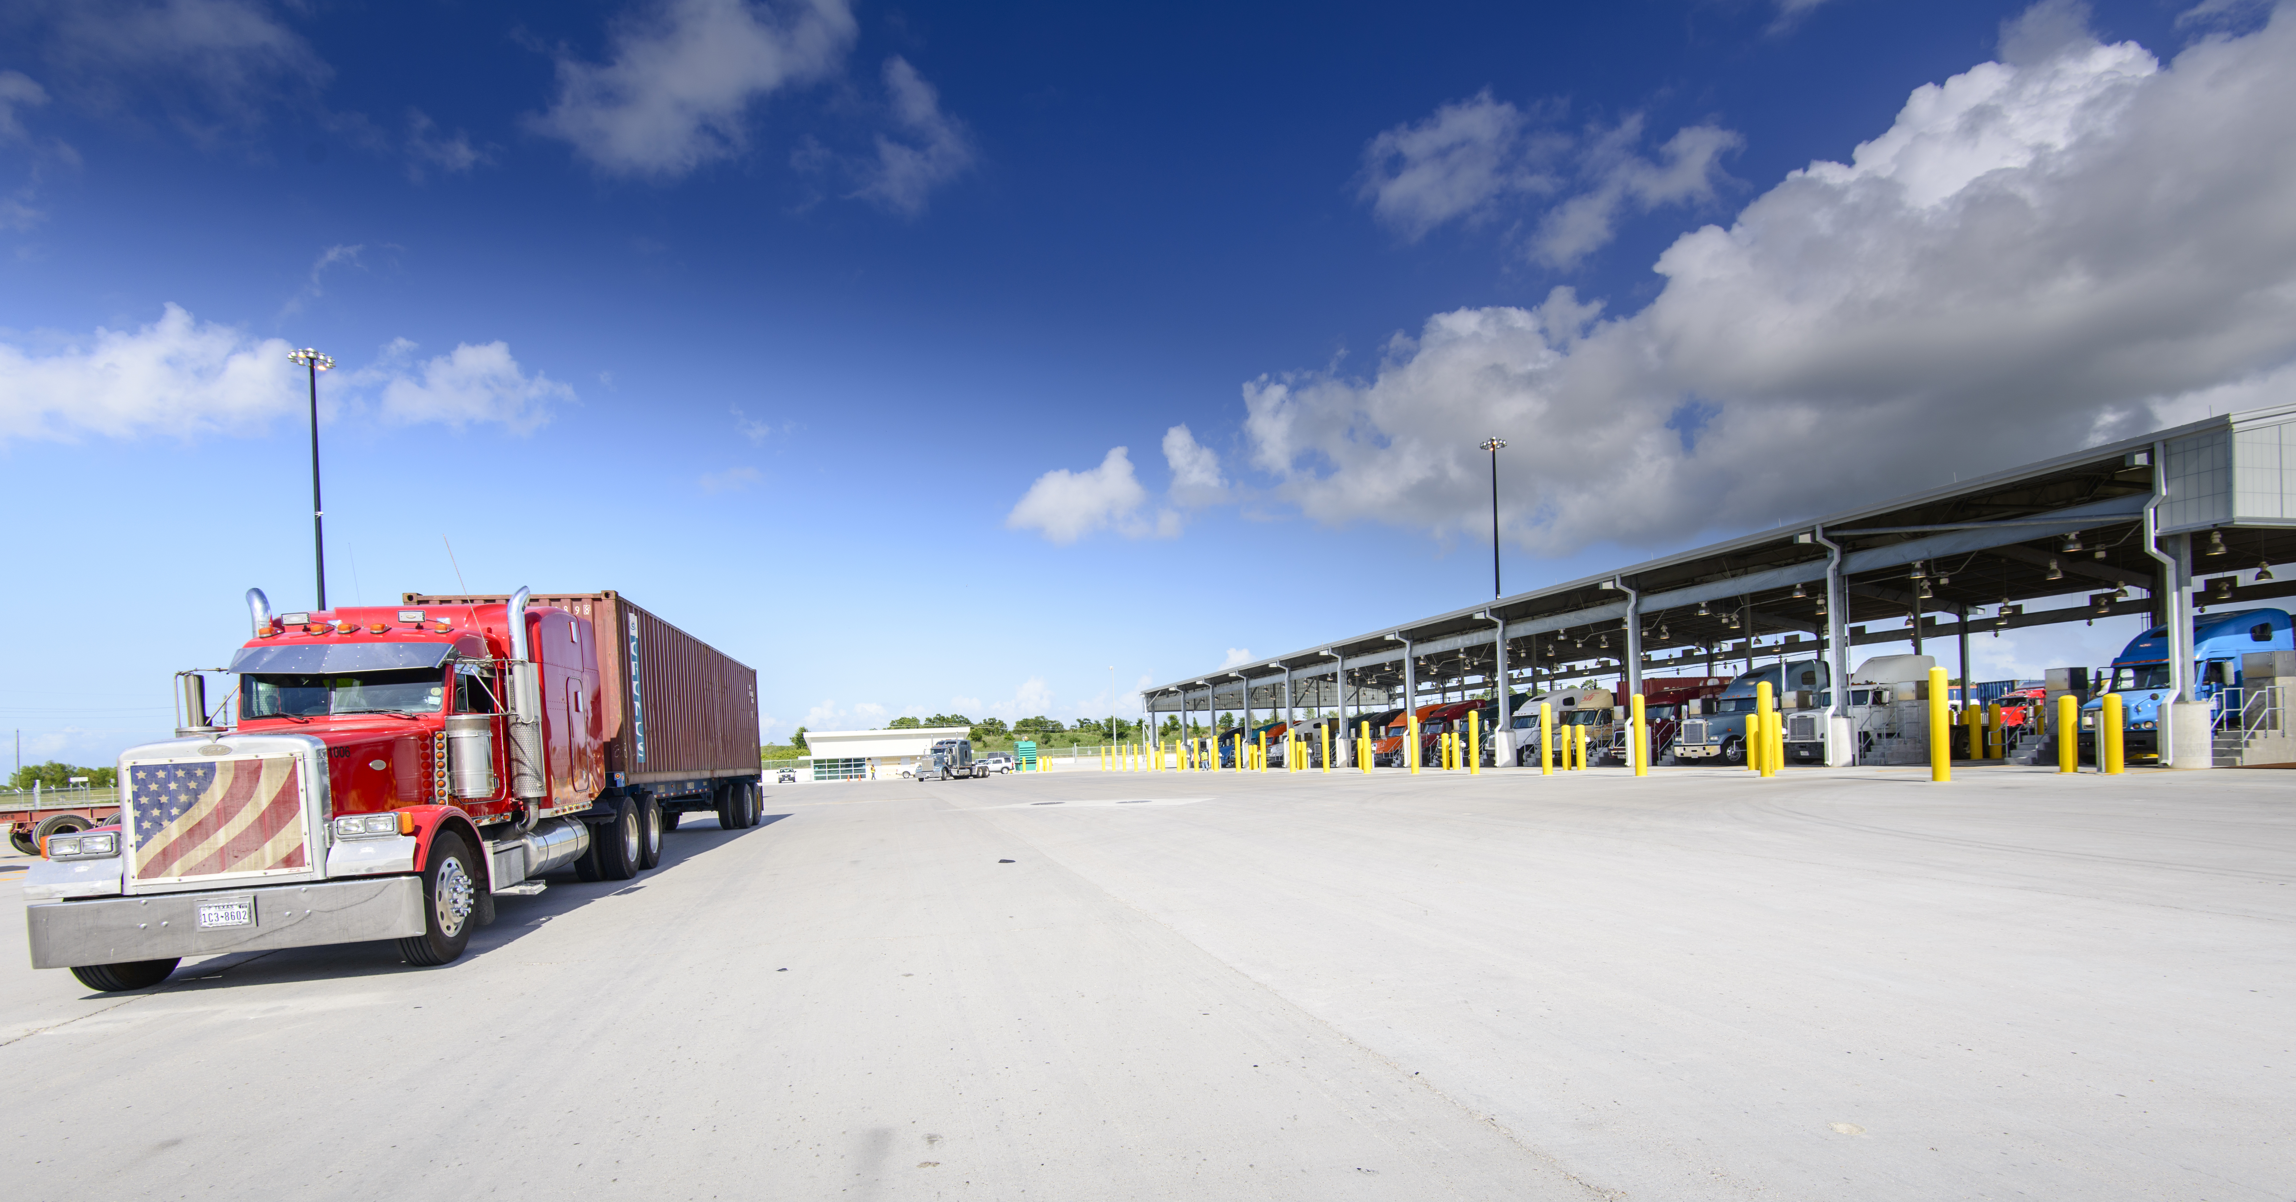
Port Houston
Research & Forecasting
Jordan Frisby
Economist
jfrisby@porthouston.com
(713) 670-2815
www.PortHouston.com

