Slide 1






GCEDD
BOARD RETREAT
Wednesday, July 29, 2026 | United Way
h-gac.com
h-gac.com
Serving Today • Planning for Tomorrow
Serving Today • Planning for Tomorrow

Slide 2

CALL TO ORDER
h-gac.com
Serving Today • Planning for Tomorrow

Slide 3

WELCOME REMARKS
Welcome everyone to today’s board retreat meeting; we appreciate your presence and contributions to our discussions.
h-gac.com
Serving Today • Planning for Tomorrow

Slide 4


PLEDGE OF ALLEGIANCE
I pledge allegiance to the Flag of the United States of America, and to the Republic for which it stands, one Nation under God, indivisible, with liberty and justice for all.
Honor the Texas flag; I pledge allegiance to thee, Texas, one state under God, one and indivisible.
h-gac.com
h-gac.com
Serving Today • Planning for Tomorrow
Serving Today • Planning for Tomorrow

Slide 5

ROLL CALL
h-gac.com
Serving Today • Planning for Tomorrow

Slide 6


PUBLIC
COMMENT
h-gac.com
h-gac.com
Serving Today • Planning for Tomorrow
Serving Today • Planning for Tomorrow

Slide 7


ACTION ITEMS FOR APPROVAL
Meeting
Minutes
Meeting
Minutes
Request approval of minutes from November 5, 2025, board meeting.
Request approval of minutes from April 22, 2026, board meeting.
Financial
Report
Financial
Report
Financial
Report
Request approval of financial report for the period ending December 31, 2025.
Request approval of financial reports for the period ending March 31, 2026.
Request approval of financial reports for the period ending June 30, 2026.
h-gac.com
Serving Today • Planning for Tomorrow

Slide 8


MEETING MINUTES
Request approval of the minutes from the November 5, 2025 meeting.
Request approval of the minutes from the April 22, 2026 meeting.
h-gac.com
h-gac.com
Serving Today • Planning for Tomorrow
Serving Today • Planning for Tomorrow

Slide 9

FINANCIAL REPORTS
  Request approval of the financial report for the period ending December 31, 2025.
  Request approval of the financial report for the period ending March 31, 2026.
  Request approval of the financial report for the period ending June 30, 2026.
h-gac.com
Serving Today • Planning for Tomorrow

Slide 10


BOARD UPDATES
Darryl will provide key updates and upcoming priorities.
h-gac.com
h-gac.com
Serving Today • Planning for Tomorrow
Serving Today • Planning for Tomorrow

Slide 11


BROADBAND UPDATE
Darryl Briscoe will provide an update on broadband coverage and challenges.
Opportunities
Strengths
Project Status
h-gac.com
Serving Today • Planning for Tomorrow

Slide 12


Slide 13


STAFF ACTIVITIES
Brandy will provide key updates on staff activities.
h-gac.com
h-gac.com
Serving Today • Planning for Tomorrow
Serving Today • Planning for Tomorrow

Slide 14

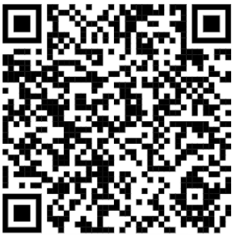
Registration and Sponsorship Information
2026 Economic Impact Summit | Houston-Galveston Area Council (H-GAC)

Slide 15

LOAN PROGRAM
REPORT
Christina Cornelius will provide a comprehensive update on current loan program status and performance.
h-gac.com
h-gac.com
Serving Today • Planning for Tomorrow
Serving Today • Planning for Tomorrow

Slide 16

BOARD WORKSHOP
At this time we will discuss two different topics for our workshop.
Workforce
HREDA
h-gac.com
Serving Today • Planning for Tomorrow

Slide 17


WORKFORCE SOLUTIONS
h-gac.com
h-gac.com
Serving Today • Planning for Tomorrow
Serving Today • Planning for Tomorrow

Slide 18
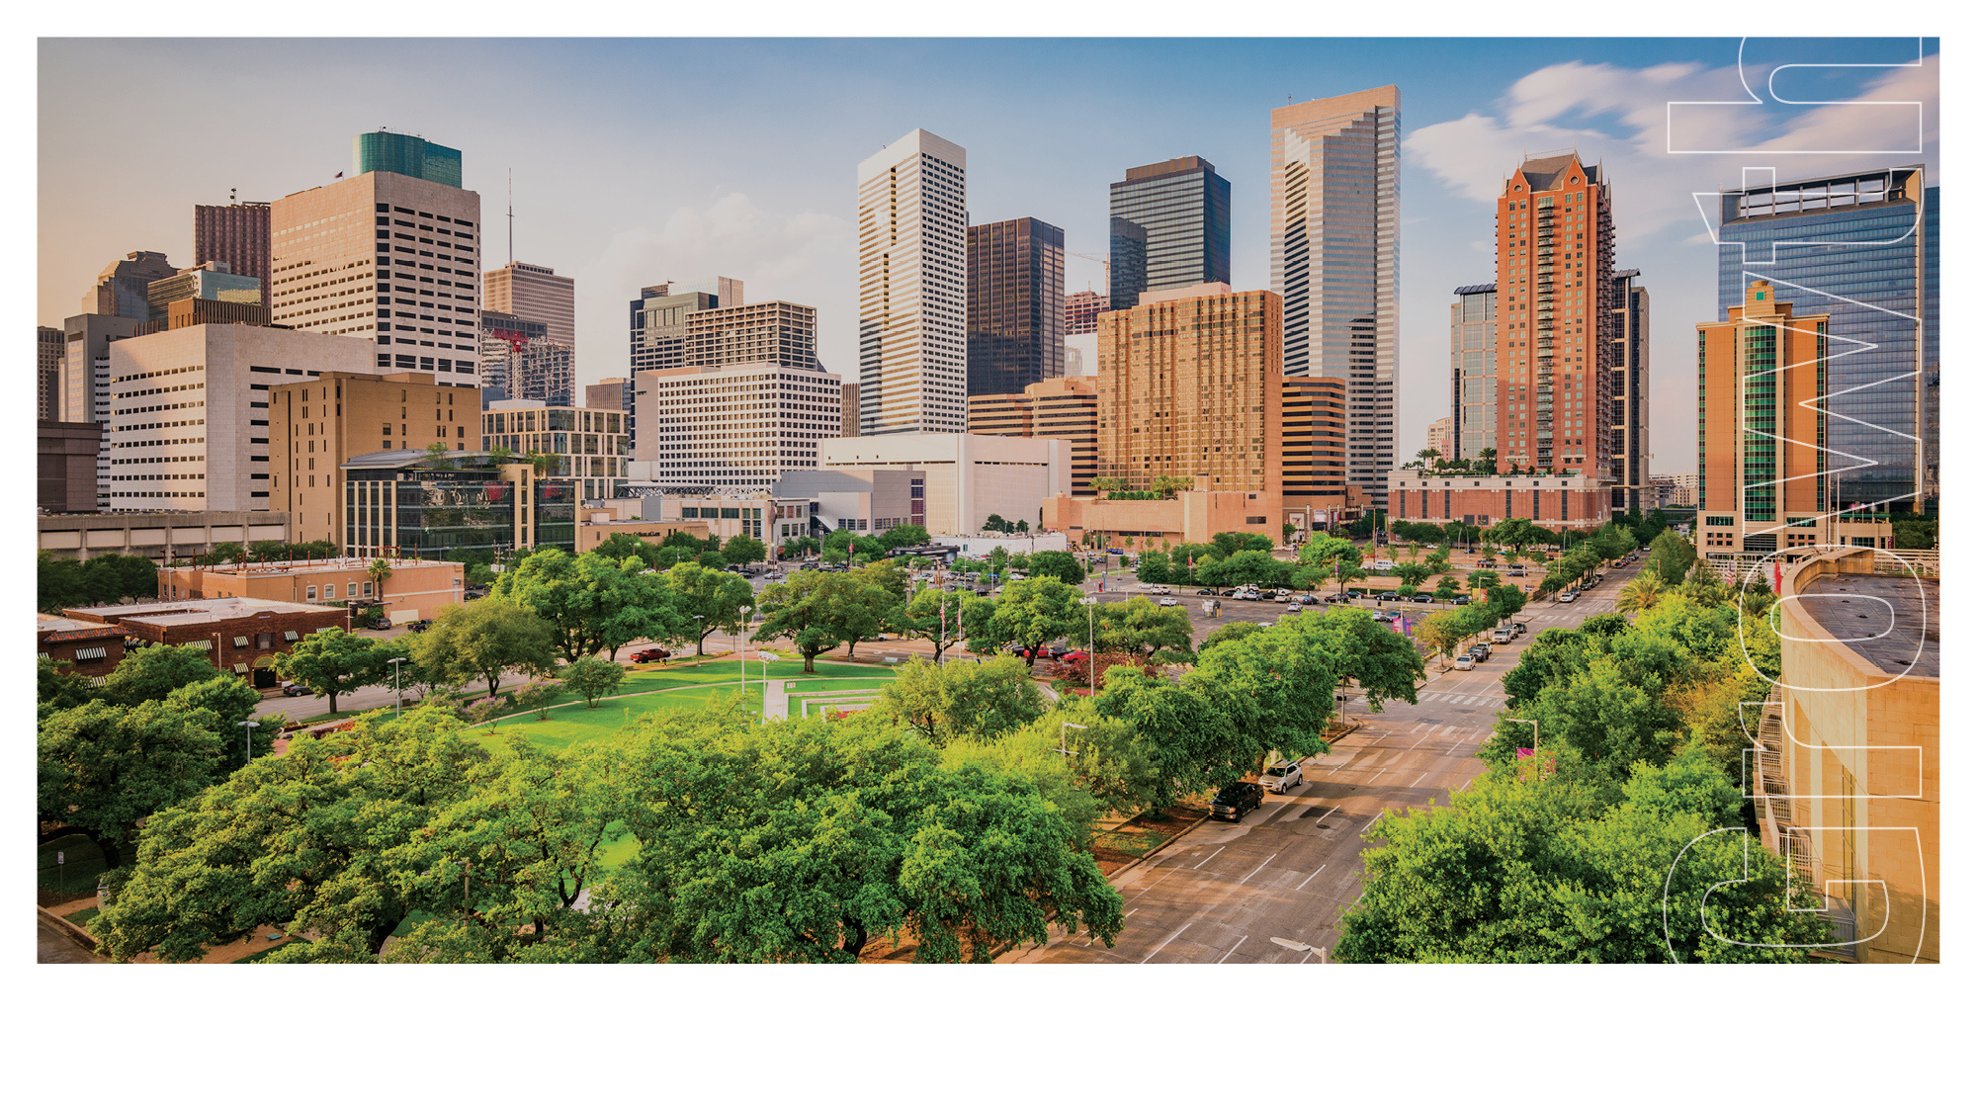
Look At The Economy
July 29, 2026
www.wrksolutions.com 1.888.469.JOBS (5627)
Workforce Solutions is an equal opportunity employer/program. Auxiliary aids and services are available upon
request to individuals with disabilities. (Please request reasonable accommodations a minimum of two business
days in advance.) Relay Texas: 1.800.735.2989 (TDD) 1.800.735.2988 (voice) or 711

Slide 19

Actual Unemployment Rates – June 2026
Source: Texas Workforce Commission and the Bureau of Labor Statistics
Notes:
2

Slide 20
Houston MSA Over-the-Month Change
Notes:
2

Slide 21
Houston MSA Total Nonfarm Payroll Employment
Total nonfarm payroll employment June: 3,521,500
April
Not-seasonally-adjusted
+5,900
jobs
+0.2%
Avg April:
0.0%
May
Not-seasonally-adjusted
+16,200
jobs
+0.5%
Avg May:
+0.5%
June
Not-seasonally-adjusted
+14,400
jobs
+0.4%
Avg June:
+0.5%
Notes:
2

Slide 22
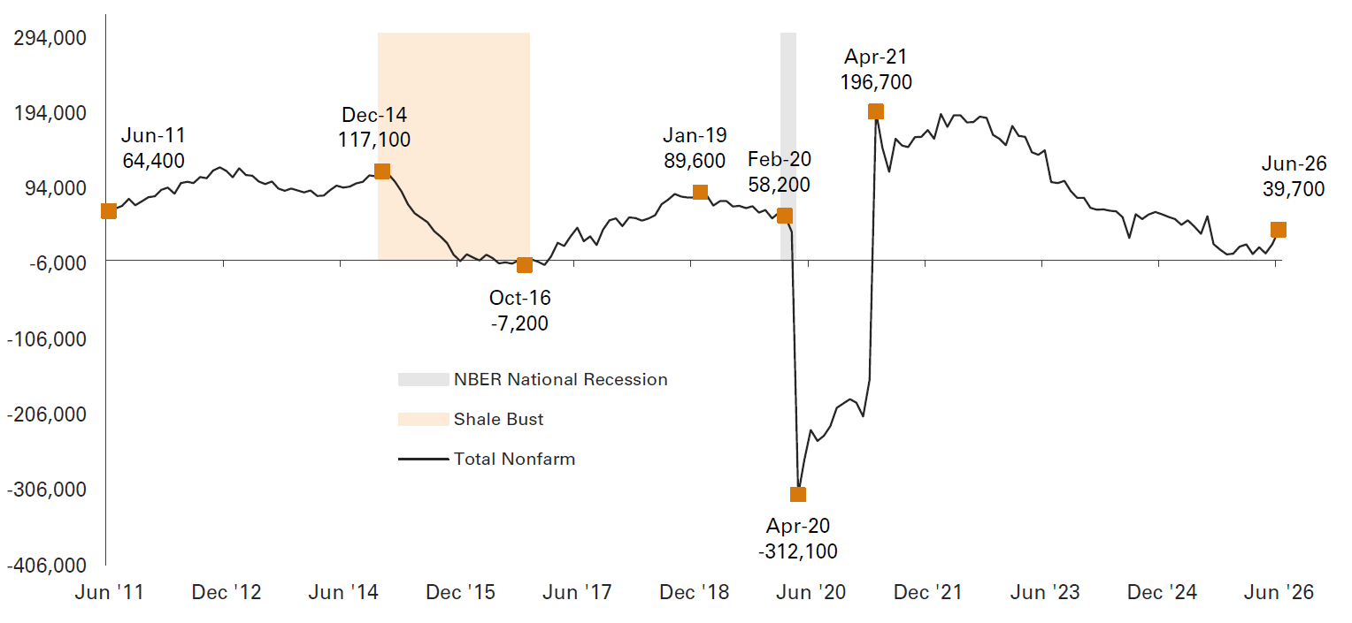
Houston MSA Total Nonfarm OTY Job Growth
Notes:
2

Slide 23
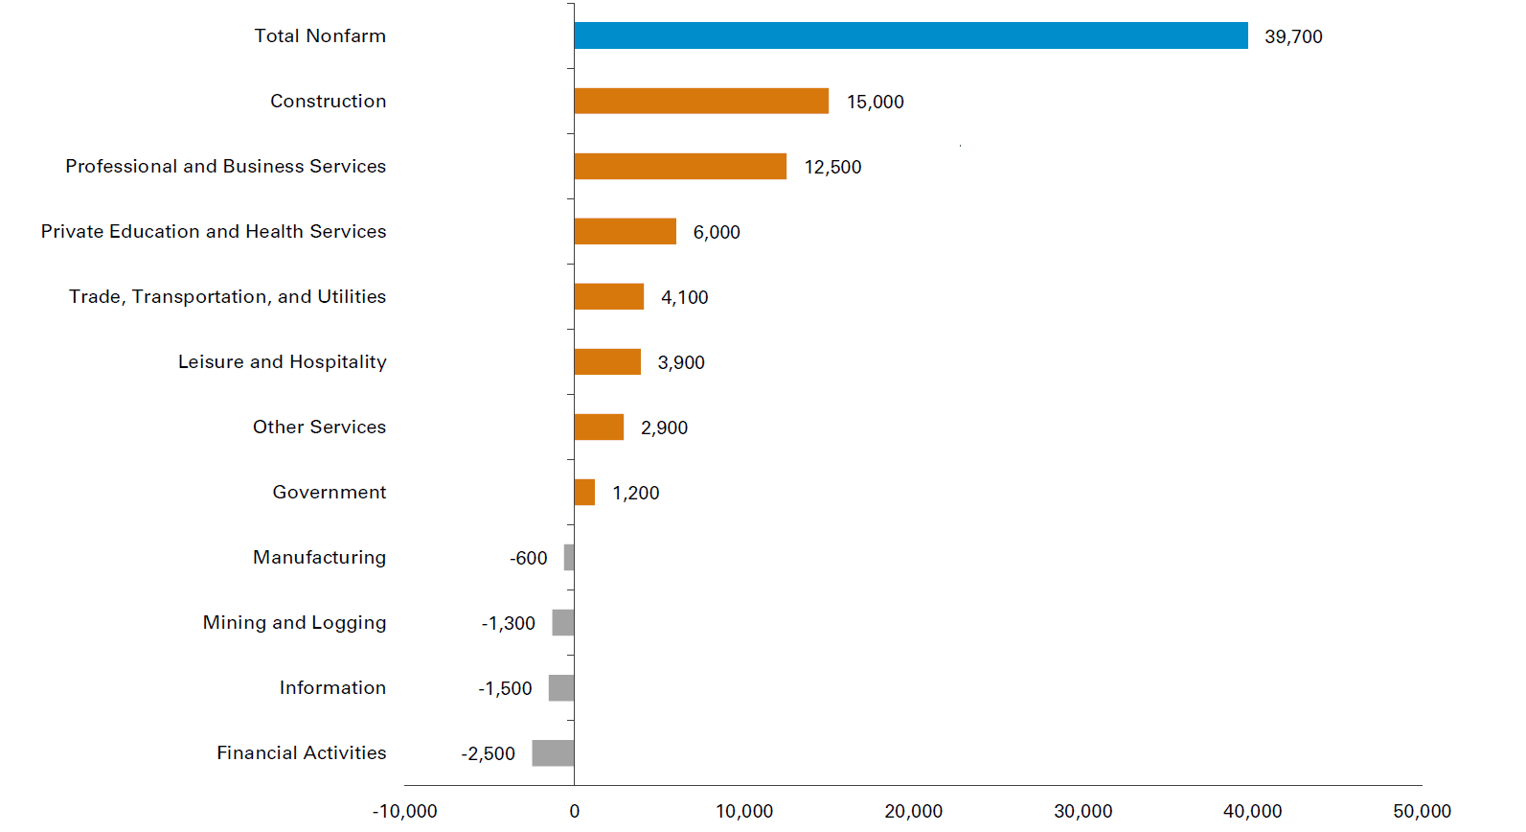
Houston MSA Supersectors OTY Net Change, June 2026
Notes:
2

Slide 24
Houston MSA OTY Job Growth Forecast by Sector, Dec 2026 (Updated)
Industry Sector | Forecasted OTY Net Change Dec 2025 - Dec 2026 |  | OTY Net Change as of December 2025
Health Care and Social Assistance | 8,900 |  | 7,900
Professional and Business Services | 8,500 |  | -600
Construction | 5,600 |  | 13,600
Leisure and Hospitality | 4,200 |  | 700
Government | 4,100 |  | 3,700
Transportation Warehousing and Utilities | 2,800 |  | 1,700
Durable Goods | 1,400 |  | 1,700
Wholesale Trade | 1,100 |  | -600
Other Services | 700 |  | - 500
Private Educational Services | 500 |  | 500
Information | -500 |  | -1,200
Retail Trade | -700 |  | -2,400
Non-durable Goods | -1,900 |  | -1,800
Mining and Logging | -1,900 |  | -3,500
Financial Activities | -2,900 |  | - 1,700
Total | 29,900 |  | 17,500
2/3s of 2026 Projected Job Growth
Previous Dec 2026 Forecast: 40,200
Notes:
2

Slide 25




OTHER BUSINESS
Next Meeting - TBA 2026 - In-person
  General Staff Updates
Other
  Business
Closing
  Remarks
h-gac.com
Serving Today • Planning for Tomorrow

Slide 26
THANK YOU!
Thank you all for your valuable input and participation in today’s board meeting; your insights have been instrumental in shaping our decisions moving forward.
h-gac.com
Serving Today • Planning for Tomorrow

