Slide 1
Ports Area Mobility Study

Slide 2
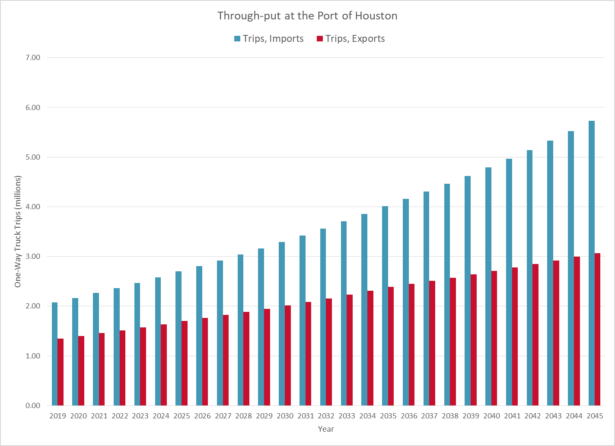
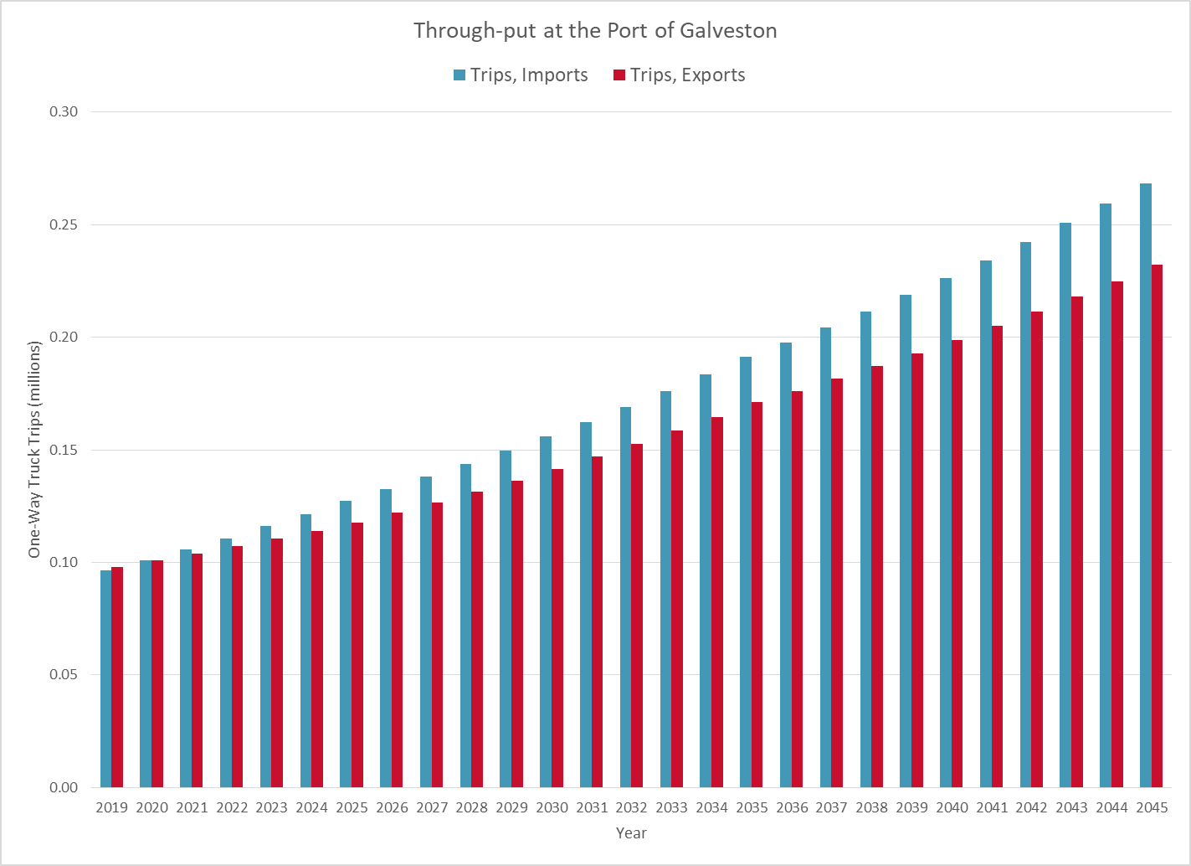
Study Needs
Transearch Data estimates the growth in truck trips to double by 2045.

Slide 3
Study Recommendations
  Infrastructure and facilities
  Multimodal improvements
  Alternative Transportation Systems
  Operational strategies and
  Policy-level changes

Slide 4
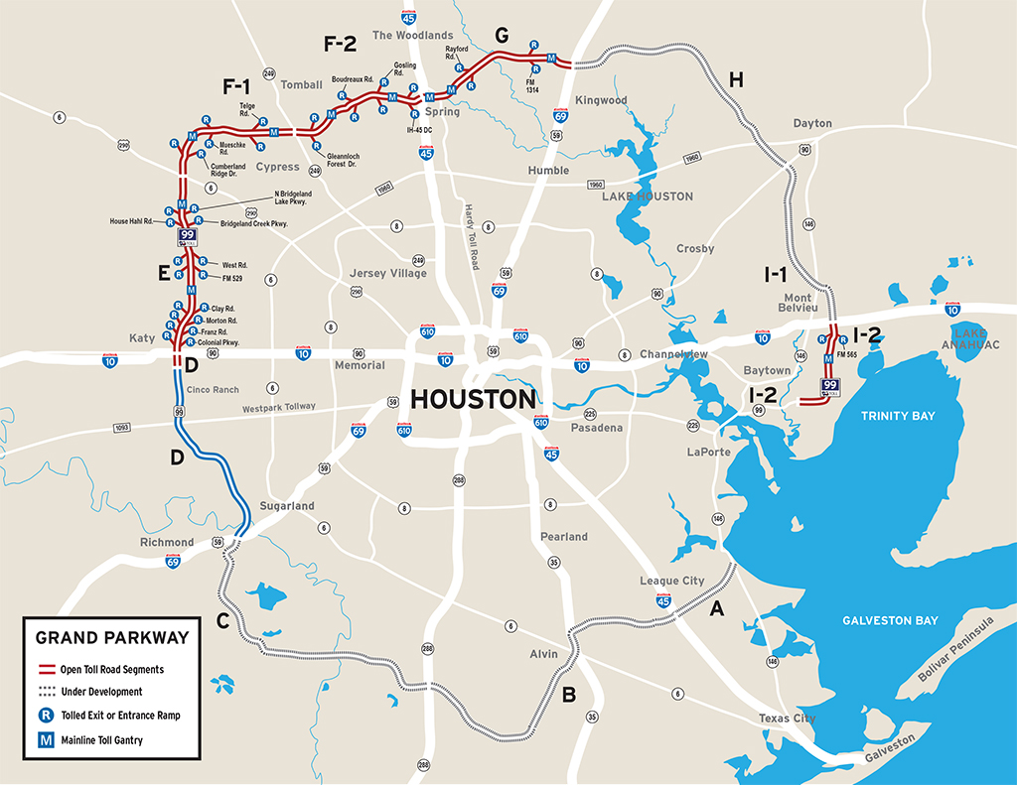
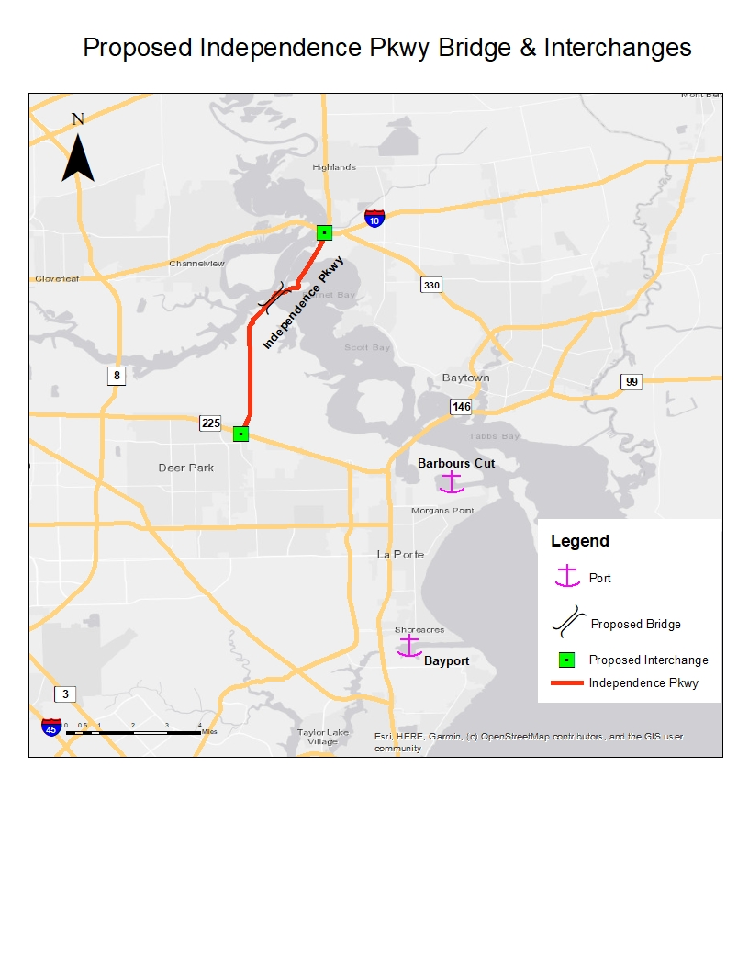
Infrastructure and Facilities
Highway Improvement Projects
  I-69 Bypass Independence Parkway Bridge

Slide 5
Multi-modal Improvements
Rail
  Houston-to-Dallas intermodal rail connection
  Inland Port
  On-dock and Near-Dock terminals
Container-on-Barge
  Dedicated container-on-barge dock
  Mobile container handling equipment
  Self-discharging barges
  Roll-on/Roll-off

Slide 6
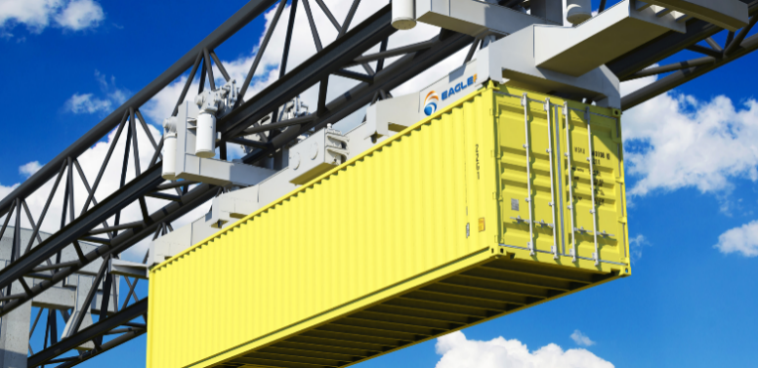
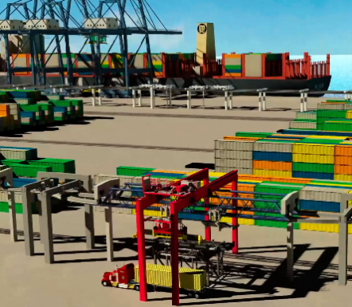
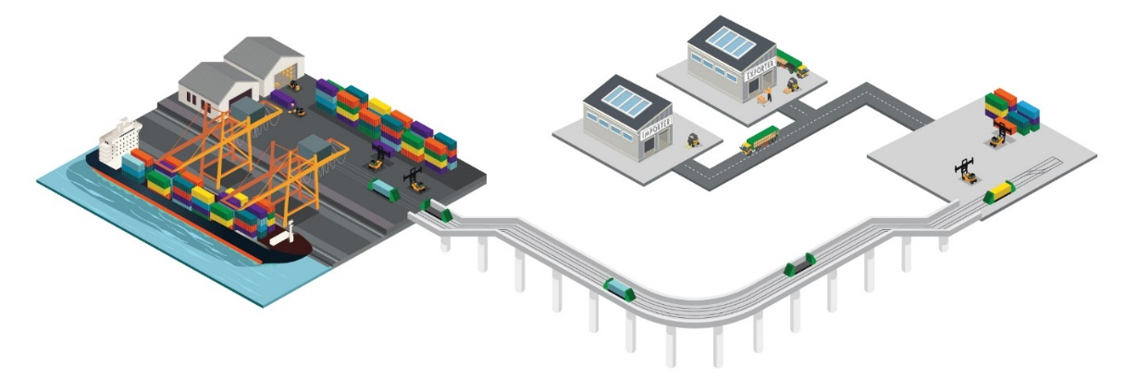
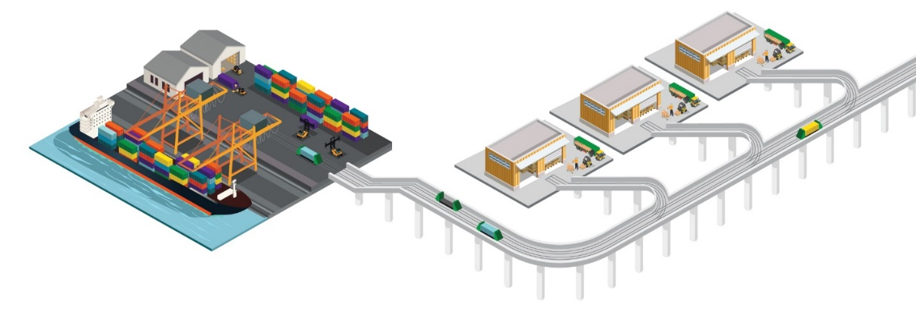
Alternative Transportation Systems
EagleRail Container Logistics
Freight Shuttle System

Slide 7
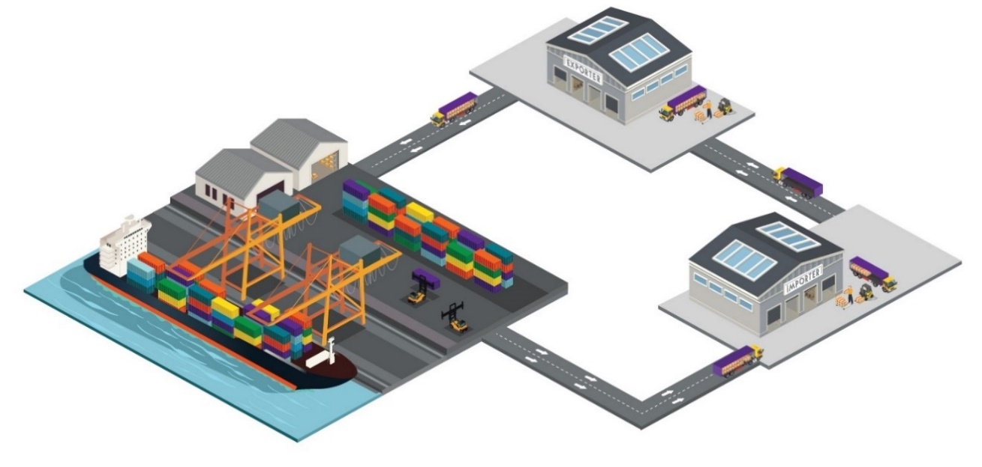
Operational Strategies
Street turn using Match back
Street turn using Virtual Container Yard

Slide 8
Policy Changes
Port Centric Logistics
Truck Reservation System
Extended Gate Times

