Slide 1







Infomaptic
Christopher Moravec, CTO

Slide 2


Custom GIS Solutions for your Business
Company Overview
Infomaptic Demo

Slide 3
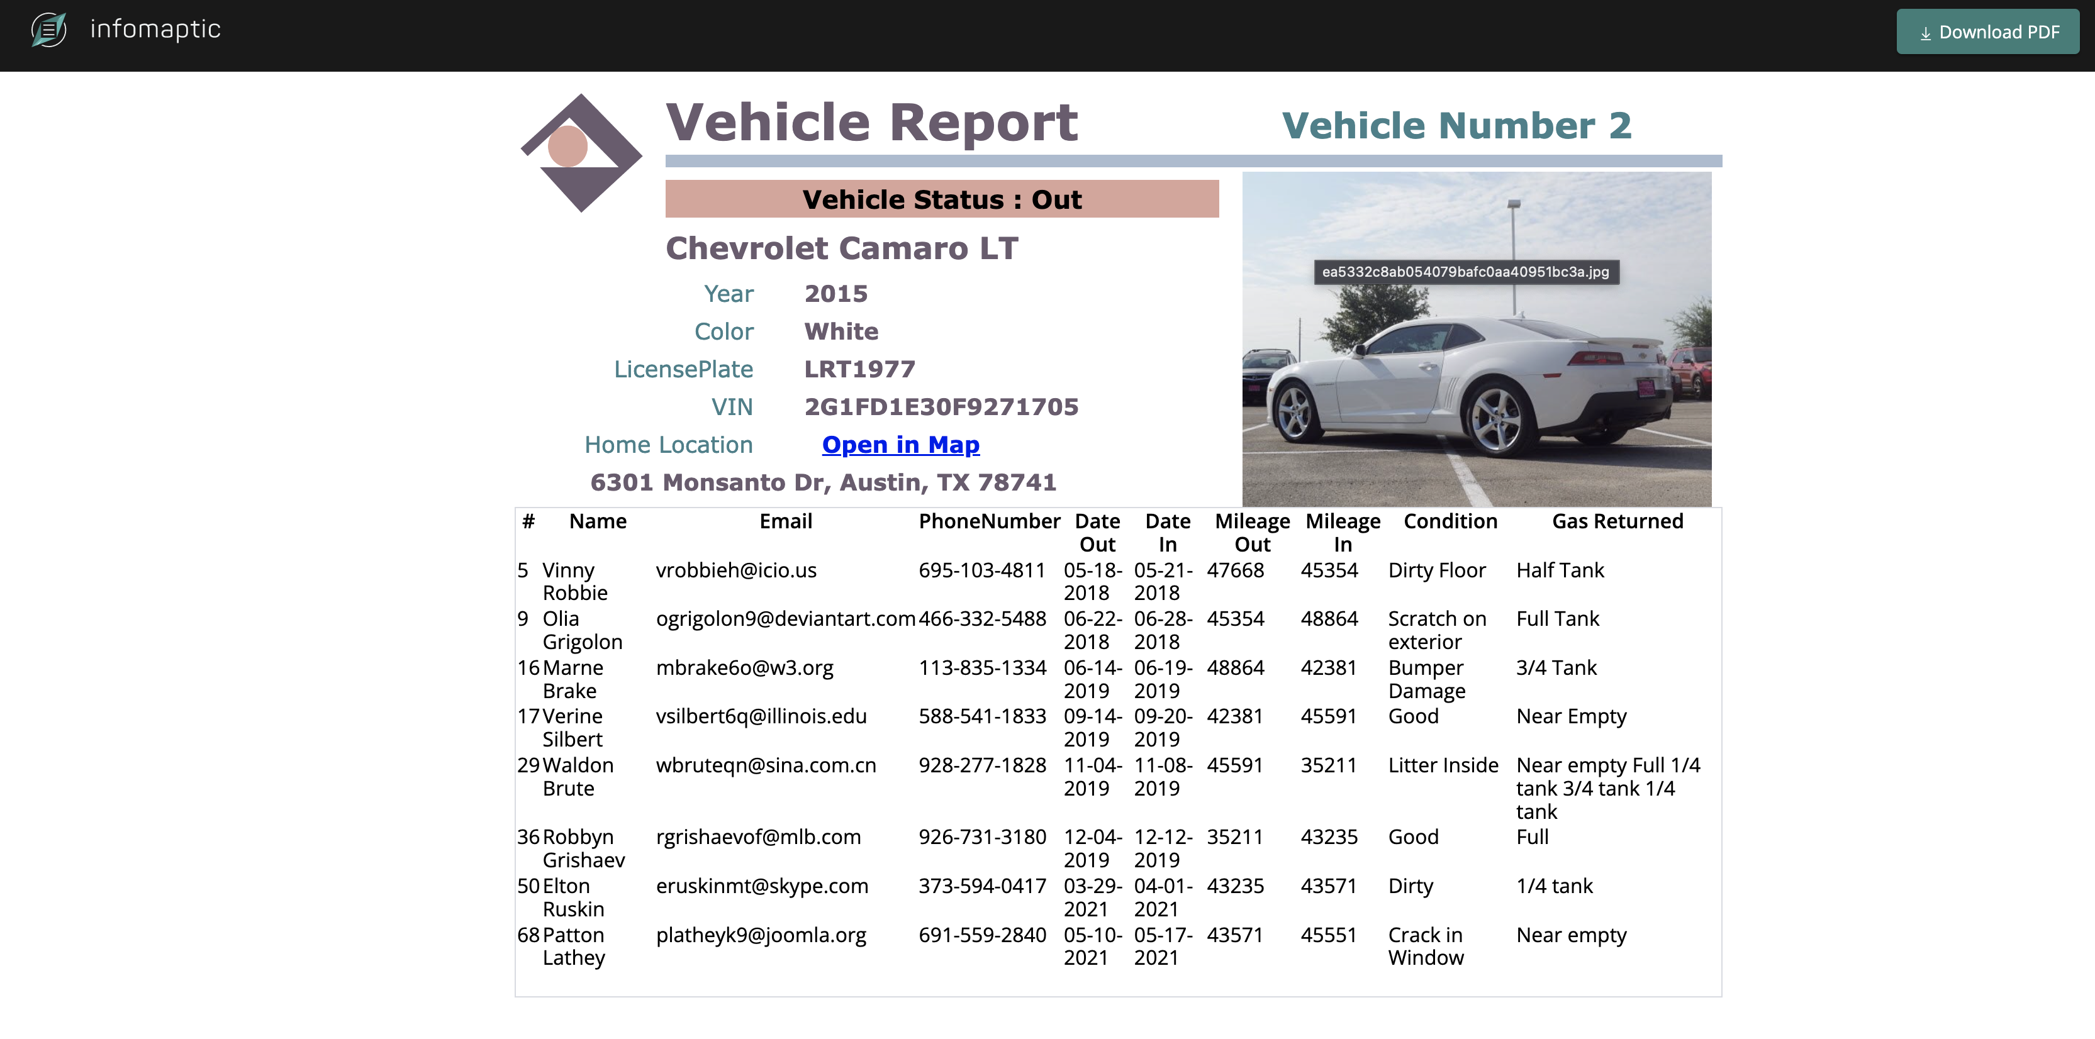

Slide 4
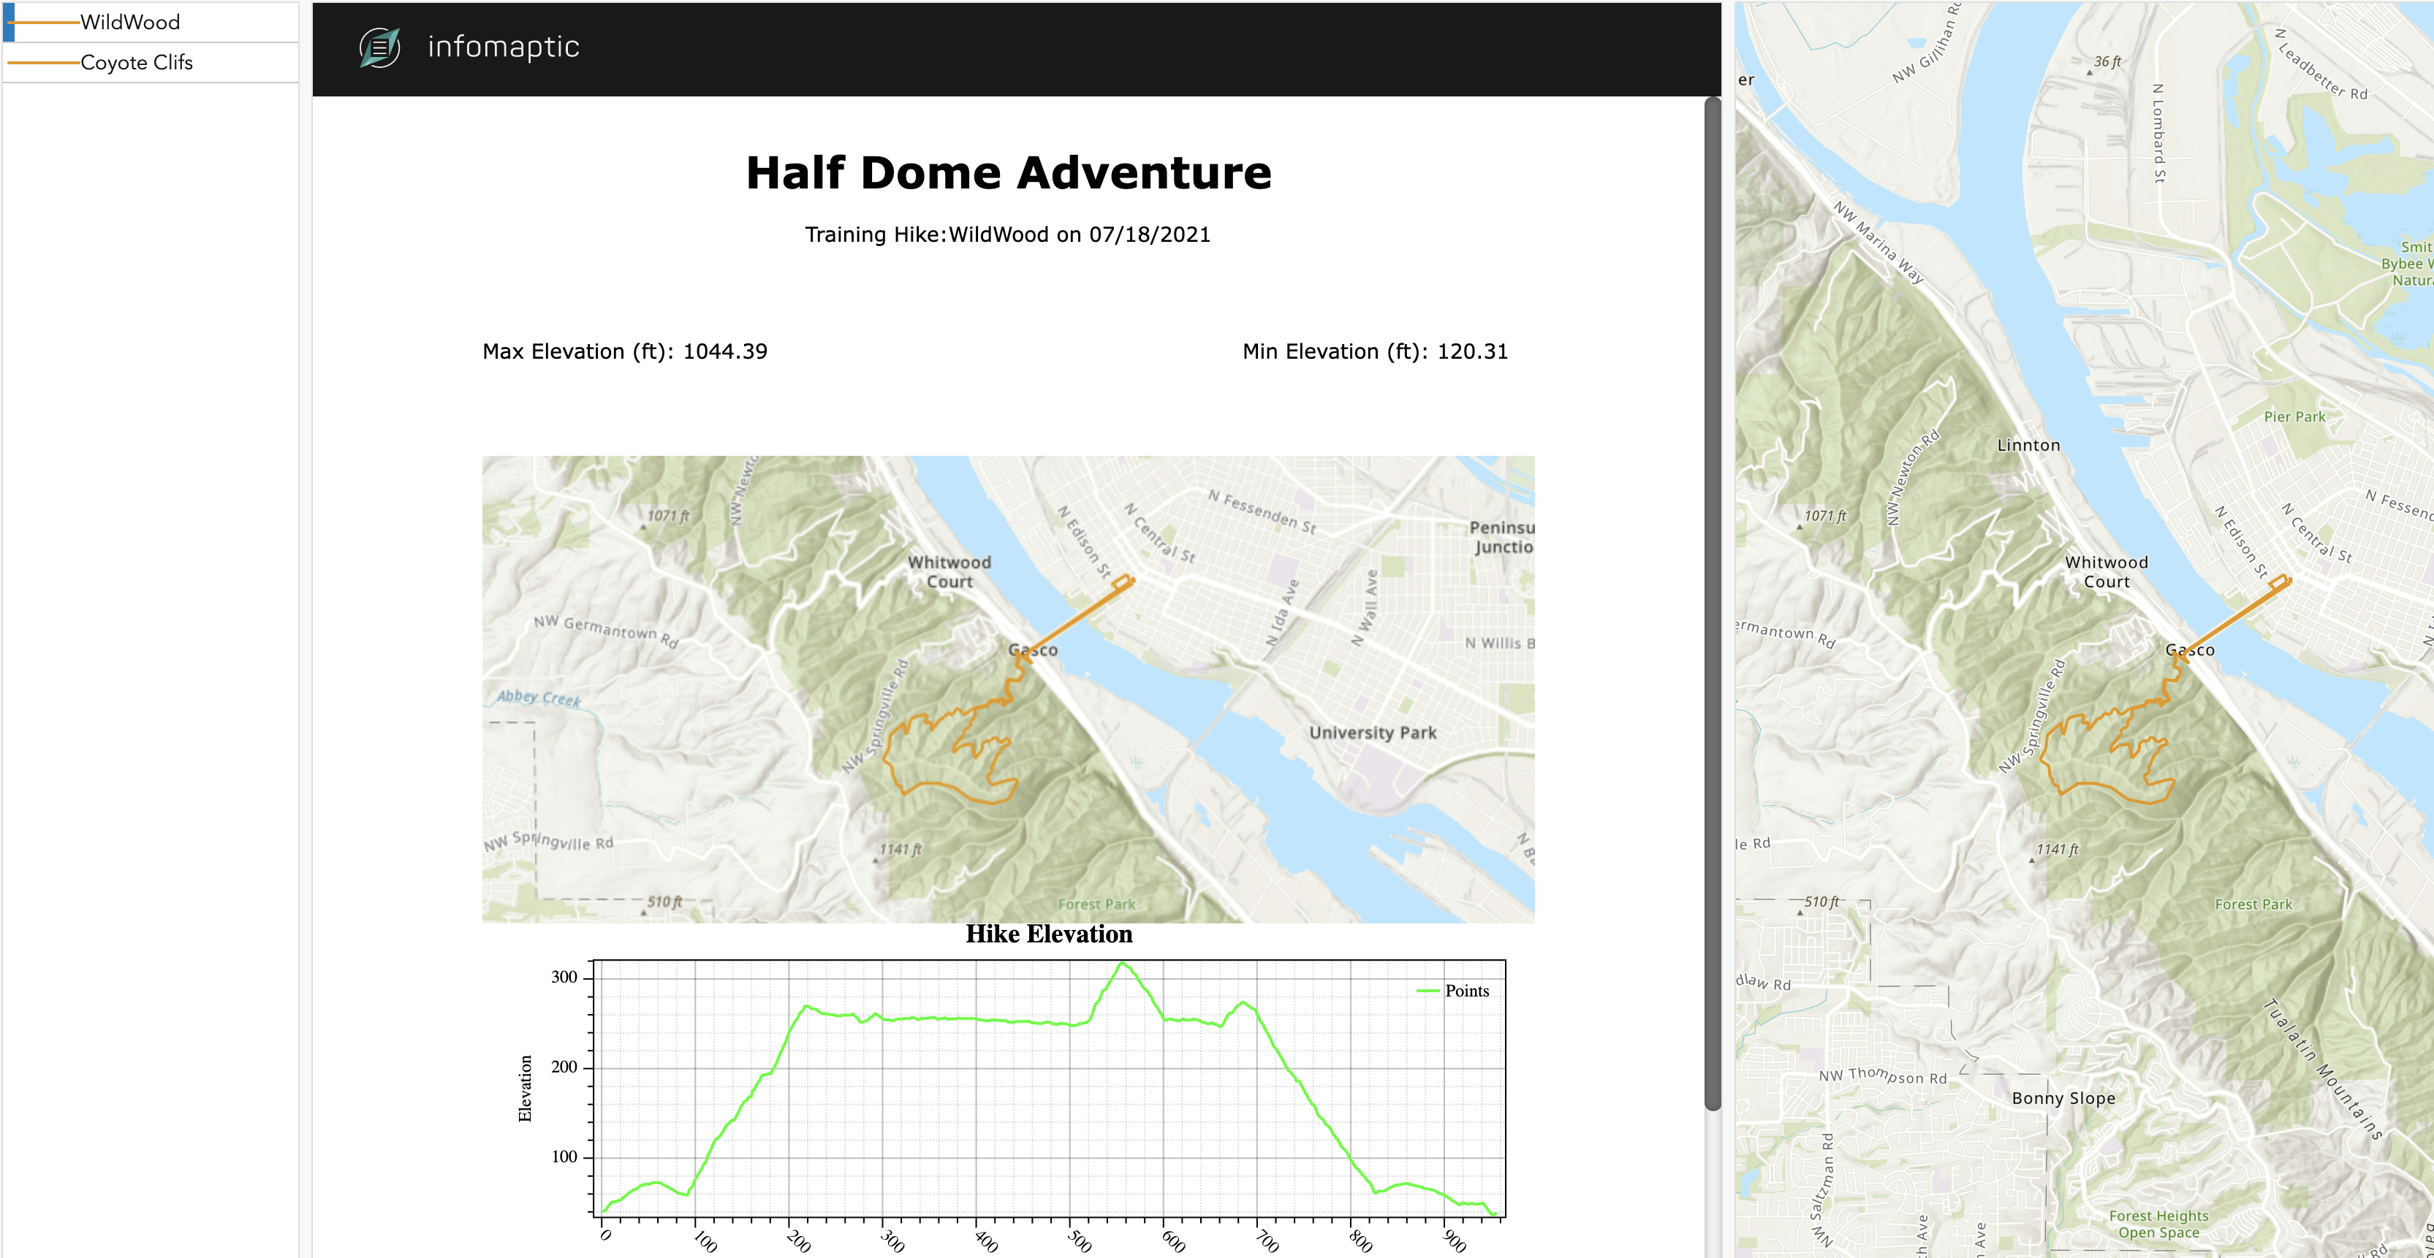

Slide 5
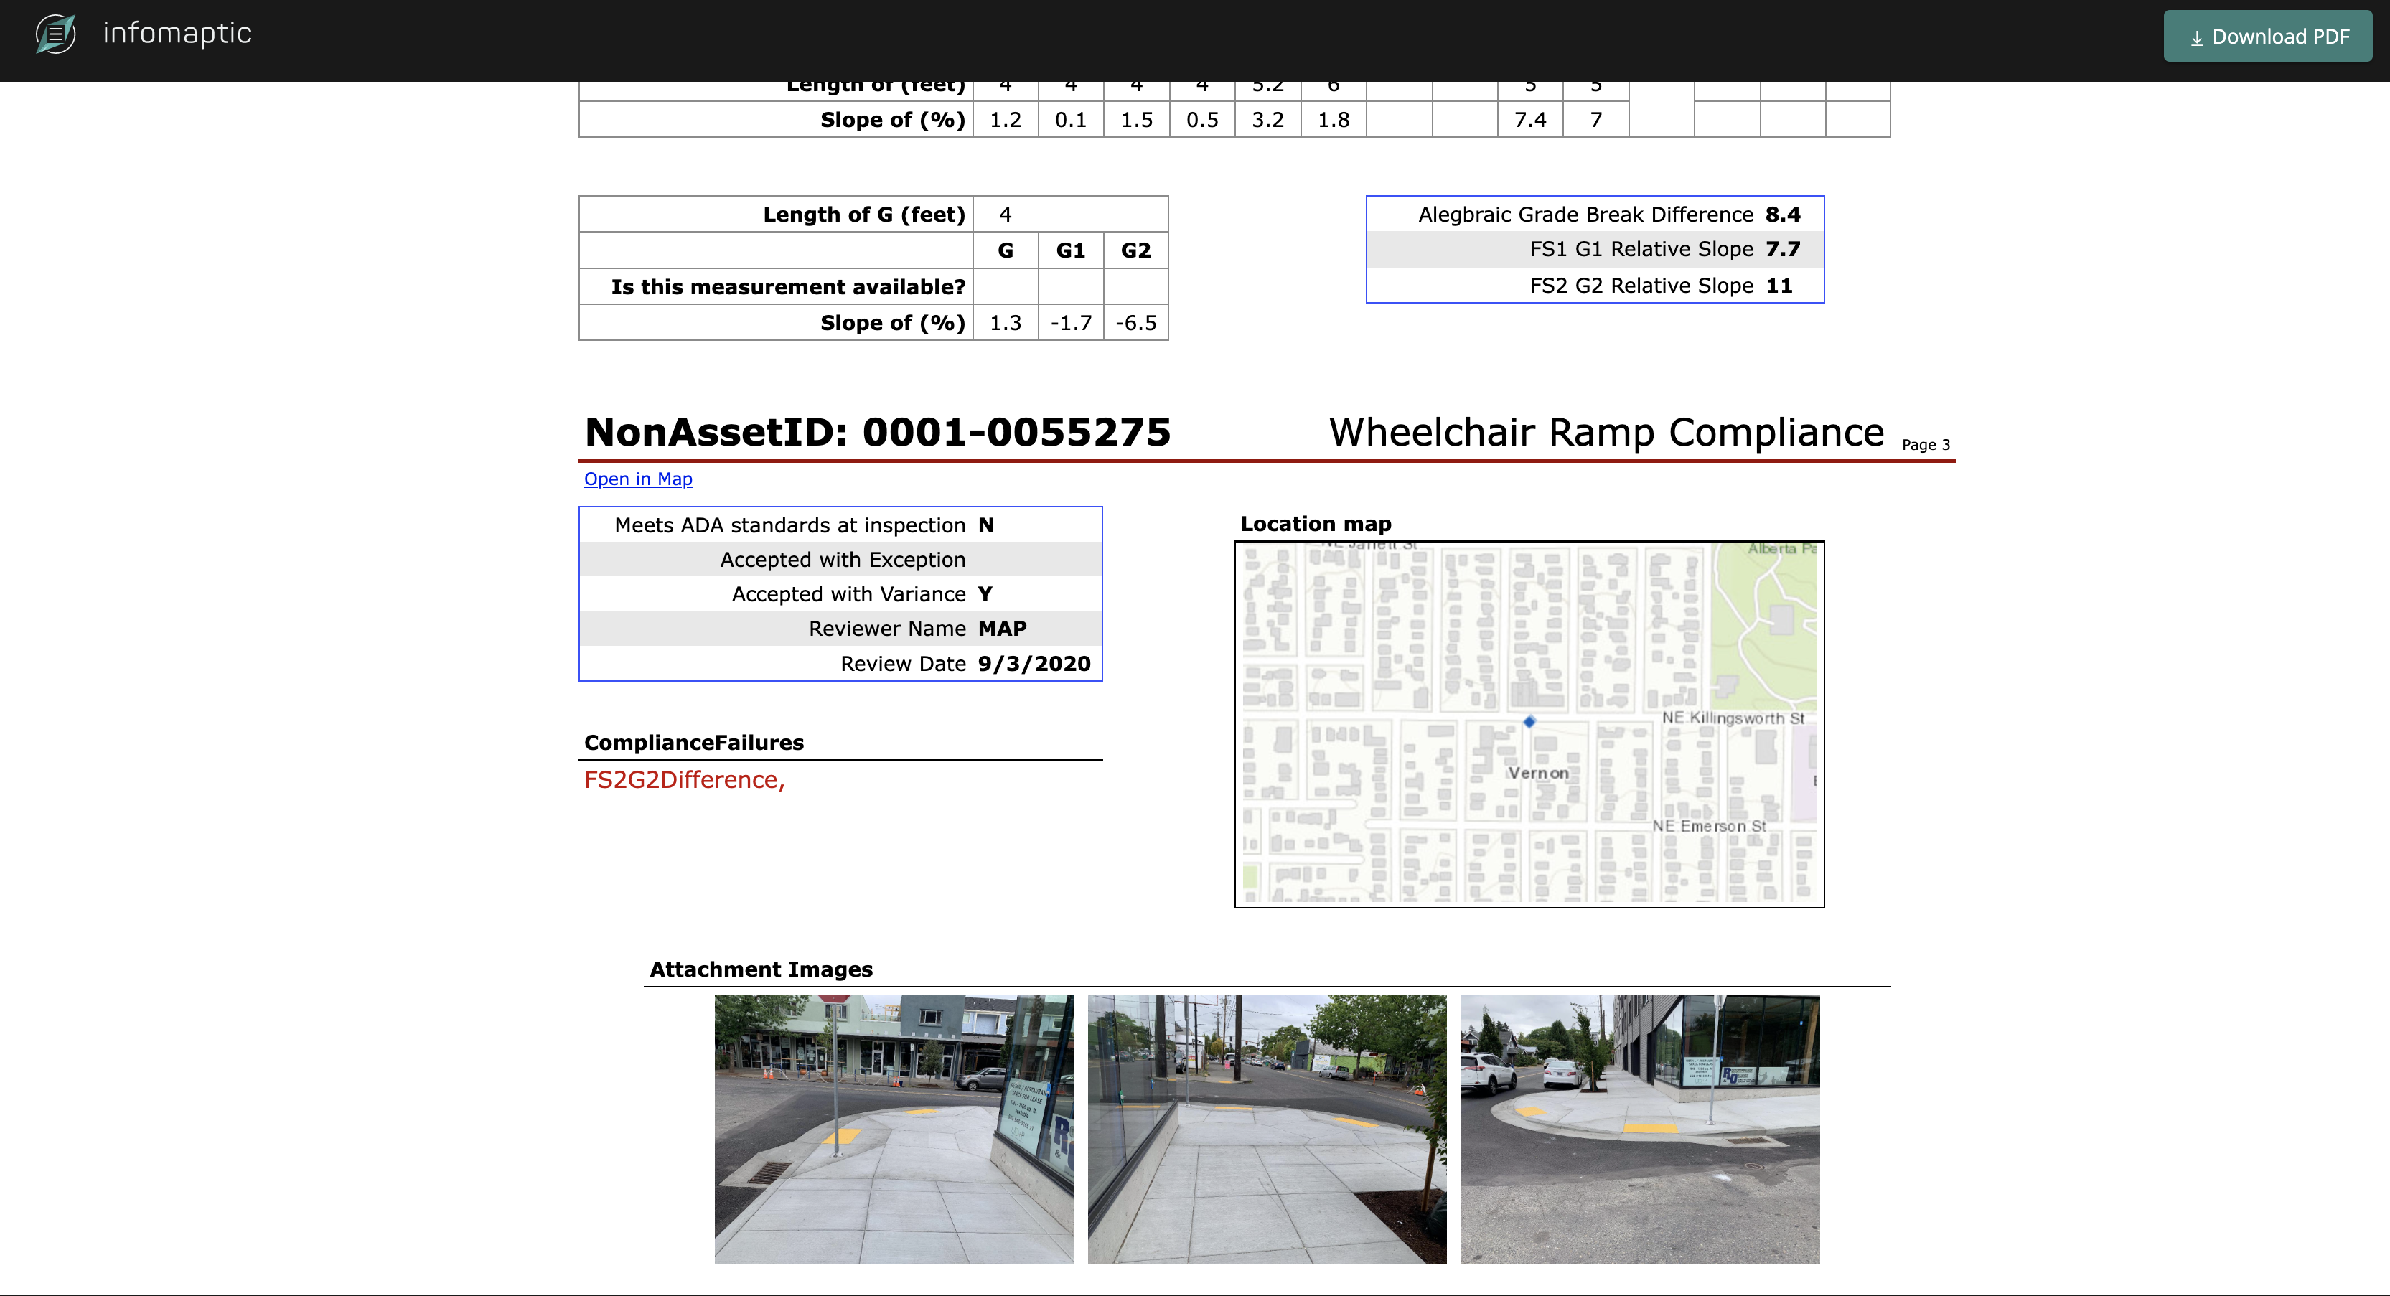

Slide 6

Thank You
Christopher Moravec
Dymaptic, CTO
christopher@dymaptic.com

