Slide 1
Environmental clearance process Project Development workshop
Denetia Robinson, MS
Environmental Manager
TxDOT Houston District

Slide 2
Presentation Overview
General purposed of Environmental Clearance
Project Environmental Classifications
Categorical Exclusion (CE)
Environmental Assessment (EA)
Environmental Impact Statement (EIS)
External Agency Coordination
Coast Guard (USCG)
Core of Engineers (USACE)

Slide 3
Environmental Clearance
The Environmental Clearance process is required for most projects and covers aspects of screening, scoping and evaluation of the project
The Main Purpose is to assess potential impacts of the planned project on the environment and people and try to abate or minimize
Project
Initiation
PS&E
Development
Environmental Process
Environmental Clearance
Letting and Award
Construction

Slide 4
The Council on Environmental Quality (CEQ) has provided guidance through a “Memorandum of Understanding” for Regulations for Implementing the Procedural Provisions of the National Environmental Policy Act (NEPA).

Slide 5
Environmental Classifications
The Texas Department of Transportation (TxDOT) utilizes the following classifications to assess a project:
Categorical Exclusions, including:
C (22)
Open-Ended (d) List CEs
Environmental Assessments (EA)
Environmental Impact Statements (EIS)
EA
Open Ended D ,
C (22)
EIS
CE

Slide 6
Categorical Exclusions
CE-level projects are projects that do not individually or cumulatively have a significant environmental effect (40 CFR 1508.4)
Normally do not require any further NEPA approvals by the FHWA (TxDOT and NEPA Assignment) (23 CFR 771.117)

Slide 7
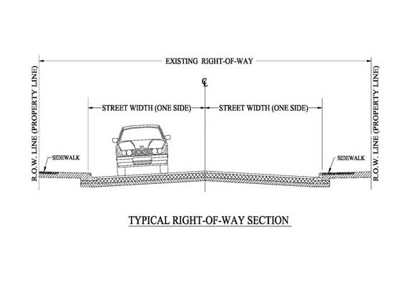
Categorical Exclusion – C (22)
C (22): projects entirely within the existing operational right-of-way
Based on programmatic agreement with the State Historic Preservation Officer, FHWA and the Advisory Council on Historic Preservation, they can not trigger:
Section 4(f)
Section 106
Endangered and Threatened Species
Clean Water Act/Rivers and Harbors Act

Slide 8
Categorical Exclusion – Open-Ended D
A project may be classified as an Open-Ended (d) if the activities of the project are on the cusp between CE and an EA
This classification type requires approval from TxDOT Environmental Affairs Division
This is for projects with activities that are not specifically included on the (c)- and (d)-lists.
There are number of criteria that must be met.

Slide 9
Open-Ended D Criteria
1. Do not have substantial controversy on environmental grounds
2. Do not induce significant impacts to planned growth or land use of the area;
3. Do not require the relocation of significant numbers of people
4. Do not have a significant impact on any natural, cultural, recreational, historic or other resources
5. Do not involve significant air, noise or water quality impacts
6. Do not have significant impacts on travel patterns
OR
7. Do not otherwise, either individually or cumulatively, have any significant environmental impacts

Slide 10
Environmental Assessment (EA)
Primary purpose of an EA is to help TxDOT determine whether or not an Environmental Impact Statement (EIS) is needed.
An EA is prepared when a project cannot be processed as a CE, and does not clearly require the preparation of an EIS or when an EA would assist in determining the need for an EIS
The end result is either a Finding of No Significant Impact (FONSI) or a recommendation that an EIS must be prepared.

Slide 11
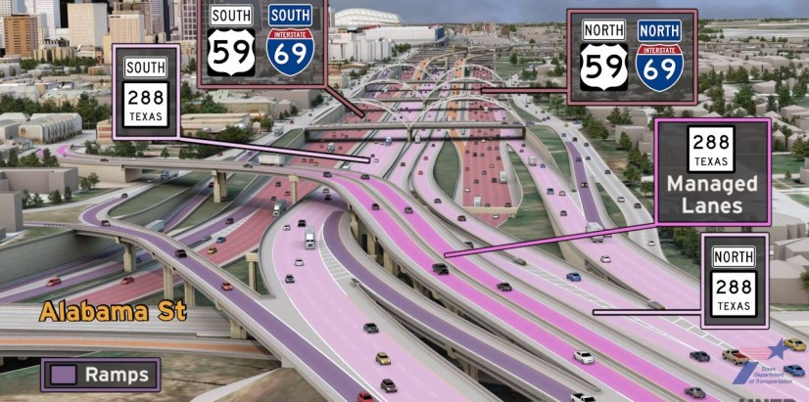
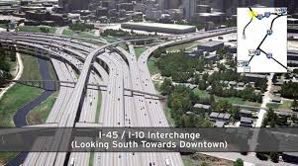
Environmental Impact Statement (EIS)
Required for:
A new controlled-access freeway
A highway project of four or more lanes on a new location
New construction or extension or a separate roadway for buses or high occupancy vehicles not located within an existing highway facility
New construction or extension of fixed rail transit facilities (e.g., rapid rail, light rail, commuter rail, automated guideway transit).

Slide 12
Environmental Impact Statement (EIS)
This level of project and documentation typically takes years of coordination and assessment.
Some examples of pieces of the process:
Notice of Intent (NOI)
Participating/Cooperating Agency Involvement
Coordination Plan and Schedule
Scoping Meetings (agency and public)
Public Meetings
Preparation of the Draft Environmental Impact Statement
Public Hearing(s)
Preparation of a Final Environmental Impact Statement
Preparation of a Record of Decision (ROD)
Section 139(l) Notice

Slide 13
United States Coast Guard (USCG)
United States Army Corps of Engineers
(USACE)
*Permitting is an important aspect of the environmental assessment process

Slide 14
U.S. Coast Guard (USCG)
This type of permit is required when work is being done in or over navigable, or historically navigable, waters
Common work may include new bridges, dolphin and fender systems, etc.
Also includes modification of any existing structures within navigable waters
The application process requires at least 60% design to move forward with permitting

Slide 15
USCG Cont’d
There are two types of actions:
Permits
Typical turn-around time is approximately 12 months
Exemptions
Applies to work done in and or over waterways used by watercrafts smaller than 21 feet in length
All NEPA requirements and other agency permits (USACE, USFWS Section 7) must be completed prior to issuance of US Coast Guard Permit

Slide 16
U.S. Army Corps of Engineers (USACE)
Delineations are performed to determine waters that are jurisdictional under the Clean Water Act (CWA)
Permits required for any work done in special aquatic sites, such as wetlands
Permits required for work done below the ordinary high water mark of rivers, streams, channels, etc.

Slide 17
USACE Cont’d
Nation Wide Permit (NWP) Program for impacts below set thresholds
Process typically takes 3-6 months
Individual Permits required for impacts greater than set thresholds –
Process averages about 18 months

Slide 18
Thank you
Questions?

