Slide 1
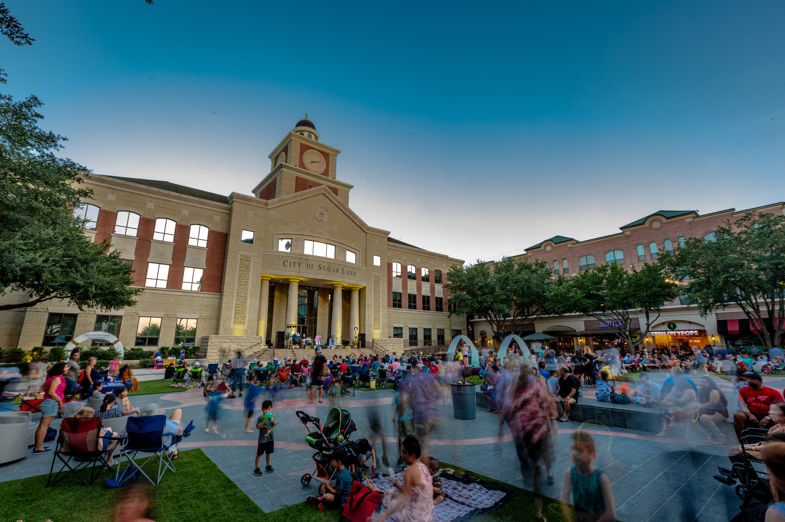


GCEDD BOARD MEETING
NOVEMBER 5, 2025

Slide 2

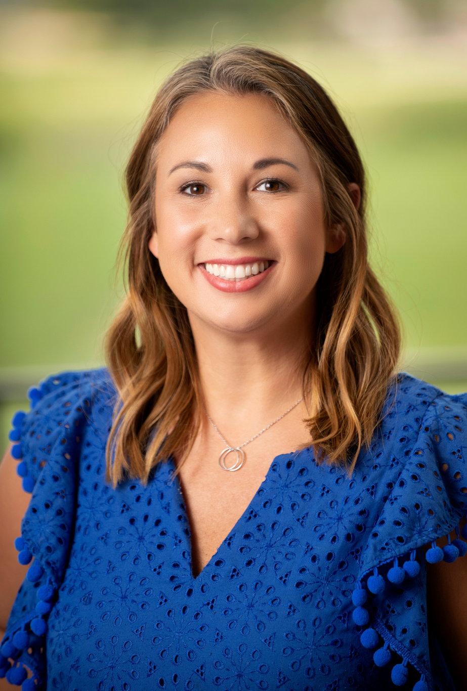
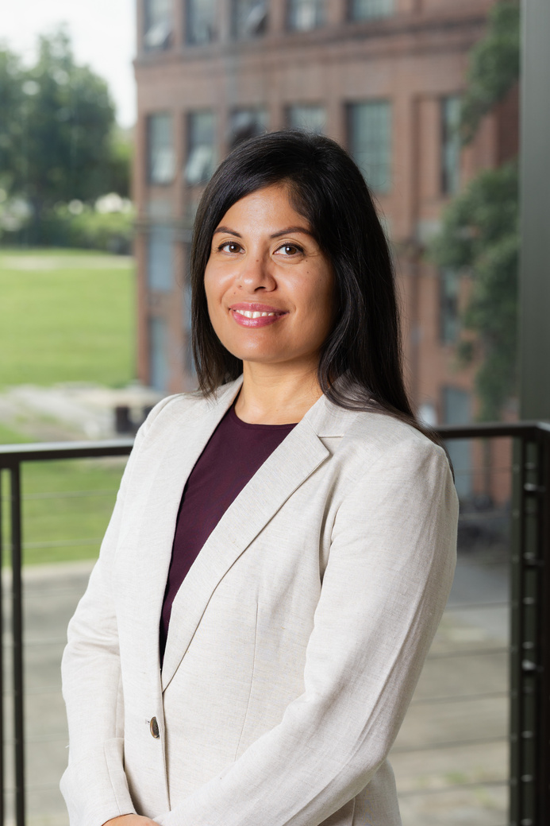
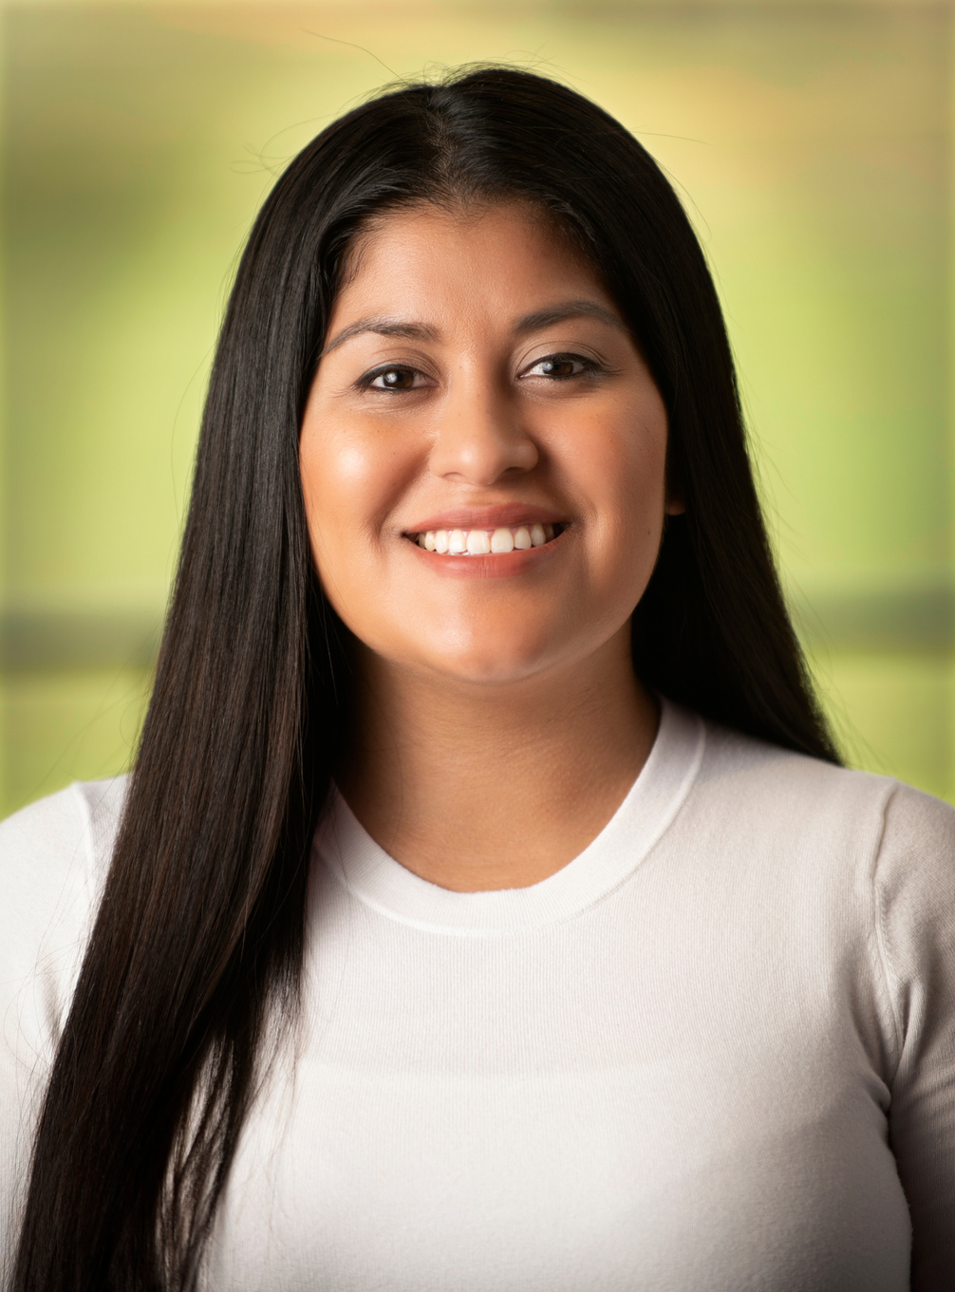

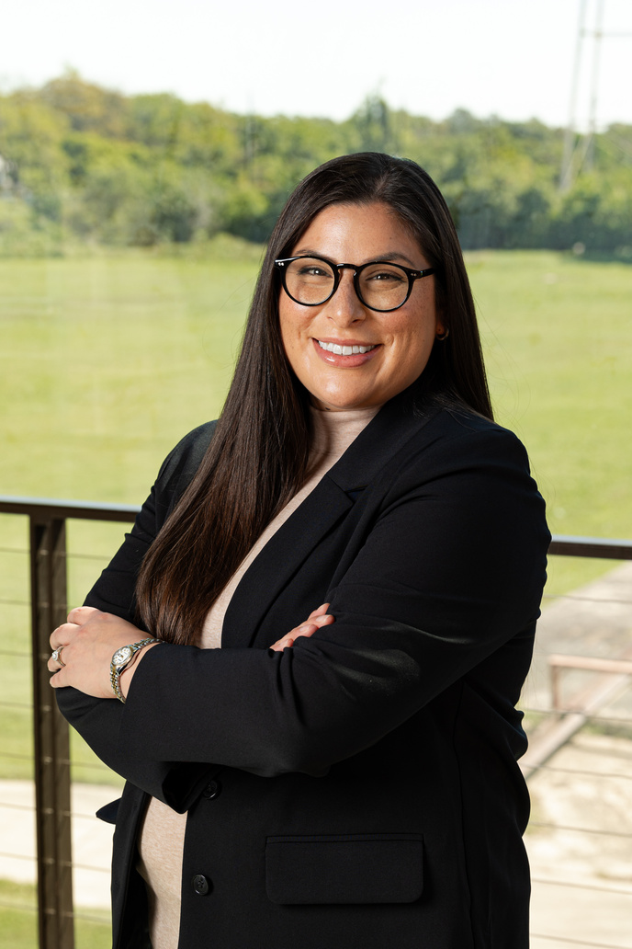
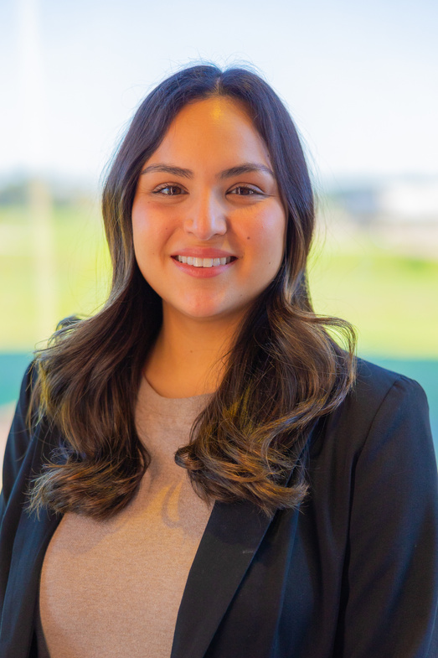
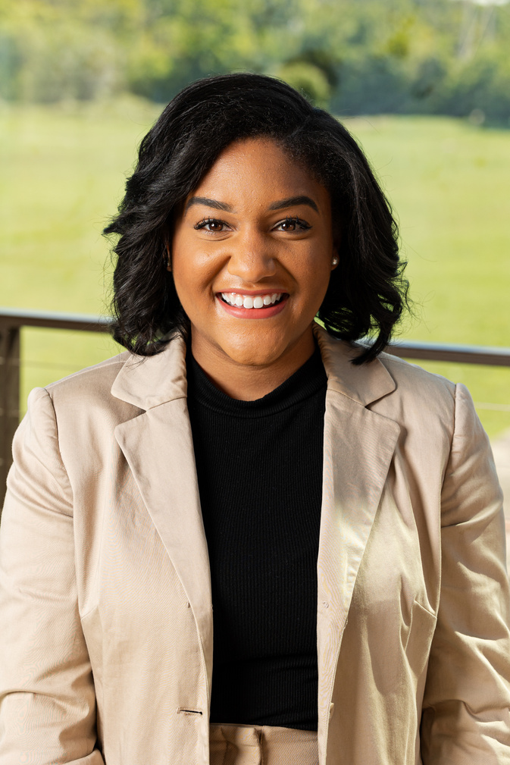
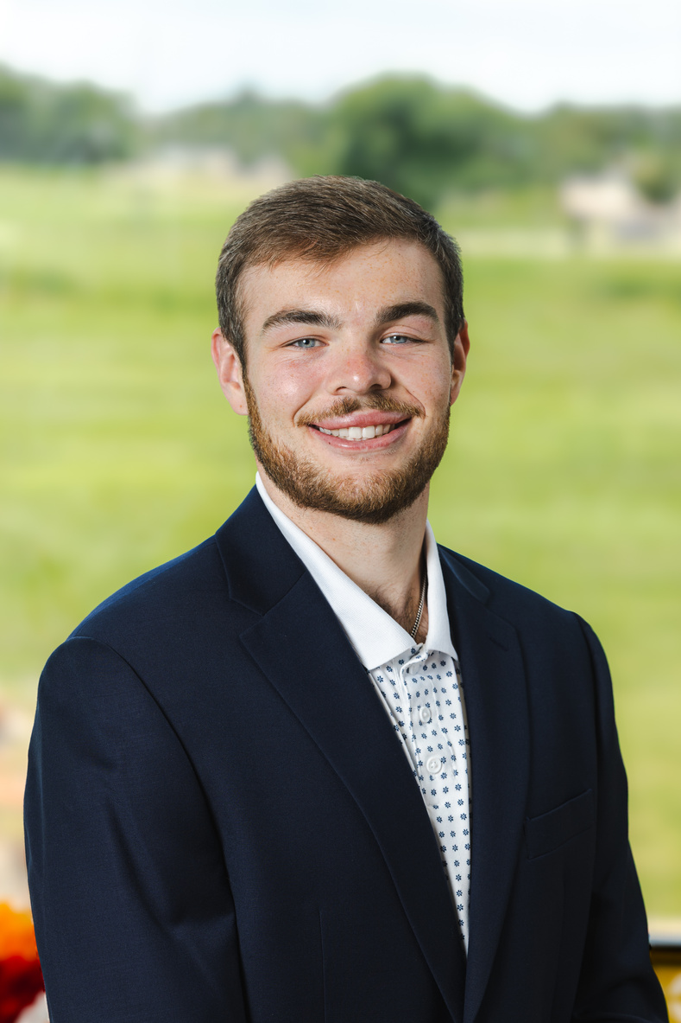
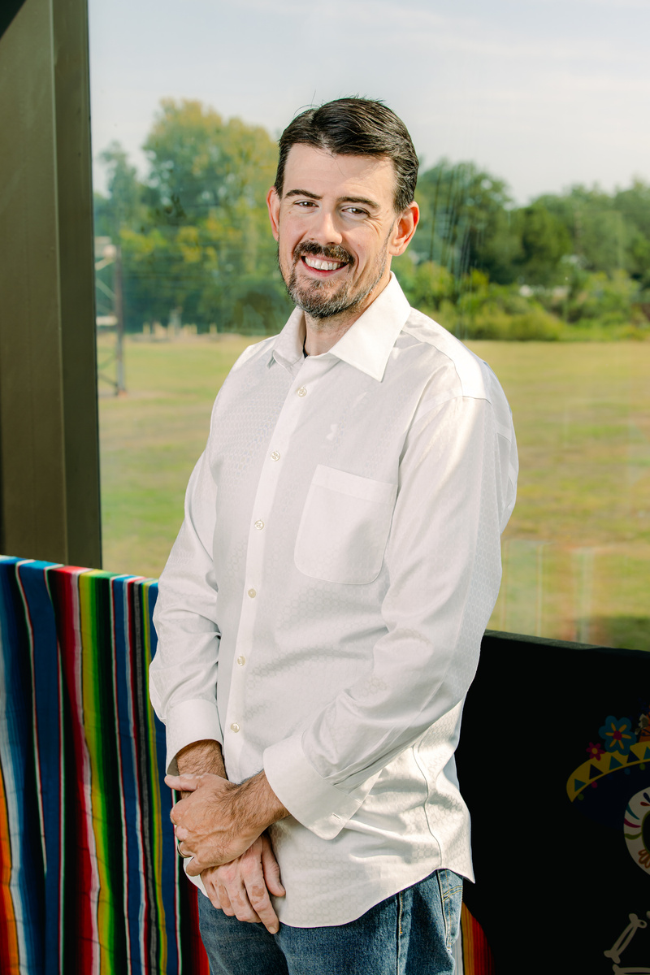
DEPARTMENT OF ECONOMIC DEVELOPMENT AND TOURISM
Elizabeth Huff Director
Gabriela Robinson
Administrative Assistant
Alba Penate-Johnson
Assistant Director
Alison Brooks
Assistant Director
Jennifer Alexander
Bus Dev Manager
Compliance and Budget Analyst
Jordan Cutler
Sr. Marketing
Manager
Alyssa Abdulla
Director of Sales
Colby Millenbruch
Business Recruitment Manager
Kevin Floyd
Special Projects Coordinator
Olvia Valdez
Digital
Marketing
Coordinator
Marketing & Engagement
Coordinator

Slide 3

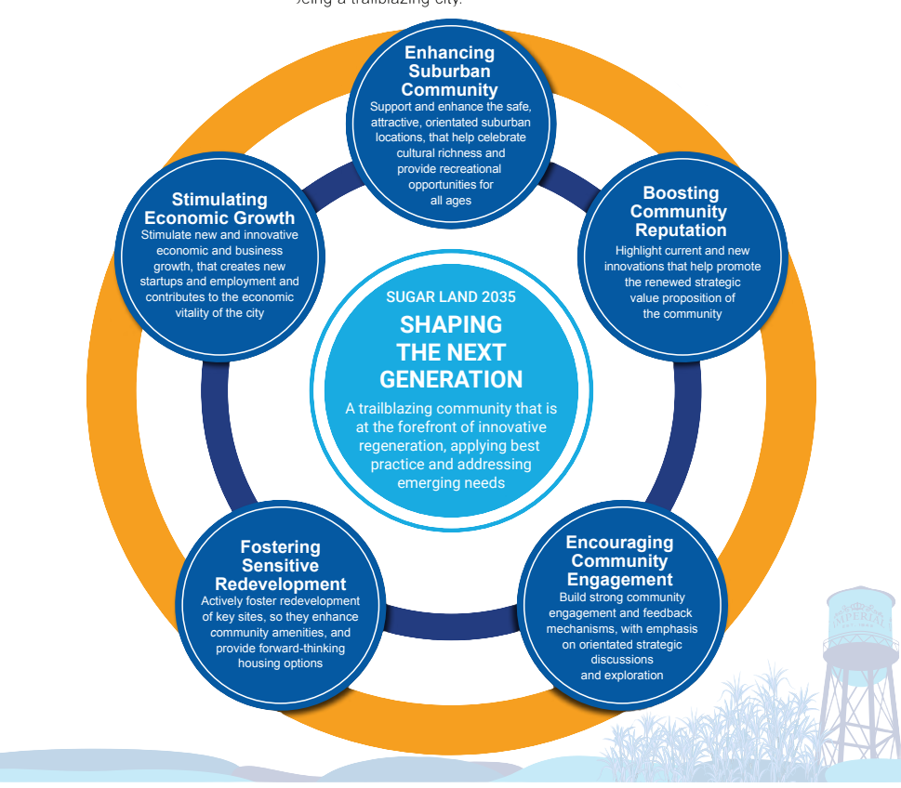
STRATEGIC PLAN - ALL IN INITIATIVES
Stimulating Economic Growth: Key Objectives
  Fostering an Innovation Ecosystem: Supporting startups, research, and high-tech industries.
  Cultivating and Maintaining Business Partnerships: Strengthening relationships with local businesses and educational institutions.
  Job Creation and Talent Retention: Making Sugar Land a top destination for professionals and entrepreneurs.
  Establishing a Bold Tourism Strategy: Leveraging attractions, events, and culinary experiences to boost local businesses.

Slide 4



BUSINESS RECRUITMENT
  Connected with 100+ global life sciences companies
  Generated 4 qualified business leads for Sugar Land
  Strengthened partnerships with GHP + regional allies
  Scheduled 2 company and media meetings
  Engaged with 3 international delegations
  Positioned Sugar Land as part of the Houston region’s investment story on a global stage
Batch 1:
  Accelerated 10 startups
  $6.5 million + capital raised
  2 Investments

Slide 5

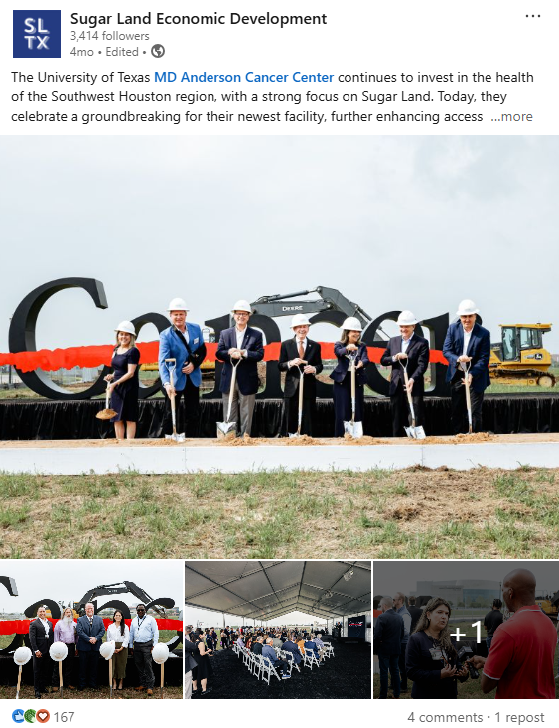


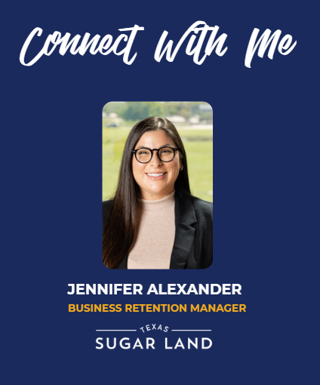

BUSINESS RETENTION AND EXPANSION
29
Strengthened Relationships
29 visits with local business and property owners
Completed Business Retention Visits
Community Engagement
Networking mixer hosted at Talyard Brewing with 100+ attendees
Business Growth
MD Anderson expansion reinforces Sugar Land’s position in healthcare & life sciences

Slide 6
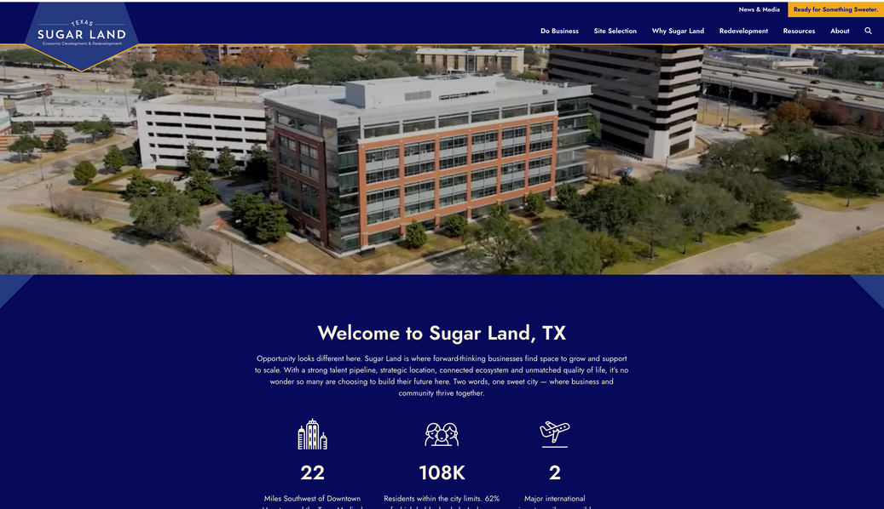

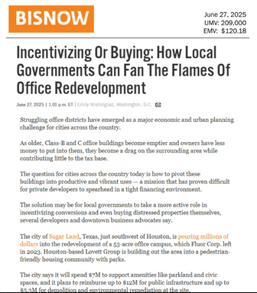
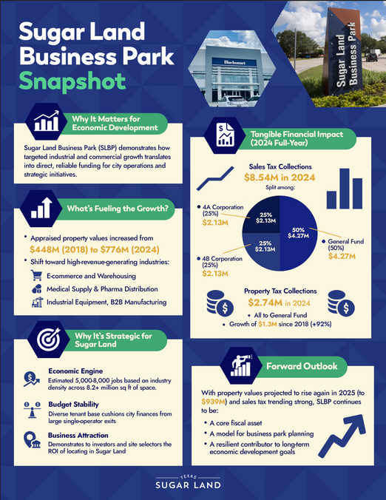
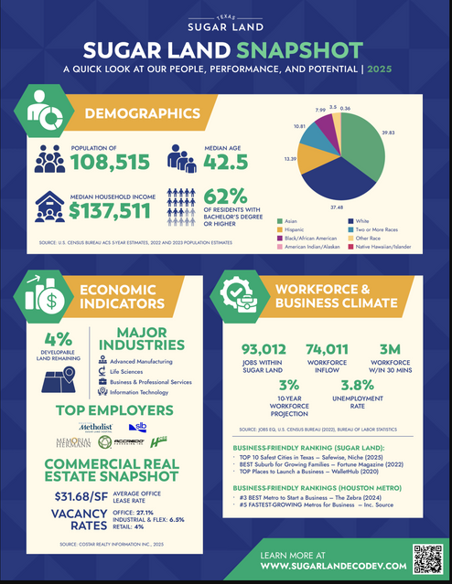
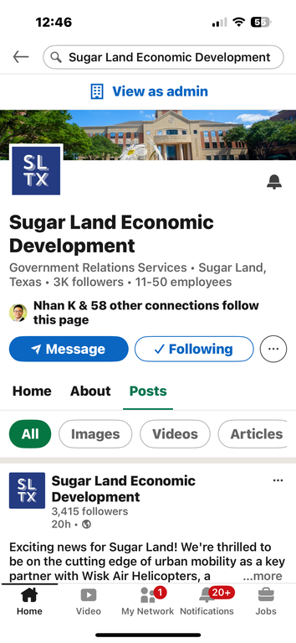
MARKETING
Marketing Impact Overview
  Website: 1,400+ monthly visitors
  Advertising & Sponsorships: 275K+ impressions (BIO 2025)
  Collateral: High-quality materials for pitches/events
  PR: $381K+ earned media (as of July 2025)
  LinkedIn (Jan–Aug 2025):
    131K+ impressions (+56%)
    17K+ engagements (+80%)
    13K+ clicks (+99%)
    555 new followers (+98%)
    12.9% engagement rate (Top 73rd percentile)

Slide 7
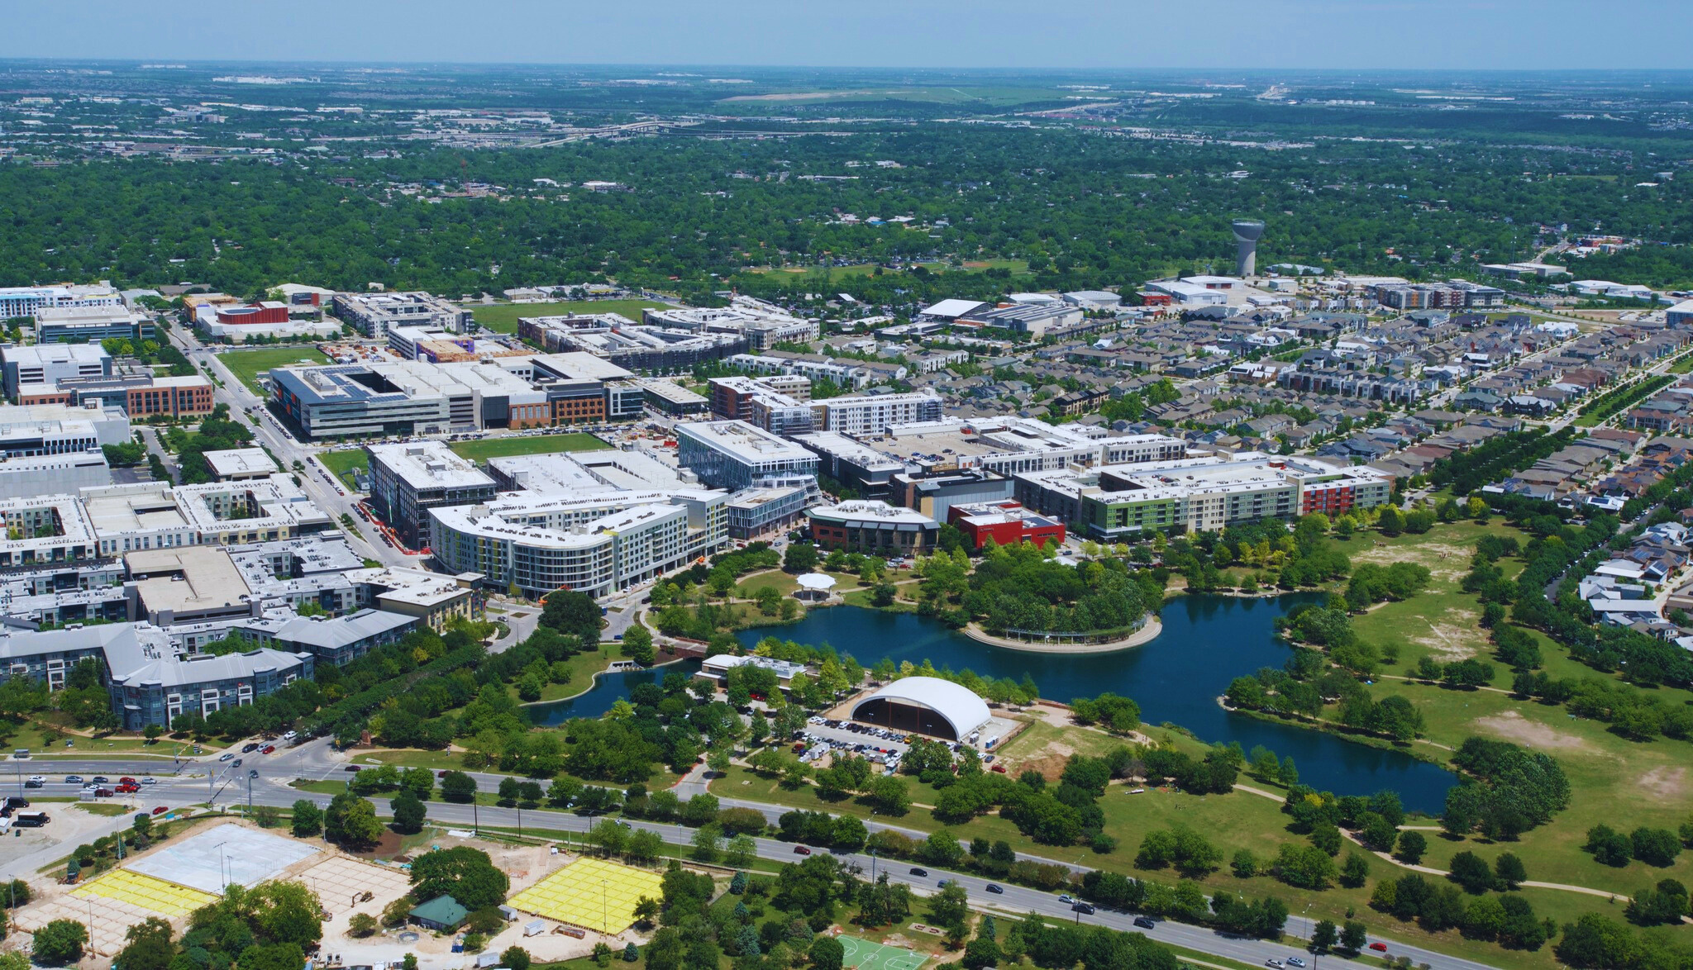
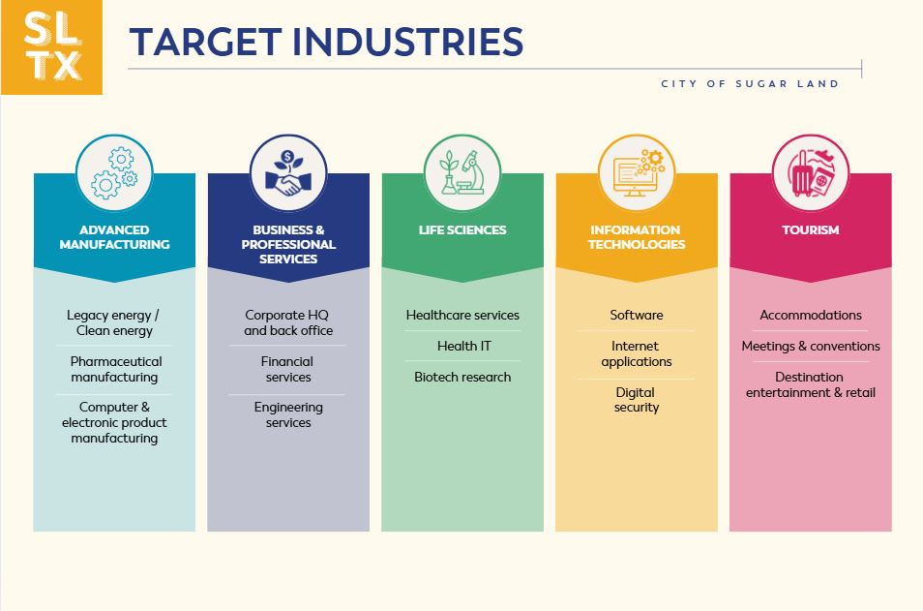
TARGETED INDUSTRIES

Slide 8
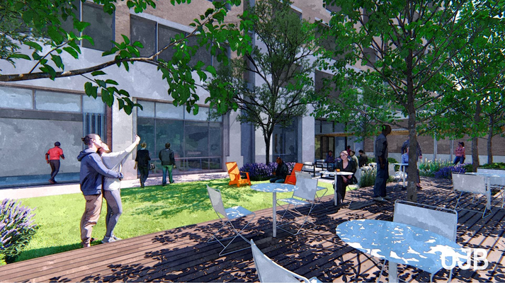
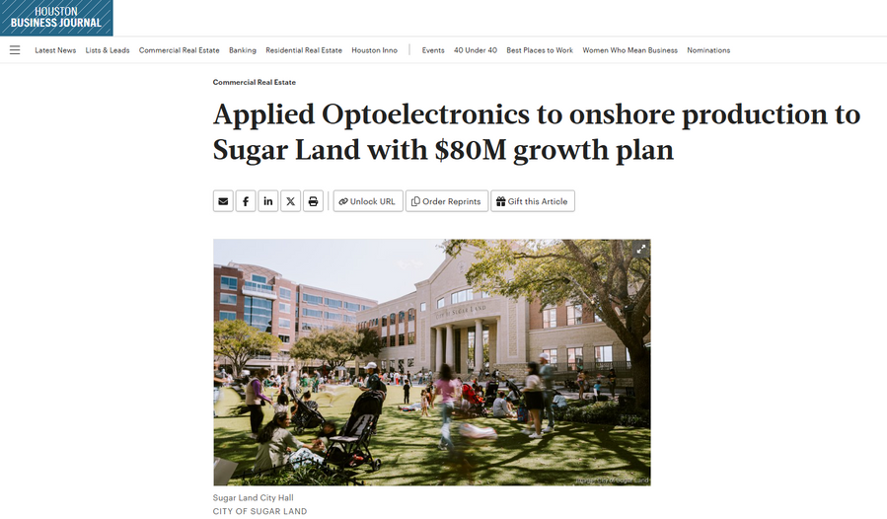
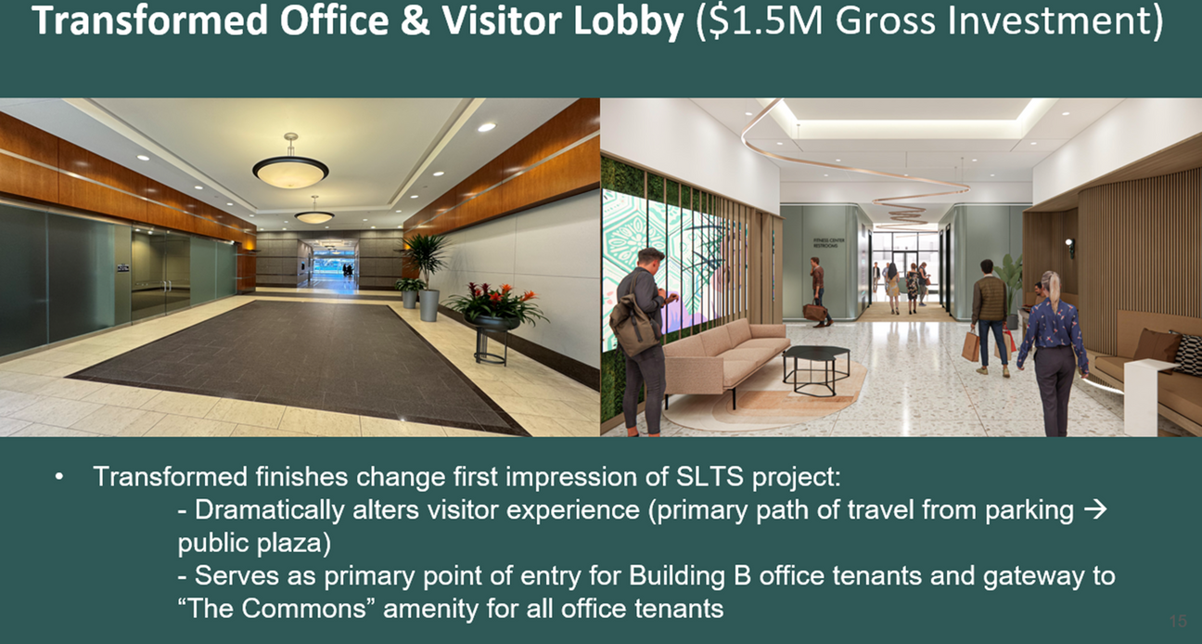
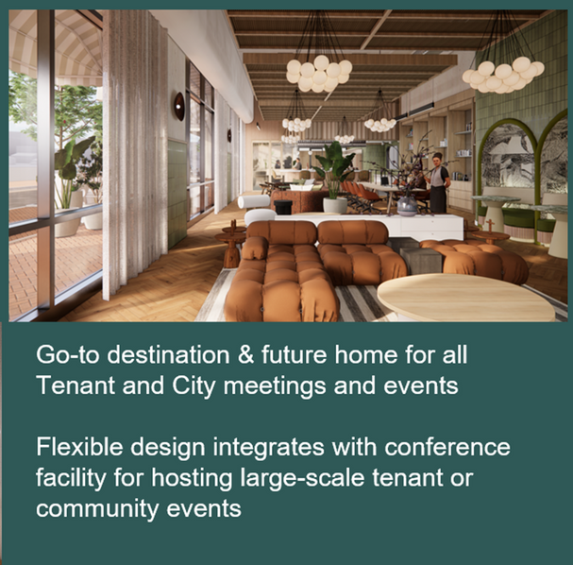
PROJECTS WON
In May 2025, SL4B and SLDC approved three performance agreements with LCFRE Sugar Land Town Square, LLC., allocating $12.5M over the next 5 years
The 2025 expansion includes a direct incentive of $2,000,000 to be paid over 10 fiscal years, with a 10-year term. As part of the performance obligations, the company will sign a new 10-year lease at 1111 Gillingham Lane, create 500 new jobs with an average annual salary of $61,240, and invest $77,000,000 in capital improvements.

Slide 9
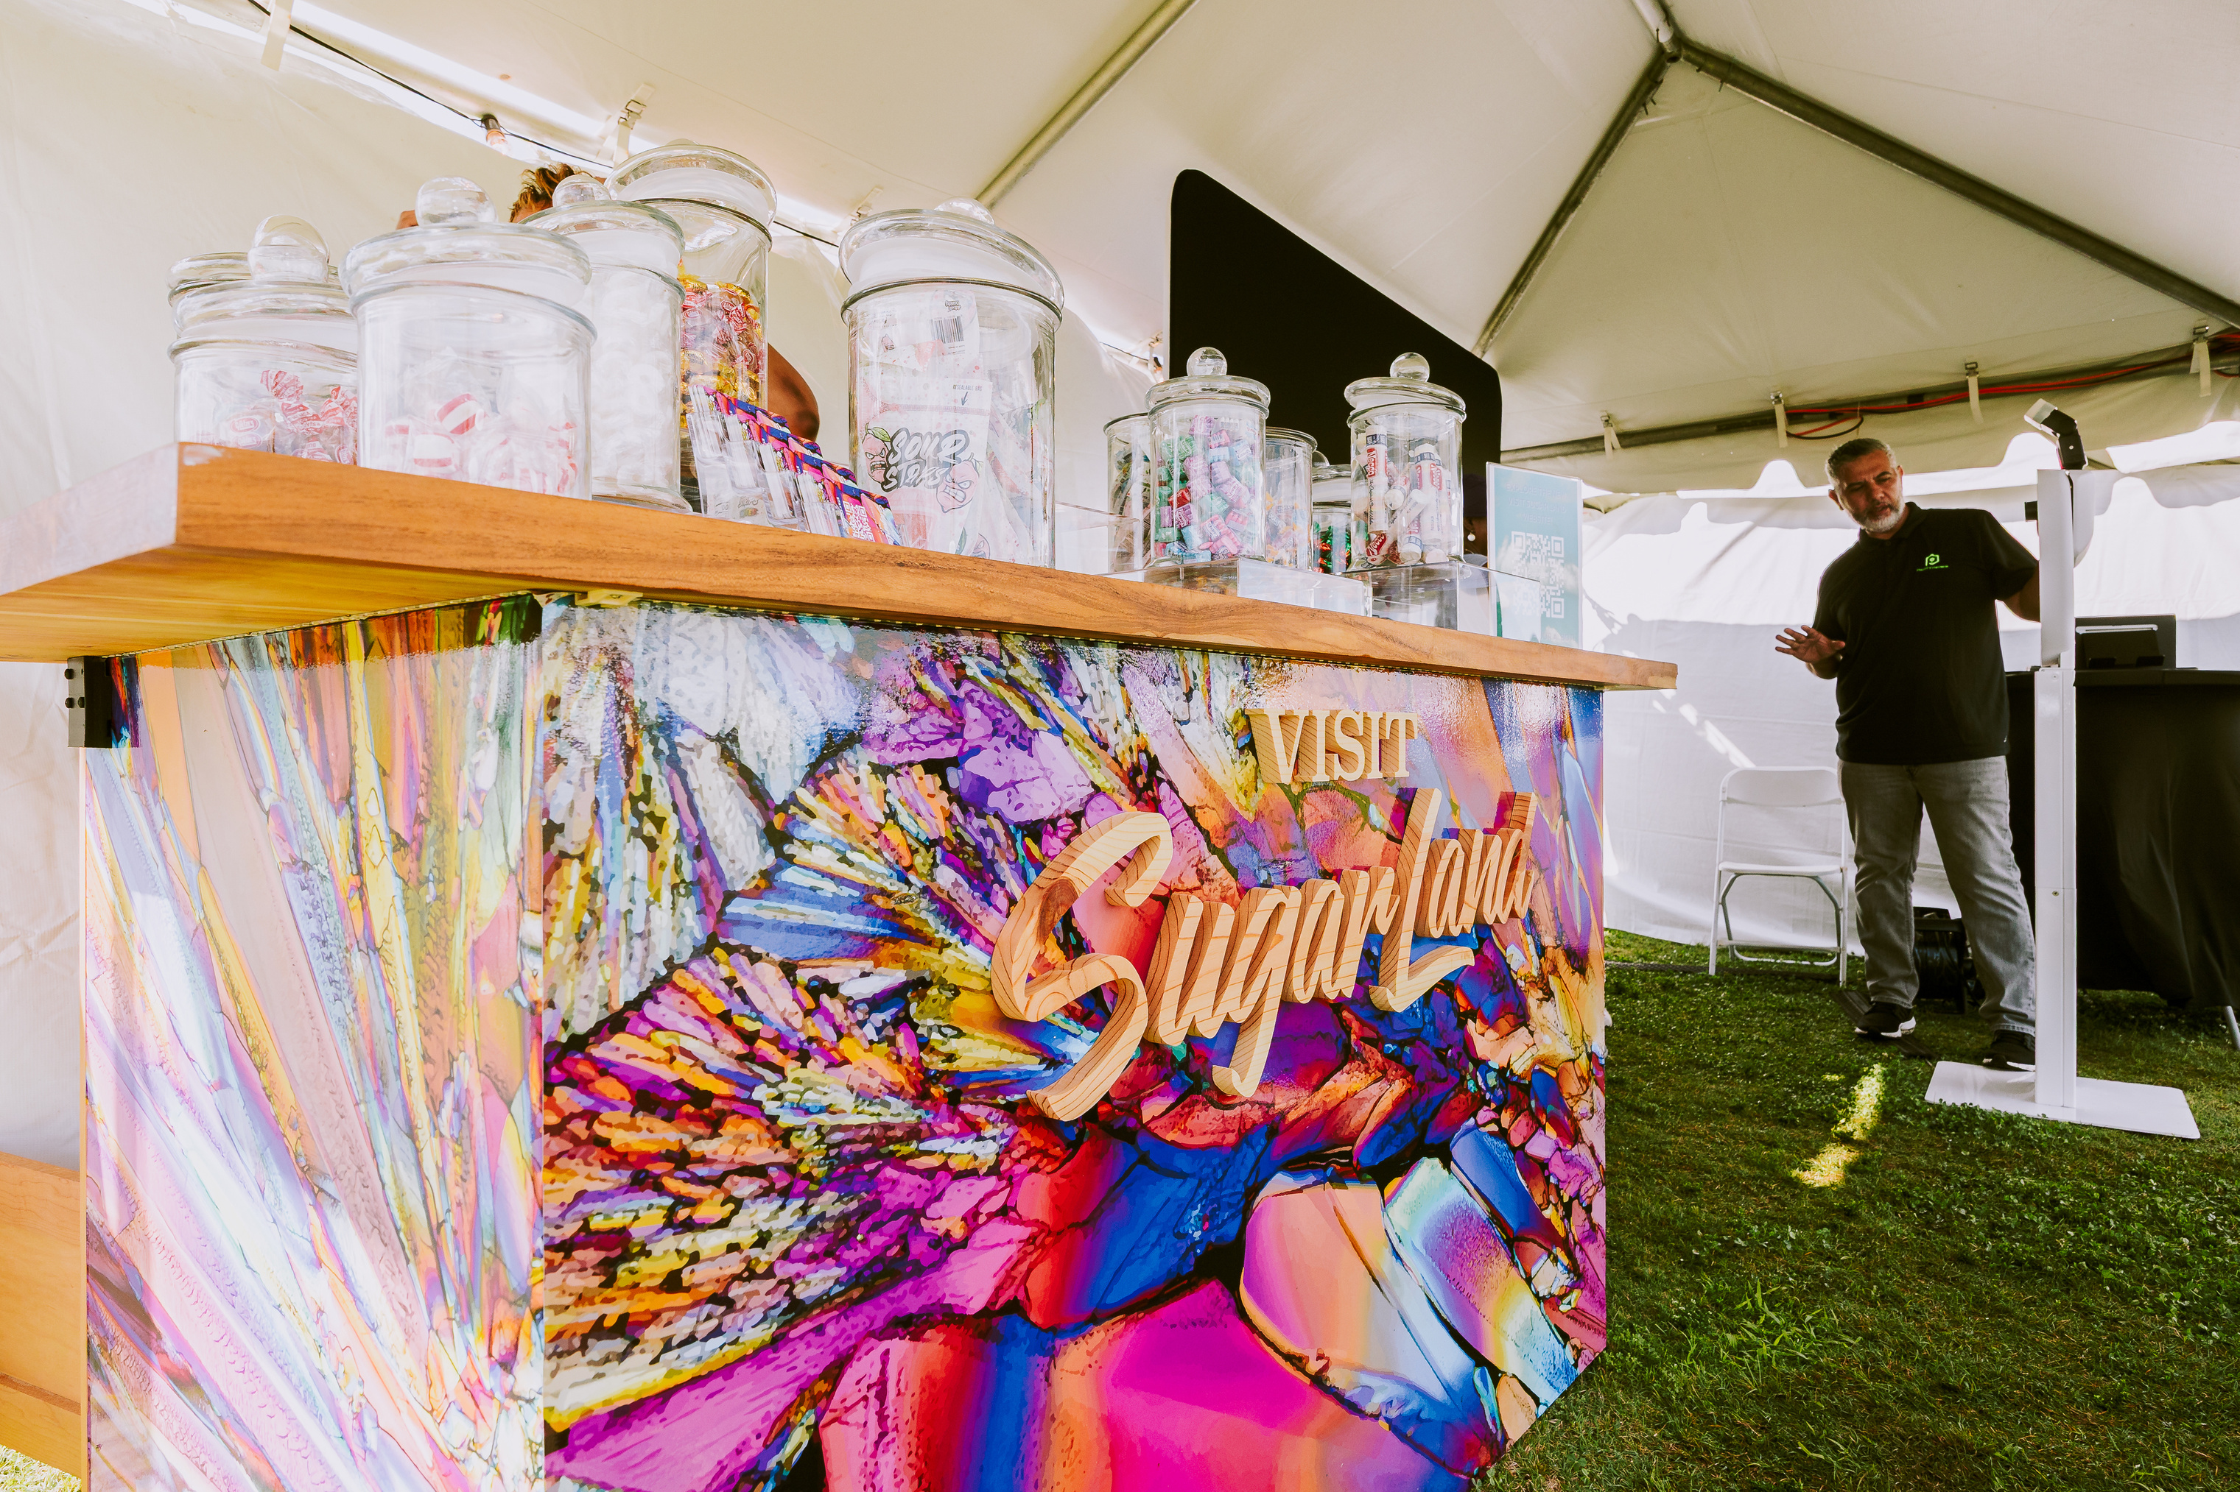

Who We Are:
Visit Sugar Land is the Official Destination Management Organization (DMO) for the City of Sugar Land
Our purpose is to attract visitors to Sugar Land, help create a positive experience once they’re here, and generate Hotel Occupancy Tax.
Notes:
We are the official Destination Management Organization- or DMO- for Sugar Land, which means we serve as the city's tourism arm.
Purpose-attract visitors to the city and help create a positive experiences once they’re here.
Goal- Generate Hotel Occupancy Tax and Sales Tax from visitors.
We then work to reinvest those funds back into our tourism economy, and continue the cycle of economic development.
HOT funding is guided by the state statute, ensuring that we align with our core mission of reinvesting back into our partners and support our tourism economy. Every dollar that we spend must fall within the statute.

Slide 10



VISIT SUGAR LAND
MARKETING
VENUES
SALES/EVENTS
The Marketing Team leads the Visit Sugar Land brand through strategic integrated Public Relations, Marketing & Advertising campaigns that boost awareness, shape perceptions and drive visitation.
Tourism in Sugar Land is anchored through key venues like Smart Financial Centre, Constellation Field, and the Houston Museum of Natural Science at Sugar Land.
The Tourism Sales team partners with meeting and events planners to attract events and group bookings, boosting hotel stays and generating HOT revenue for tourism reinvestment.
Notes:
We do that by:
Marketing Sugar Land as a great place to visit for unique experiences.
Partnering with our key venues, hotels, and businesses to attract larger audiences
Helping plan and support conferences and events that benefit our hotels and local attractions.
Overall-
Our purpose is to increase economic impact by increasing hotel stays, spending at local businesses, and showcasing Sugar Land as a destination.

Slide 11
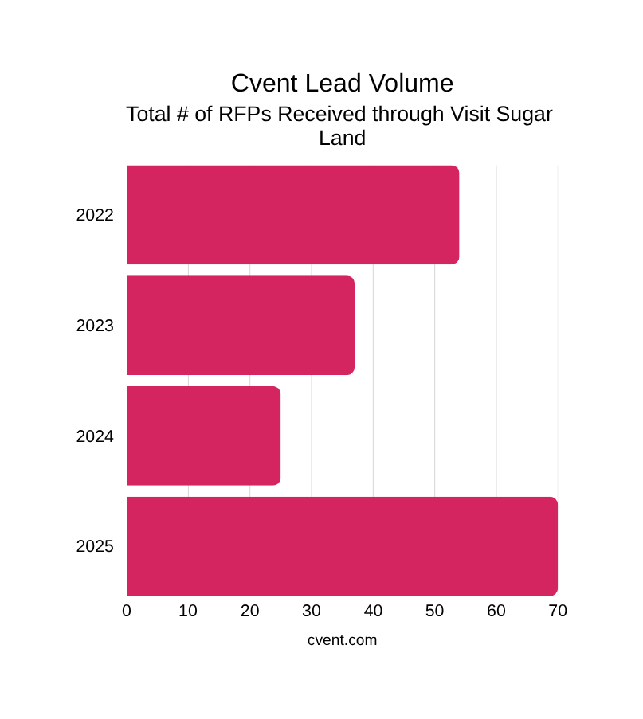
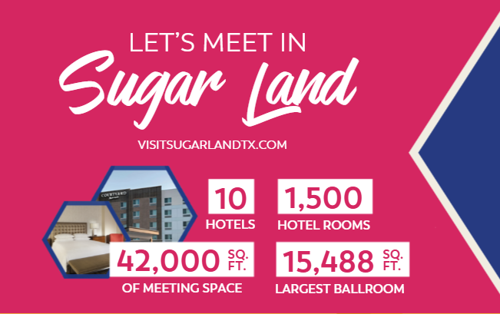

MEETINGS & CONFERENCES
$6.3M Total Conference Revenue
291 Room Blocks
24,000 Total Room Nights
$3.6M Group Revenue

Slide 12
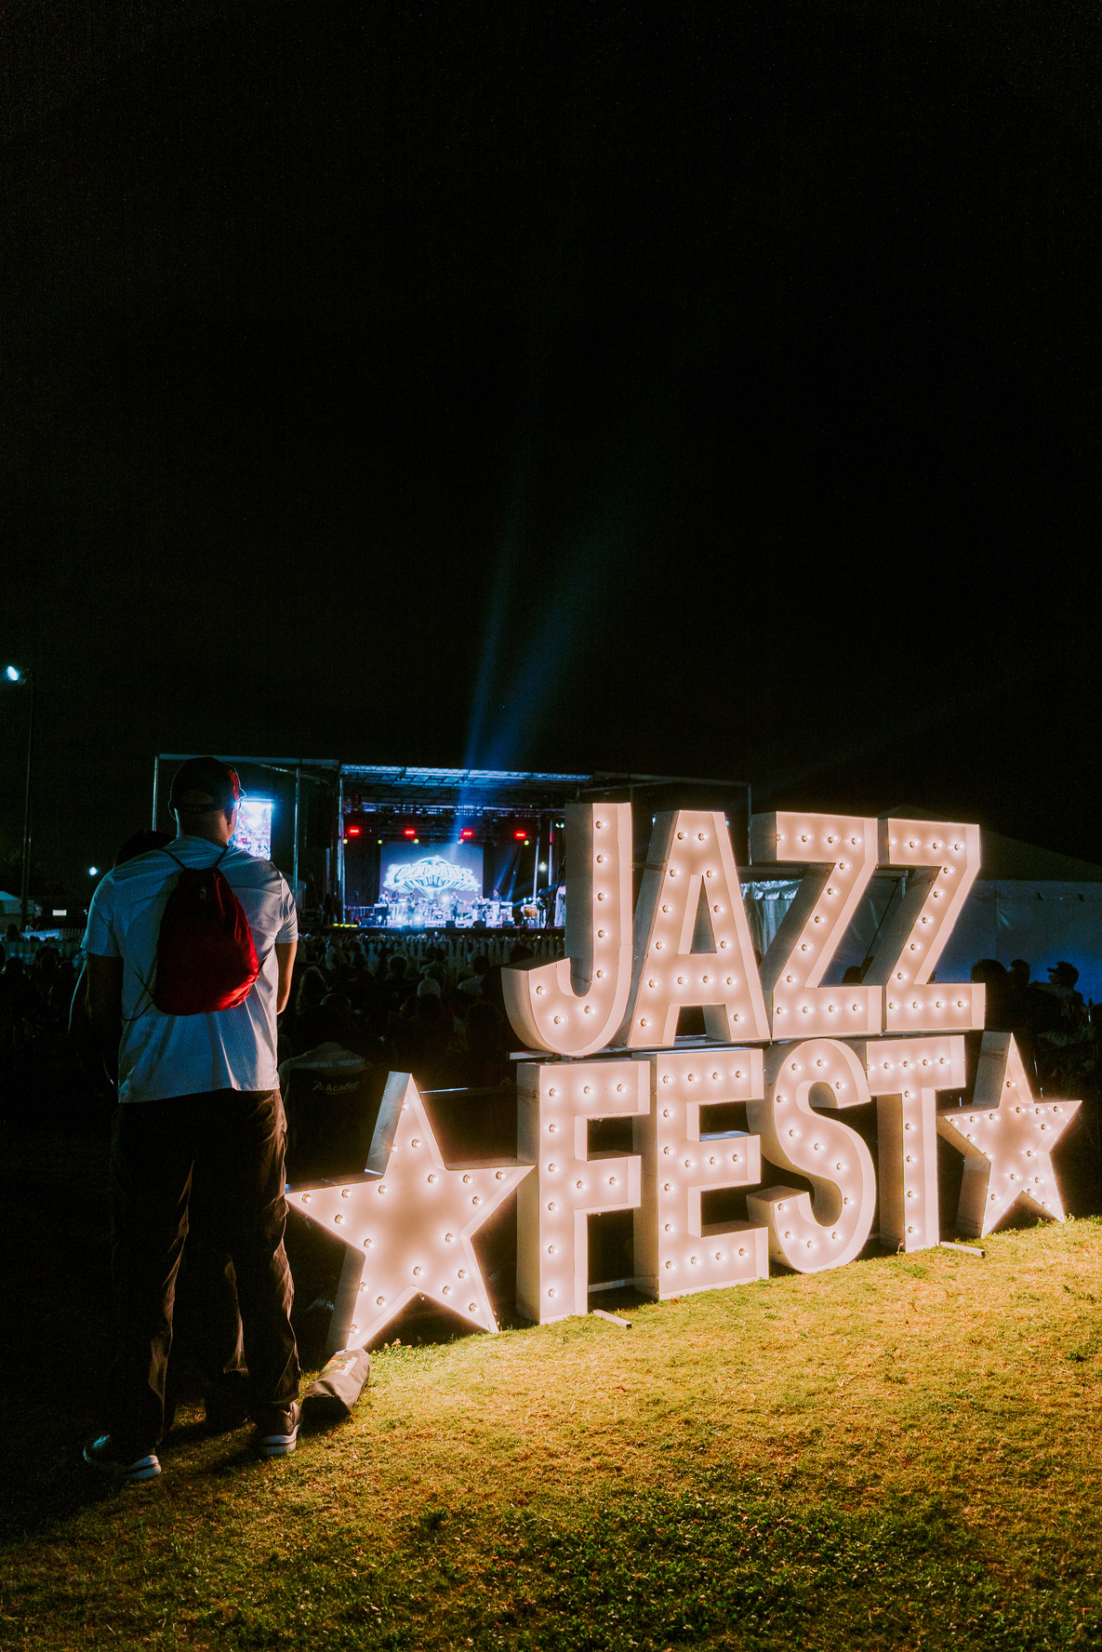
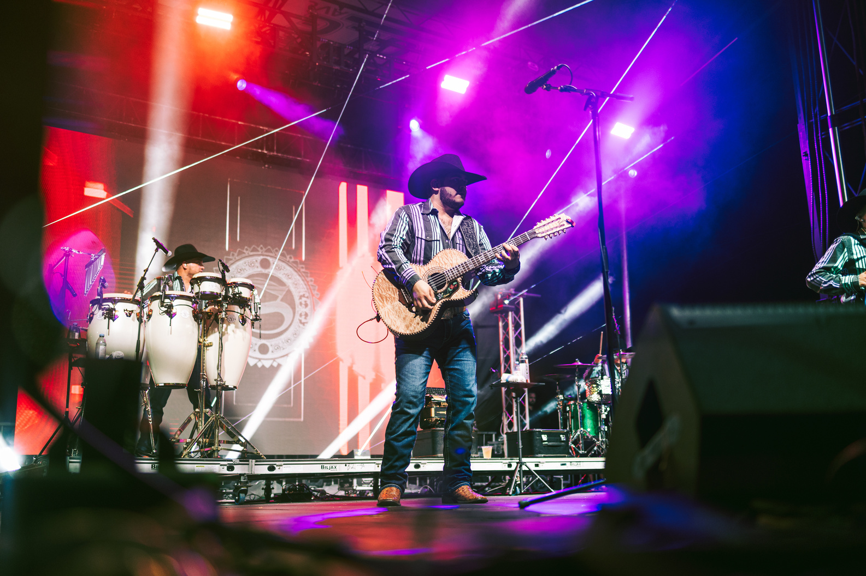
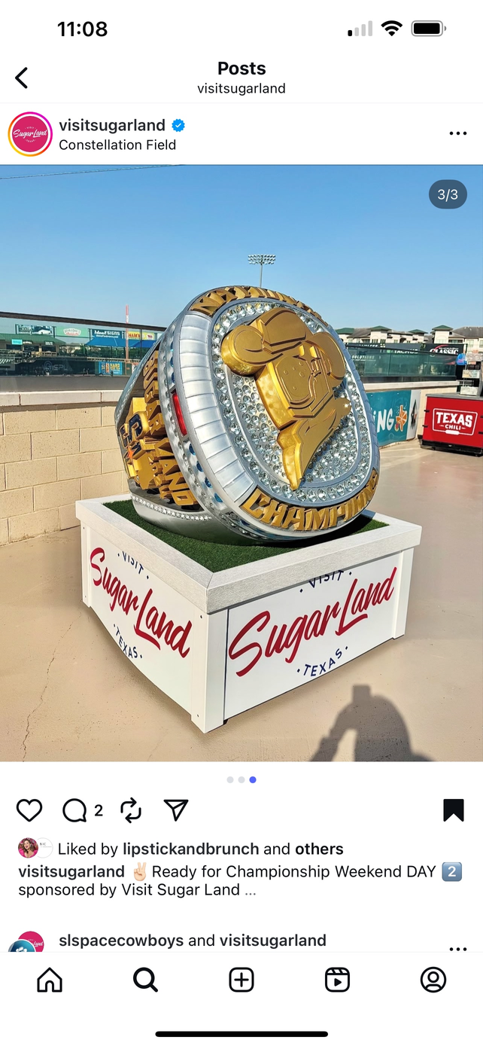
PARTNERSHIPS- EVENTS AND VENUES
  Jazz Festival and Sweet Beats at The Crown Festival Park, produced $930,000 in Economic Impact over the first 2 years (2024/2025), with over 15,000 tickets sold.
  Through sponsorships and activations, Visit Sugar Land helps our venues and events attract larger audiences and amplify their exposure.
  Key partnerships this year include Jazz Fest, Sweet Beats, Space Cowboys Championship Weekend, Cirque de Soleil, etc.

Slide 13

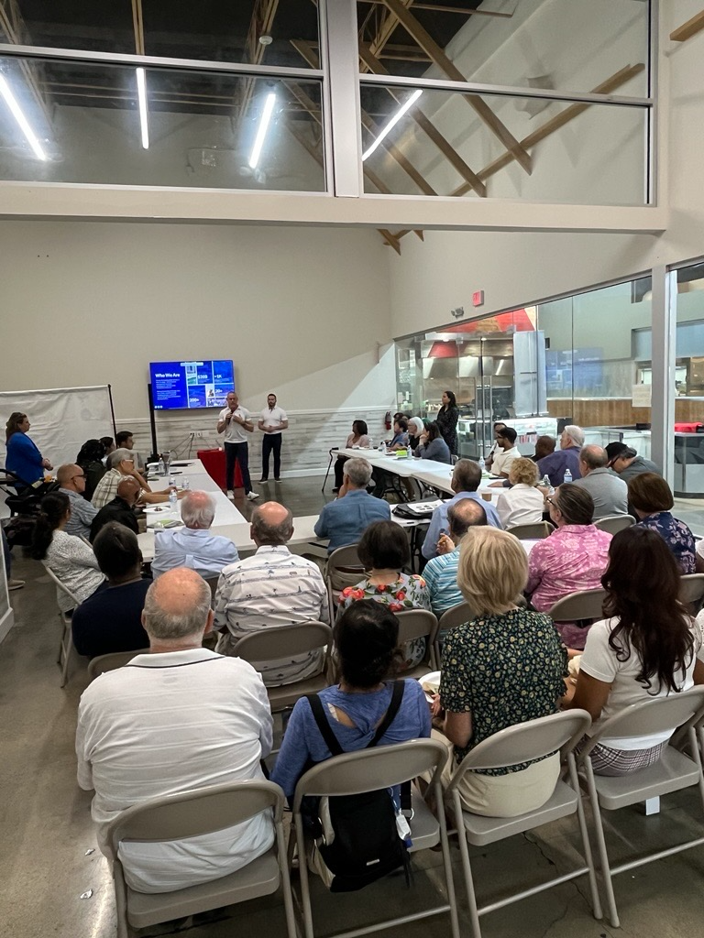
PRIORITIES AHEAD
Tourism & Sports Feasibility Study
  This is a joint project in collaboration between Tourism and Parks & Recreation. Funded fully by HOT.
  Scope: 5-Year Strategic Tourism Plan + Sports Tourism Feasibility.
  Process: Market research, benchmarking, stakeholder engagement, focus groups.
  Goals:
    Guide future planning & support the growing tourism economy in Sugar Land
    Evaluate Sugar Land’s sports tourism potential
    FY25 Project within the City’s Strategic Action Plan

Slide 14


Slide 15
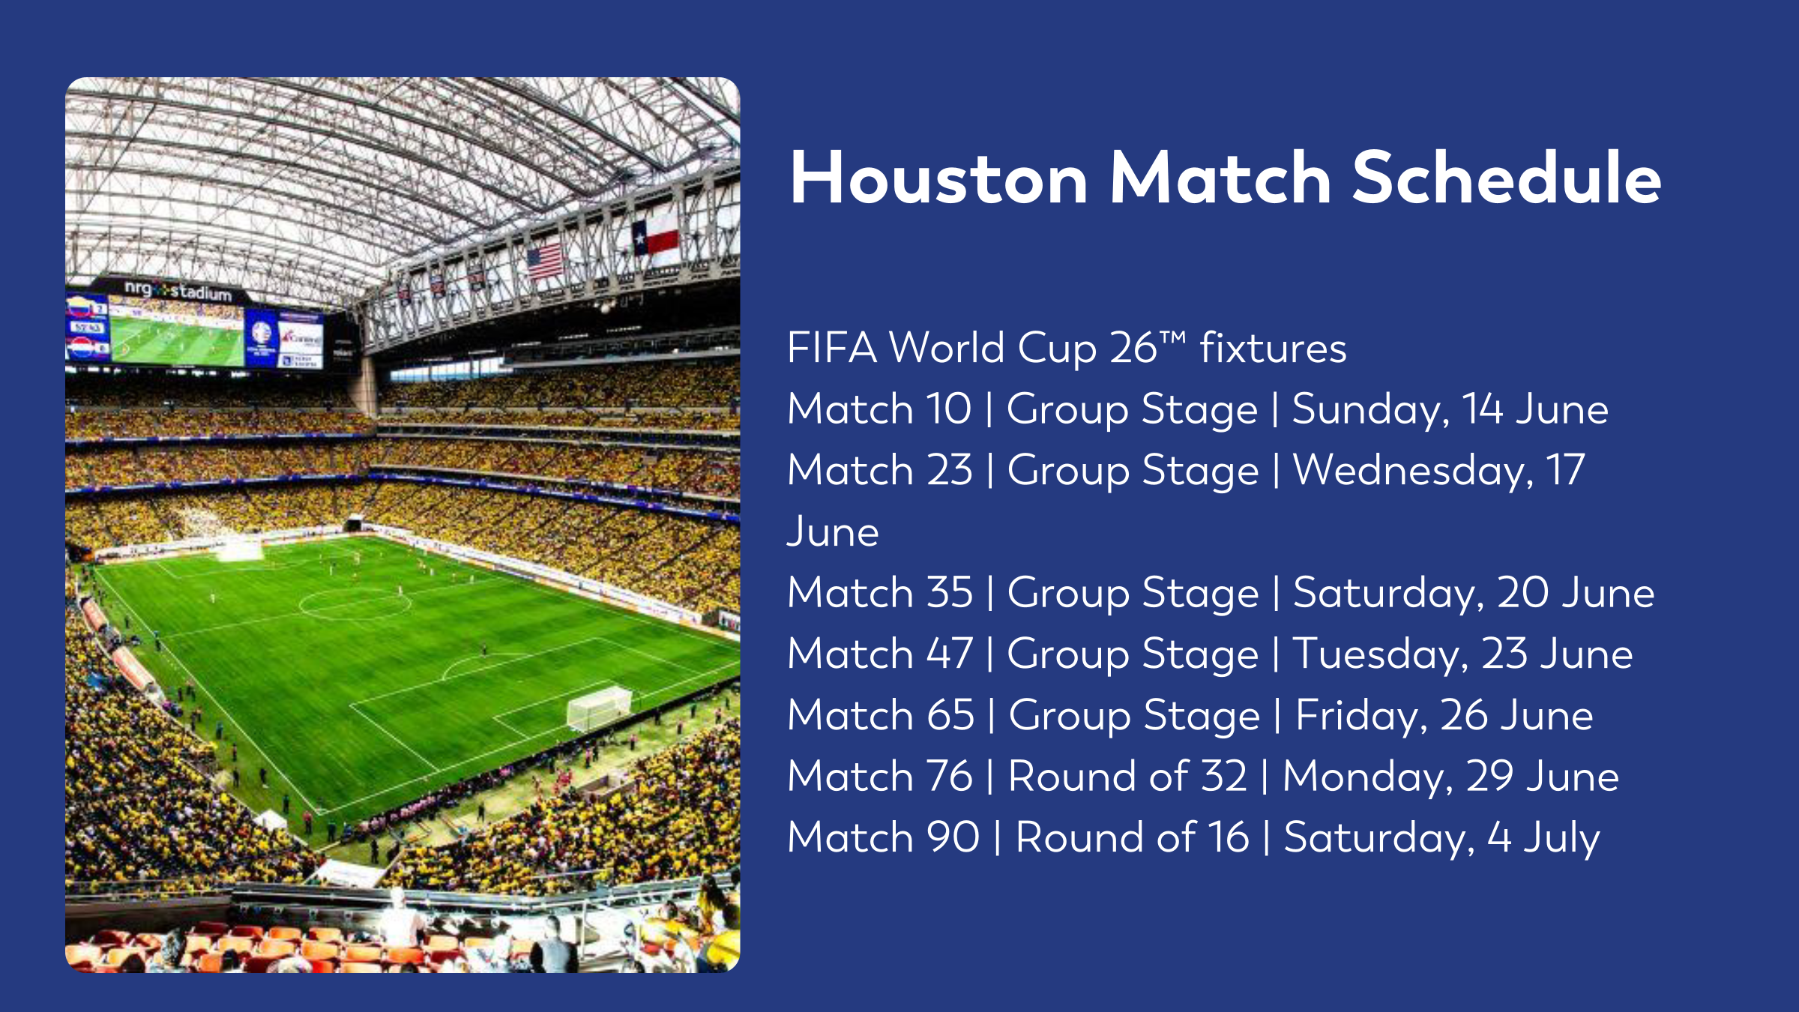
Houston Match Schedule
FIFA World Cup 26™ fixtures
Match 10 | Group Stage | Sunday, 14 June
Match 23 | Group Stage | Wednesday, 17 June
Match 35 | Group Stage | Saturday, 20 June
Match 47 | Group Stage | Tuesday, 23 June
Match 65 | Group Stage | Friday, 26 June
Match 76 | Round of 32 | Monday, 29 June
Match 90 | Round of 16 | Saturday, 4 July
Notes:
Houston- 7 matches, beginning June 14th.

Slide 16
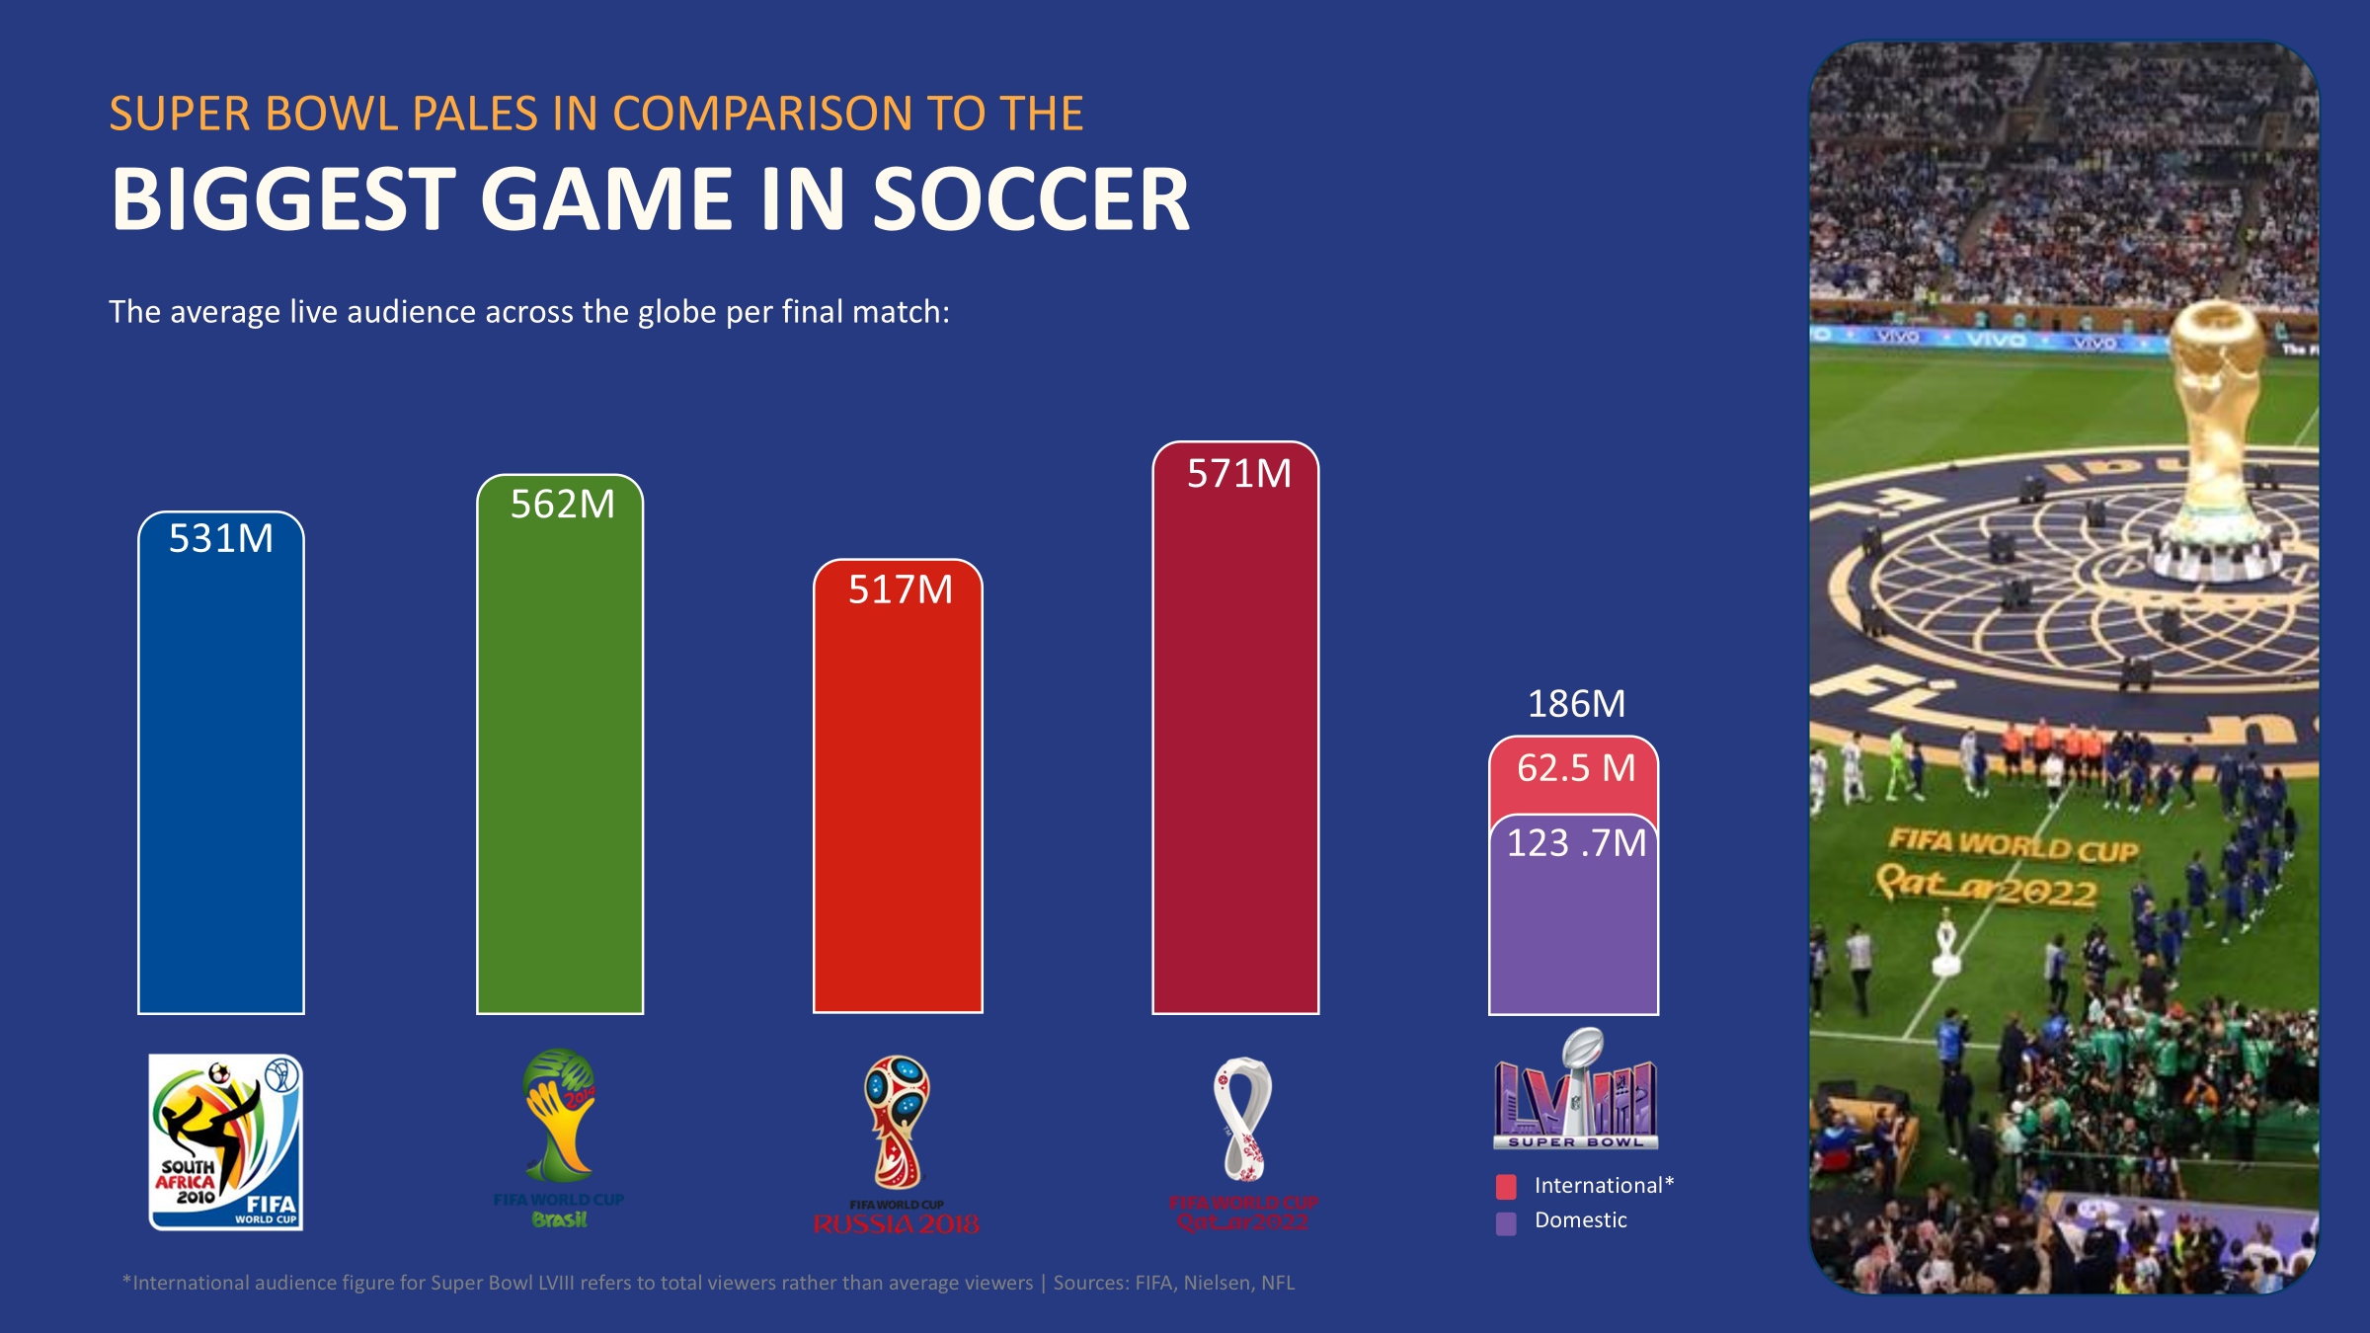

Slide 17
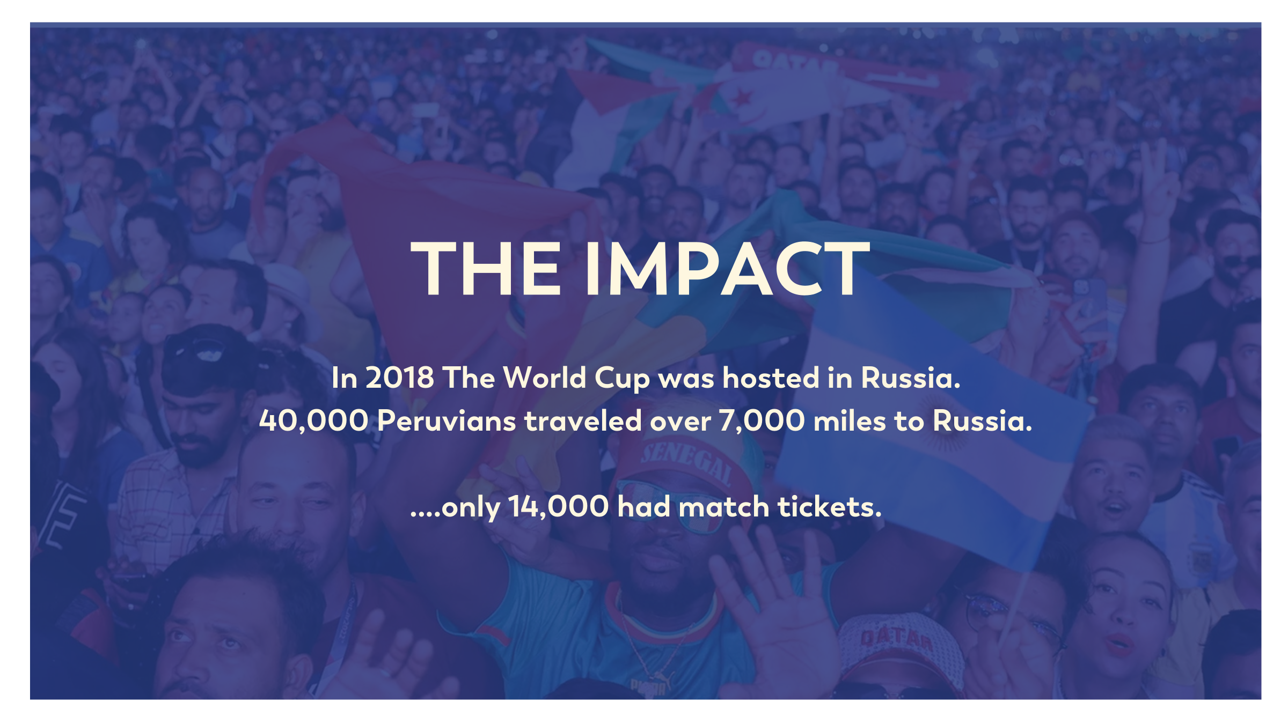

Slide 18
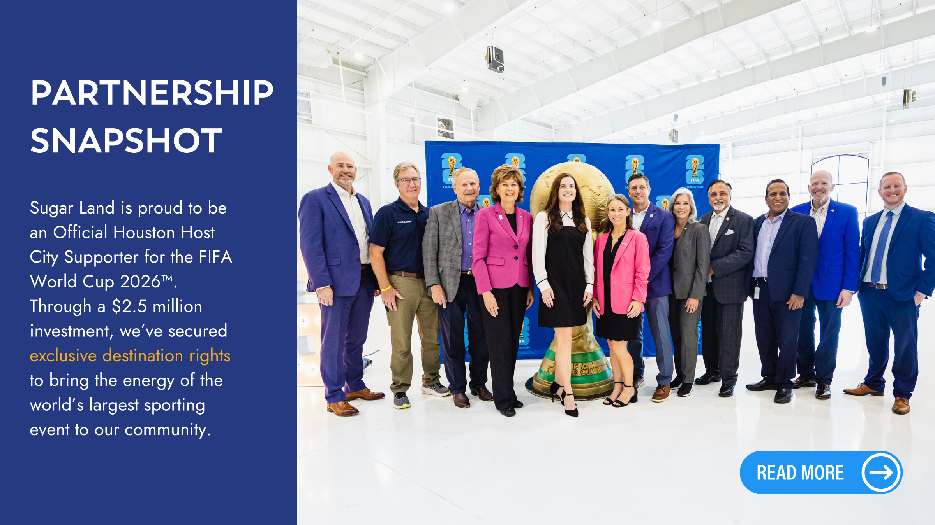

Slide 19
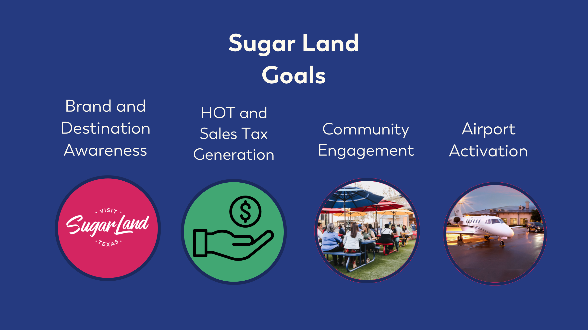

Slide 20
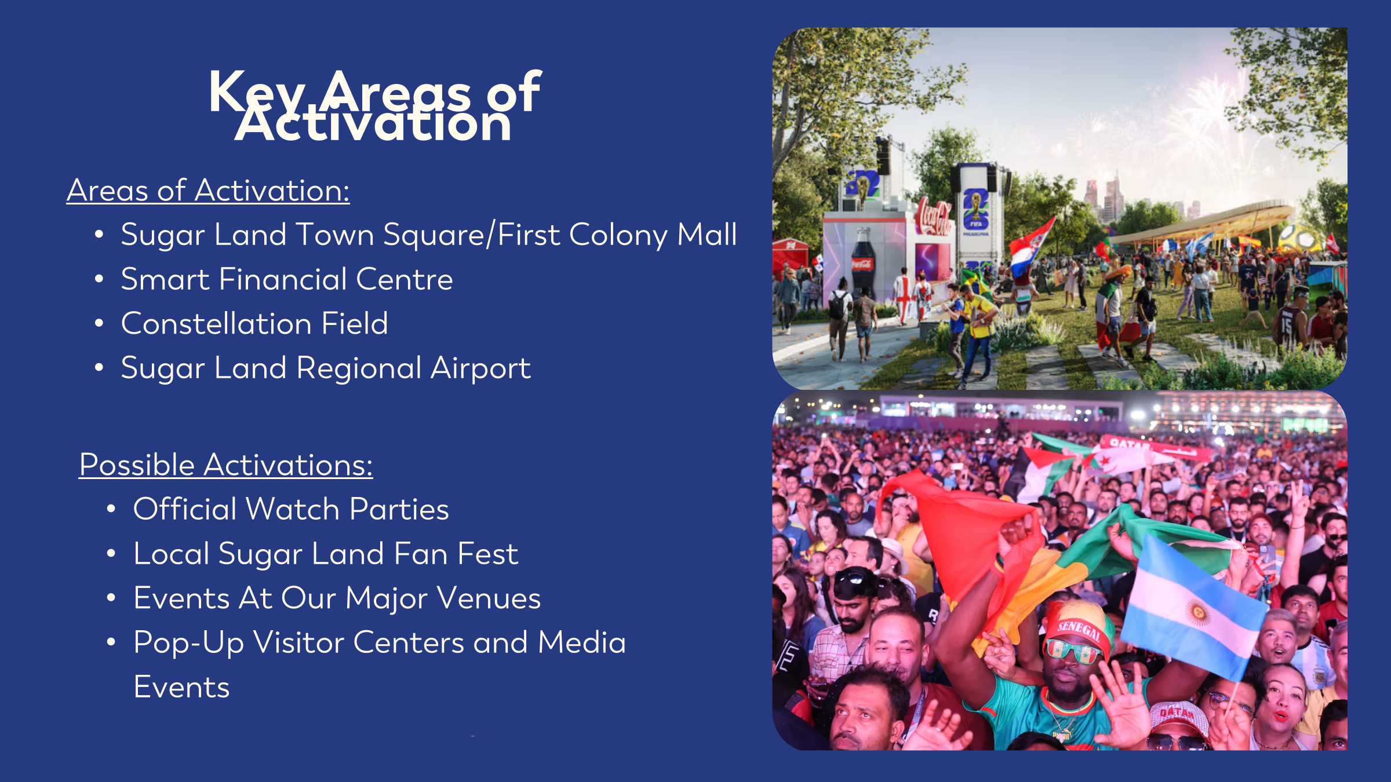

Slide 21


